Slide 1
EduBox 01: Culture, a new perspective
Author: Prof. Dr. Adelheid Iken Project: EduBoxes for Hamburg Open Online University (www.hoou.de)
CC BY-SA 4.0 „EduBoxes Logo“ Source: Hans Limo Lechner (2016)

Slide 2
INTRODUCTION TO EDUBOX 01
The socio-cultural and economic features of globalisation have a strong influence on the practices of modern organisation and thus business communication and management.
More than ever before, managers and co-workers are networking and communicating at the intersection of diverse cultures. And yet, at the same time, cultures are undergoing rapid change, catalysed by new forms and means of communication.
These rapid changes have required us to review our understanding of culture as well as the tools we use to develop a common basis of understanding. Through these new tools and ways of viewing culture, we open up the possibility of not only solving issues that may arise from cross-cultural encounters but of actively developing synergies that can emerge from such interactions.
And that is precisely the objective of this EduBox.

Slide 3
INTRODUCTION TO EDUBOX 01
Hints for its use
Speaker notes: Please note that some slides contain so-called speaker notes, which can be used to comment on the respective slide. They can be accessed by opening the Note Page. Meaning of the didactic icons:
Discussion / Reflection
Task / Home assignment
Learning Outcome / Objectives
Summary
License
Video

Slide 4
EduBox 01: Culture, a new perspective
Session 01: Culture, a critical review
Author: Prof. Dr. Adelheid Iken Project: EduBoxes for Hamburg Open Online University (www.hoou.de)

Slide 5
CULTURE, A CRITICAL REVIEW
Introduction to Session 01
Culture was and still is a concept commonly applied to social groupings that are geographically distinct from one another. A growing interconnectedness across boundaries, an increase in people’s mobility, as well as cultural mixes and adaptations make it necessary to critically review the approaches currently used, and to develop revised concepts, which are able to cater for the growing complexity of intercultural interactions.
The ability to do this is the goal of this session.

Slide 6
ICONS
Discussion / Reflection
Task / Home assignment
Learning Outcome / Objectives
Summary
License
Video

Slide 7
LEARNING OUTCOME
Students recognise cultural features from the perspective of an open definition of culture.

Slide 8
OBJECTIVES
At the end of these sessions, students will
have critically reviewed definitions of culture and their characteristics
be able to show the limitations of a national approach to culture
be able to argue why an open definition of culture based on the understanding of multi-collectivity is better able to capture the multi-faceted nature of culture in today’s world

Slide 9
CULTURE, A CRITICAL REVIEW
Topics
Learning outcome
Objectives
Lead-in
Culture, a critical review
Culture, some definitions
Components of culture
Culture, a critical reflection
Summary and reflection
Assignment
Sources

Slide 10
LEAD-IN
Look at the following pictures carefully. Do they have anything to do with culture and if so, what?

Slide 11
LEAD-IN
CC BY-SA 4.0 „New York“ Source: Adelheid Iken (2010)
Notes:
Shared understanding of symbols and conventions:
The broom indicates that the parking space must be vacated before the road sweeping machine passes by between 11 a.m. and 12.30 p.m.) Using 11 a.m. and 12.30 p.m. relates to the convention of dividing time into two periods, a.m. (Latin ante meridiem) meaning before midday and p.m. (Latin post meridiem) meaning after midday. Each period consists of 12 hrs., each numbered, a system which is rarely used outside English speaking countries.
The 12 hour clock system of showing time is often also referred to as in the morning, in the afternoon, in the evening and at night. In most countries computers by default show the time in 24-hour notations but some operating systems activate the 12-hour notation by default in specific languages and regional settings.
The pictures indicate that culture is linked to knowledge and conventions, in this case how to acknowledge time. It also refers to shared meanings, e.g. the symbol of the broom indicating cleaning periods. The broom is used as a symbol despite the fact that it is actually machines that do the job.

Slide 12
LEAD-IN
CC BY-SA 4.0 „Hamburg“ Source Adelheid Iken (2016)
Notes:
The question here relates to why we find Buddha statues in offices, gardens and many other places in Germany and whether the teachings of Buddha could now be considered part of the German culture?
According to the information of the Buddhist centre Hamburg (http://www.buddhismus-nord.de/zentren/hamburg/buddhismus.php 5.7.2017), Buddhism started with Buddha, a title meaning the one who is awake or in other words a person who has awoken to perceive his reality. Buddha was born as Siddhartha Gautama in Nepal around 2,500 years ago. He obviously had a privileged upbringing but, realising that life involves the harshness of illness, old age and death, he started to wonder and think about the meaning of life.
On his journey he became adept at meditation and took up ascetic practices. This way of life was based on the firm belief that one can free the spirit by denying the flesh. The ultimate aim of Buddhism is nirvana, the deliverance of the mind and thus supreme happiness.
The Buddhist centre in Hamburg is one of the largest centres in Germany and there are about 500 volunteers working at the centre. It seems that there is definitely a community dedicated to following Buddha’s teaching, which is part of German society and thus also part of German culture.
Buddha statues are generally perceived as symbols of peace, calmness, mindfulness and reflection. Many people who integrate the statue into their living environment want to convey these thoughts. Many if not most of them may not consider themselves to be Buddhists but feel the wish to integrate the idea of calmness and peacefulness into their daily life. This indicates that through exposure and interaction, culture is created and integrated into existing structures.
Yet others may simply buy a Buddha statue because it is fashionable, showing that symbols may change their original meaning by being taken out of their context and integrated into a new one.

Slide 13
LEAD-IN
CC BY-SA 4.0 „Baltic Sea“ Source Adelheid Iken (2010)
Notes:
In Germany, dogs are commonly perceived as pets that can be cuddled and need to be taken care of. This also means that especially in cities they live indoors and are often considered to be ‘part of the family’ and become close companions. In order to meet their needs and at the same time consider the aspect of hygiene, space has been allocated for dogs to run around freely, e.g. at the beach. Looking at the sign, those who grew up in Germany will understand its meaning, indicating that shared knowledge is one aspect of culture.
The perception of a dog as a ‘member of family’ may not be shared among all people living in Germany, for example in the countryside dogs may have tasks such as rounding up cattle or sheep and thus not be perceived as a pet. Also, there may also be some people who consider that dogs are unclean, should not be touched and should not become a member of a family. Nonetheless most people who have grown up in Germany will understand the signpost and thus share the knowledge linked to the signpost.

Slide 14
LEAD-IN
CC BY-SA 4.0 „Paris“ Source: Adelheid Iken (2009)
Notes:
Many societies use signs for protection and good luck and some of the signs, such as the hamsa (meaning five) are believed to provide defence against the evil eye in the Middle East and North Africa. The evil eye is a malicious stare believed to cause illness, death or bad luck. In addition to its protective character it also represents blessings, power and strength. In Algeria, the hamsa is a national symbol and appears in its emblem. The hamsa used to be in widespread use as a talisman by Jews from Islamic countries but for a considerable time was looked down upon in the Eurocentric cultural milieu. More recently it has started to regain popularity and nowadays it is even described as an icon of Israeliness and secularity.
This picture was taken in Paris, showing that symbols and signs also travel and migrate, and at times are incorporated into an existing culture. Sometimes they change meanings along the way.
Symbols are part of the visible part of culture and if we are not familiar with them we need to enquire about their meaning. Many societies share commonalities such as the desire to use symbols and emblems for protection.

Slide 15
LEAD-IN
CC BY-SA 4.0 „Israel“ Source: Janet Pawelcyk (2014)
Notes:
This picture was taken in Israel showing that the same symbol is used in different countries either for a similar or the same purpose. In India the ‘bindi’, a dot on the forehead is seen as an extra ‘eye’ which takes on the role of protection. People may think that their culture, or part of it, is unique, but there are many commonalities that can be observed across cultures such as the notion of protection using the eye as a symbol for it.

Slide 16
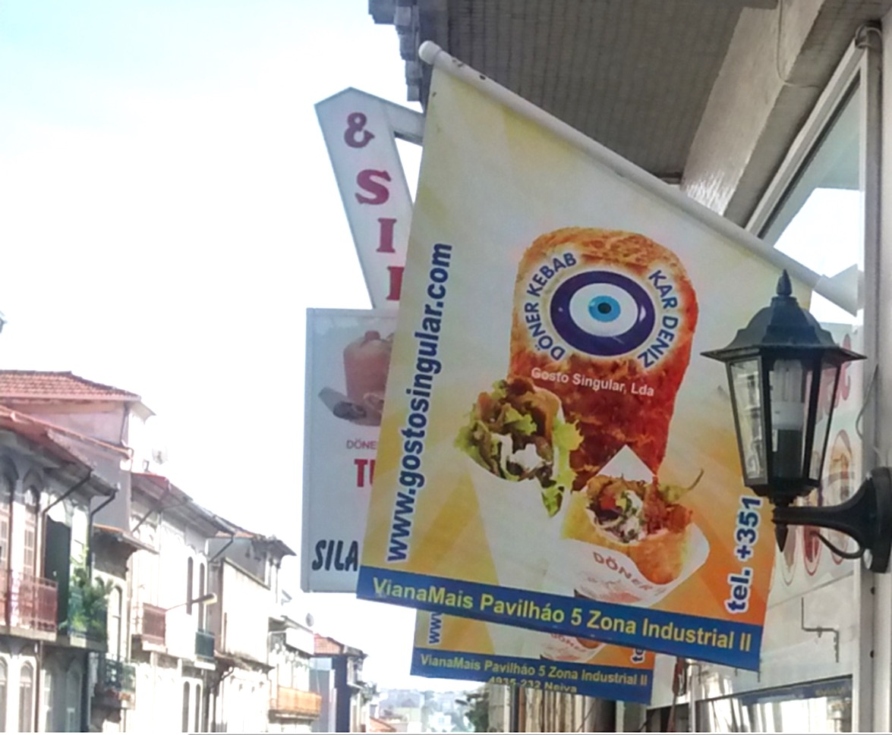
LEAD-IN
CC BY-SA 4.0 „Porto – Kebab shop“ Source: Adelheid Iken (2015)
Notes:
Another eye shaped amulet is the nazar which appears to have its origin in Turkey and is also believed to protect against the evil eye, whereby the word nazar is derived from the Arabic meaning ‘seeing‘ or ‘sight‘. This picture was taken in Portugal, indicating that people bring their culture with them and integrate it into the new environment.

Slide 17
LEAD-IN
CC BY-SA 4.0 „Ponte de Lima, Portugal“ Source: Adelheid Iken (2015)
Notes:
The idea and thought of an ‘extra eye’ can be found in many countries and it is also not uncommon to the Catholic Church as this picture shows. However, the ‘eye’ in this case is often interpreted as symbolising God who is watching you and your behaviour. This shows that at times you may see same or very similar symbols but their meaning may differ.
.

Slide 18
CULTURE, A CRITICAL REVIEW
Culture, some definitions
Read the definitions on the worksheet “Definitions of culture” and identify what they have in common and where they differ

Slide 19
CULTURE, A CRITICAL REVIEW
Culture, some definitions
E. B. Tylor | W. H. Goodenough | Peoples & Bailey | Bedeutung, deutsch
knowledge | knowledge | knowledge | Wissen
members of society | members | group of people | Gemeinschaft von Menschen
- | acceptable to | shared | Übereinstimmung
acquired | learning | socially learned | erlernt
belief | believe | - | Überzeugungen/ Anschauungen
habits, custom | operate | patterns of behavior | Verhalten

Slide 20
CULTURE, A CRITICAL REVIEW
Components of culture
Definitions of culture
Culture relates to groups of people
Culture refers to knowledge and behaviour
Culture is learned and thus passed on
Culture is shared
Notes:
What the definitions have in common is that culture obviously relates to a group of people, whereby the size of the group remains open and thus poses the question of whether we are referring to a culture in terms of a nation, a profession, a group of friends or other collectives.
Obviously when we talk about culture, we are referring to knowledge and behaviour which is learned and passed on to others. For example, a student starting an internship in another country will have to learn how things are done in his or her new environment and will have to adjust his or her behavioural patterns. This may include learning new words or even a new language, a different way of filing and writing reports, adapting to unfamiliar ways of greeting each other and so on. What exactly has to be learned very much depends on the knowledge and behavioural patterns one already possesses and to what extent one is prepared to negotiate with regard to behavioural patters and cultural meanings.
If we understand that passing something on to others can never be done on a 1:1 basis, then this aspect of culture indirectly acknowledges that culture is subject to change and therefore dynamic. This is an aspect that requires more attention. Another element, not specifically mentioned by Tylor, refers to the understanding of culture as something which is shared or accepted by its members.
On the following slides we will critically elaborate on the different aspects of culture in order to refine our understanding of culture.

Slide 21
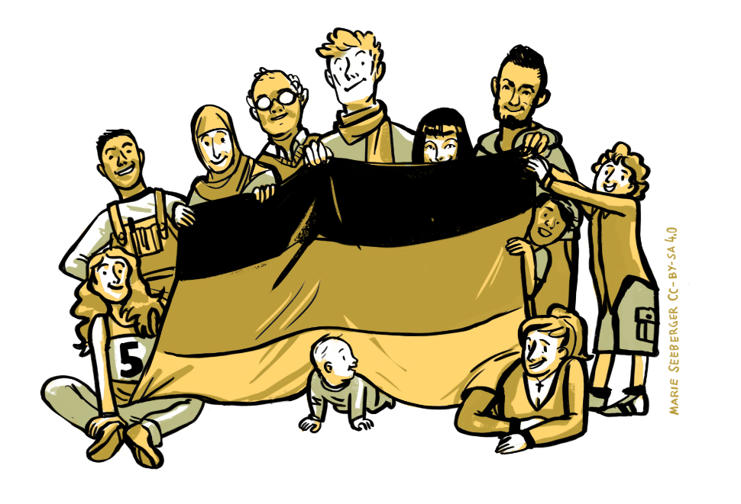
CULTURE, A CRITICAL REVIEW
Components of culture
Culture relates to groups of people
CC BY-SA 4.0 Source: Marie Seeberger (2016)
Notes:
This statement simply accepts that culture is an attribute of human groups and thus shared by some kind of collectiveness. It does not specify the size of the group. Societies or nations are often considered to share a culture, which is then referred to as the ‘German’ or ‘British’ culture. And at the same time there are smaller entities such as sports clubs and organisations in which their members are equally considered to share a certain culture. Generally speaking it can be said that culture can be viewed from different perspectives as the following chart indicates, a geographical, a professional, personal or localised perspective.
Generally speaking it is important to keep in mind that considering culture on a societal or national level always means generalising and ignoring that many societies exhibit internal socio-cultural differences.

Slide 22
CULTURE, A CRITICAL REVIEW
Components of culture
Matrix for the identification and structuring of collectives
and sub-collectives
Geographical/Regional/ Areal culture | Professional culture | Personal culture | Localised culture/Culture of the social environment
Supranational culture (e.g. Western Europe) | Business- / Professional culture (e.g. IT-industry, medical staff, specialists) | Family culture (e.g. migration and family history) | Group membership (e.g. Sports club, choir)
National Culture (e.g. Germany, Great Britain) | Corporate/ organisational culture (e.g. BMW, ) | Individual cultural orientation (e.g. based on personal biography, age) | Life worlds and lifestyles (e.g. modern, traditional)
Sub-national Culture (e.g. Hamburg, Lower Saxony) | Sub-organisational culture (e.g. Administration, Marketing) |  | Socio-cultural milieus
Local Culture (e.g. Countryside around Hamburg) |  |  | Facebook community
Neighborhood culture (e.g. village community, neighborhood)
Notes:
We can look at culture or the notion of belongingness from different perspectives, for example from a geographical, a professional, an individual and a social perspective and consider what we share. When we think of ourselves as a member of a supranational culture such as Western Europe, it is a lot more difficult to identify what we share than if we consider ourselves to be a member of a professional group such as IT specialists or as a member of a sports club. The groups we belong to are thus different in size and complexity. If we argue that culture is something specific to groups, the question arises of whether culture is unique and homogeneous within these groups, for example, a geographic entity.

Slide 23
CULTURE, A CRITICAL REVIEW
Components of culture
Cultural homogeneity and uniqueness within entities
Hofstede’s approach and value orientations
Individualism
High power distance
Low power distance
...
CC BY-SA 4.0 Source: Marie Seeberger (2016)
Notes:
Geert Hofstede is an academic who analyses cultures by viewing them predominantly as national entities. His research results have, for more than 20 years, guided the study of intercultural encounters, in particular in the business context. Hofstede, a Dutch anthropologist, supports an approach which considers cultures as relatively well defined, territorially unique and homogeneous entities. His assumption is that since people are socialised in the same environment, they grow up in the same historical milieu and therefore learn to share a common set of values.
His primary data were extracted from an employee attitude survey undertaken in the 1970s within IBM subsidiaries in more than 60 countries. He based his cultural dimensions on the analysis of these survey responses and concluded that there are basically four largely independent bi-polar dimensions of culture. He later added two other dimensions (long vs. short term and indulgence). He applied these value orientations (e.g. Individualism vs. Collectivism) to countries and was thus able to develop country profiles and measure the degree of orientation for any particular country.
The advantage of such an approach is that it provides a straightforward method of classification and comparison. It enables us to see broad and large-scale differences between national cultures. However, such thumbnail sketches often lead to generalisations and incorrect assumptions. For example, according to Hofstede, the USA is a ‘masculine’ country, the assumption being that it is a country characterised by aggression. This conclusion is obviously incorrect and empirically untrue in many areas of life and thus shows the danger of such broad-brush approaches.
Hofstede’s dimensions assume implicitly a relative homogeneity, stability and coherence of cultures which needs to be questioned. It thus neglects intra-national variations. Another point of criticism is that the idea of cultural entities with fixed boundaries between nations focuses on differences and communicational barriers. It does not offer a path towards developing and exploring common ground and possible ways to forge connections across cultures through negotiation, exchange and an encountering of the other.
Apart from criticism concerning the generalisations which are encouraged by Hofstede’s survey results, another critical issue relates to the sample size for each country (e.g. in 15 countries the numbers were less than 200) and thus the representative nature of the results. Additionally, the study was carried out in the 1970s, and therefore does not acknowledge the changes which have taken place since then. For example, it hypothesised that the major political upheavals of the 1990s, with the breakdown of the former Soviet Union and the reunification of the two Germanys, must have left a mark on the cultural environment. Other critical claims refer to the fact that Hofstede used the results of surveys from a single organisational culture, that of IBM, indicating that there was already an occupational match of participants, leading to questions of whether and to what extent such a match is not already a basis of shared organisational culture?
Furthermore, it should be acknowledged that Hofstede’s depiction of a national culture does not apply to the individual level or organisational level. Some studies (e.g. Gerhard and Fang 2005; Oysernam et al. 2002) show, for example, that only a very small part of differences in individual values can be linked to national differences. However, in teaching and research, the national culture dimensions' characteristics, scales and scores are often used to draw conclusions about individuals, which is often an incorrect assumption. The reason why Hofstede’s national dimensions have nonetheless so often been applied to individuals in teaching and research is also related to the fact that, as Brewer and Venaik (2013) discuss, Hofstede’s books are themselves full of projections of his national dimensions onto managers and organisations. They quote as an example from Hofstede’s (2001, p.178) work saying: Hofstede claims that, ‘…in a society with a strong uncertainty avoiding norm scholars fear the risk of exposing their truths to experiments with unpredictable outcomes.’
In conclusion it can be argued that criticisms of Hofstede’s approach are well founded and his findings can only be applied on a very general level providing a first impression of a national culture. This also warns us that when using his findings, we need to acknowledge and emphasize that his results cannot be applied on an individual level. Considering the growing diversity within national boundaries and increasing global interconnectedness and exchange, it is not only becoming increasingly important to consider inter-national heterogeneity, but also to review and refine our approaches to cultural analyses.

Slide 24
CULTURE, A CRITICAL REVIEW
Components of culture
Can cultures be considered homogeneous within entities such as a nation or organisation?
Think about countries such as Switzerland, Canada, Mongolia. Would you consider them to be homogeneous entities with regard to ethnic, religious and linguistic aspects?
Think about companies such as Siemens or the Otto group, would you perceive them as having a homogeneous culture?
Notes:
There are many examples that we can use to argue that cultures, especially national cultures, should not be perceived as homogeneous.
Japan for example is an island state that went through a period of self-imposed isolation, has a very small foreign population and whose inhabitants share a common language, all reasons why it is often perceived as homogeneous. This is also because it has very unique cultural tradition. However, the fact that there are a number of different religions and worldviews in Japan that exist side by side challenges the view of a homogeneous culture as well as the social stratification.
There are also many countries that are deeply multicultural, such as India with its many different ethnic, religious and linguistic groups. Apart from it being home to two major language families, Hindi was chosen as the official language of the government and English as a ‘subsidiary official language’ which is widely used in business and administration. In addition, each state has one or more official languages, providing an indication of its language diversity. In terms of religion, Hinduism, Islam, Christianity and Sikhism are some of the acknowledged religions in the country to give one more example why national cultures cannot be perceived as homogeneous.
Another reason is that colonization and decolonization have resulted in borders that are straight lines on a map with little respect for linguistic and cultural realities, for example in many parts of Africa, making the notion of a ‘national culture’ meaningless.
With regard to companies it is equally difficult to consider them as homogeneous entities. Organisations such as Siemens, for example, are complex systems with many different departments e.g. Finance and Human Resources. Due to the specific roles and tasks to be carried out in these departments, they develop individual and appropriate rules and behaviour patterns, an indication that departments can be seen as sub-cultures. In addition, Siemens is a company operating in more than 200 countries and regions. Therefore local cultures are bound to have an influence on their operations. This does not mean that the company as such does not share common goals and values.

Slide 25
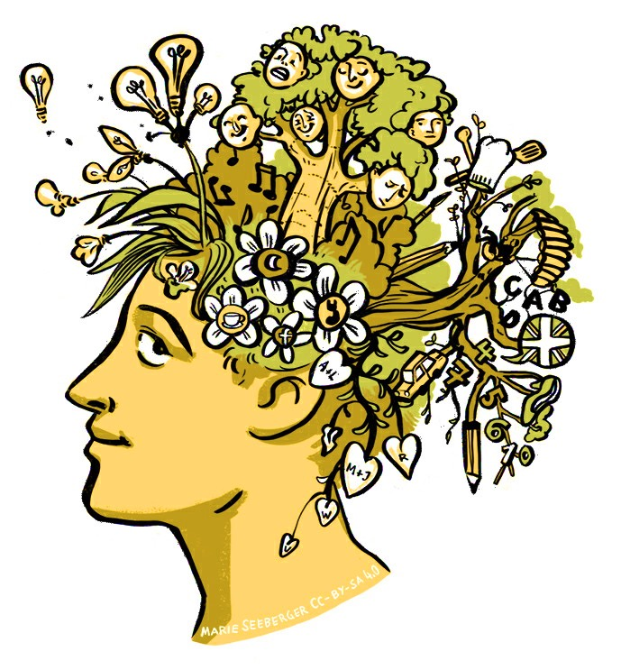
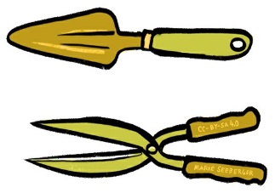
CULTURE, A CRITICAL REVIEW
Components of culture
Culture refers to knowledge and behaviour
CC BY-SA 4.0 Source: Marie Seeberger (2016)
Notes:
Culture can be perceived as acquired knowledge that people use to make sense of the world around them, to interpret experiences and generate social behaviour. The knowledge of one cultural group can be distinct from the knowledge of other groups and this enables group members to behave in a way that is meaningful to them and acceptable to the others. This means we can think of culture as a cognitive map or a frame of reference, or guidelines as to how we ought to behave. Such cognitive maps help us to assess what we consider to be right or wrong and we use these maps as an orientation. This does not mean that they necessarily compel us to follow a particular course. It also does not mean that such maps cater for all circumstances, but they do contain some principles and an orientation regarding how to respond to and interpret certain situations. Whereas knowledge is something that people carry in their minds, behaviour is directly observable. And it is knowledge and information that underlie behaviour. By referring to the fact that culture consists of the shared information in people’s minds and their behaviour, we acknowledge that it includes mental as well as behavioural phenomena.
Our maps or frames of reference should also not be considered unchangeable. New boundaries may be set and changes in behavioural patterns may need to be made and accepted by the group. For example, when people start working in a company, they often receive a booklet with guidelines concerning expected behaviour. These guidelines may be linked to communication (e.g. that emails should be answered within three working days) or how to deal with gifts (e.g. personal gifts worth more than 5 Euros cannot be accepted). Although people entering an organisation will try to understand and follow these guidelines, as members of the organisation they may also become mapmakers. This means that these maps are subject to change and are in a state of flux, i.e. they are dynamic.

Slide 26
CULTURE, A CRITICAL REVIEW
Components of culture
Culture is learned and passed on
Read the case of socialisation at Disneyland (WS) and answer the following questions:
How did Disneyland socialise newcomers?
Why do you think the socialisation process at work in Disneyland was so effective?
What lessons can other organisations learn from Disneyland’s methods?
Notes:
Very closely linked to the idea that culture can be referred to as a map of orientation is the understanding that culture is learned and passed on. In other words, people are socialised into groups such as a family, an organisation, a sports club or a university. To say that culture is learned is simply to negate that culture is something we are born with. Also, it refers to the fact that we are able to learn through communicating and imitating the actions of others. In addition, It means that the knowledge and behaviour acquired by past generations is made available to future generations. Of course, some of it may get lost or changed, but it is potentially available and can be tapped into.
Learning culture is also referred to as socialisation. This process starts with childhood and continues throughout our lives. Socialisation in companies usually takes place in a formal but also informal way. The formal way may involve an initial introduction and instruction regarding ‘the way we do things around here’, whereas the informal way refers to the process of observing behavioural patterns or asking questions. From a critical perspective, it should be noted that it is not possible to pass on culture piece by piece as different people understand things differently and have their own personal way of interpreting. Culture is subject to change for this reason, but also because the environment changes, making adaptations necessary.

Slide 27
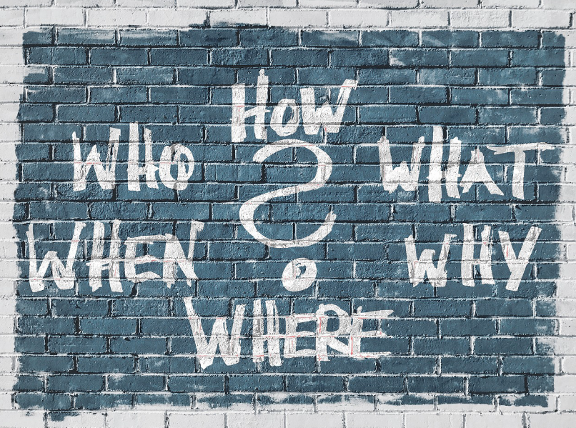
CULTURE, A CRITICAL REVIEW
Components of culture
Culture is shared
CC0 Source: pixabay
Notes:
By definition, culture is shared and therefore collective. This statement is rather vague, however, because it neither specifies the group, nor what is shared. However, what we usually mean by sharing is that the group and its members are capable of communicating and interacting without serious misunderstandings and without the need to explain what their behaviour means.
If culture is considered to be shared, the question arises: How much do members of a group have to share in order to be acknowledged as members of the group?
Most scholars agree that culture is a group level construct and that group members share a set of values and behavioural patterns and thus a culture. If this is so, how much then do members of a culture actually have to share in order to be considered members of the group? One aspect to be considered may be the question of relevance. The more central values of a culture could be the ones that are most relevant to the effective functioning of the group and might thus be supported by normative practices. Another aspect to be considered in this context is the tightness or looseness of a culture. This differentiation refers to the strength of social norms and the degree to which sanctions might be used when a member deviates from the social norms of the group. Whereas in a loose context members are likely to experience more tolerance for variations in individual beliefs and behaviours, in a tightly regulated culture members are likely to experience sanctions for minor deviations from the norm and expected behaviour. In such cultures, people usually have clear ideas about what is expected of them and what is considered to be appropriate behaviour. This also means that different groups may share the same set of values, but that they might nonetheless exhibit a different degree of tolerated behavioural variance.
Authors such as Martin J. (1992) and Meyerson D. (1991) argue that culture can also be defined as an incomplete shared system. They maintain that if group members share a common orientation, have comparable experiences and face similar problems, such a group can, for example, accommodate the different beliefs of its members, but still be considered a culture. The commonality of the group may thus also be limited. Another aspect to be considered in this context is that cultures undergo transformation as members negotiate and re-negotiate meanings while interacting, which means that group members are constantly defining what constitutes their culture. The culture people bring into the group influences the attitudes and behaviours of group members, but the group itself also develops a set of behavioural patterns that its members consider to be valuable and appropriate.
An approach which may be helpful in discussing whether culture is something shared, in particular on the national level, is to differentiate between different group properties. According to Tsui et al (2007), a group construct can have global, shared and configural properties. A global property can be easily observed and has a high level of objectivity such as the GDP for a nation or the number of schools and museums per capita. A global property is thus independent from the perception of individual group members. In contrast, the shared property stems from a common experience, perception, and behaviour within a group and therefore represents a consensual and collective aspect of the group. The configural property refers to the variability of the individual characteristics within the group. They emerge from the specific characteristics of the group members and do not have to be consensual. In other words, culture might involve some shared and global characteristics, the members of the cultural group may or may not share several aspects of it. Examples of configural properties might be income disparities or differences in values. This calls for a differentiated view, thus moving away from focusing on treating culture as a global property by using nation as a proxy and considering the variance of cultures influencing people within a nation. This allows for the acknowledgment of the configural nature of culture, which is often neglected.
In sum it can be argued that although culture might involve some shared characteristics, what and how much has to be shared in order to belong to the group is defined by the group itself and is often subject to negotiation.
e.g. Pilots will have a clear professional code and similar backgrounds and training, sharing values such as punctuality and safety. These may, however, not be in keeping with their personal value preferences.

Slide 28
CULTURE, A CRITICAL REVIEW
Components of culture
Sum-up
Read the following quote and analyse it considering our discussion about the notion of sharedness:
“Members do not agree upon clear boundaries, cannot identify shared solutions, and do not reconcile contradictory beliefs and multiple identities. Yet these members contend they belong to a culture. They share a common orientation and overarching purpose, face similar problems, and have comparable experiences. However, these shared orientations and purposes accommodate different beliefs and incommensurable technologies, these problems imply different solutions, and these experiences have multiple meanings…Thus, for at least some cultures, to dismiss the ambiguities in favour of strictly what is clear and shared is to exclude some of the most central aspects of members’ cultural experience and to ignore the essence of their cultural community.“
(Meyerson 1991: 131f.)
Notes:
Meyerson, D. (1991) Acknowledging and uncovering ambiguities in cultures, In: P. Frost et al. (Eds.) Reframing Organizational Culture, 254-70. Newbury Park, CA: Sage

Slide 29
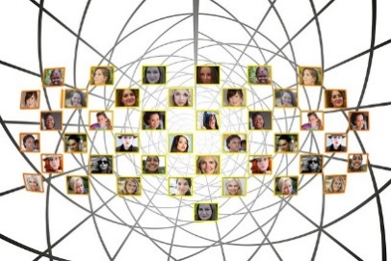
CULTURE, A CRITICAL REVIEW
Culture, a critical reflection
The concept of culture
Narrow concept
(High culture)
Expanded concept
(Life-world/ Actor field)
Structure Perspective
Process Perspective
Closed
(Divalent, homogenous, coherent)
Open (Multivalent/ diverse/ fuzzy/ cohesive)
CC0 Source: pixabay
Geographically
CC0 Source: pixabay
Politically
Linguistically
Others…
Source: Bolten 2007 and 2016a, amended and translated
Religious
Notes:
We can consider culture from different perspectives. Generally speaking, we consider culture in the context of interactions with others or with our living environment. Here Bolten makes a distinction between viewing culture as a closed system (e.g. English speakers, geographical entities), which is relatively stable, homogeneous, coherent, i.e. a ‘container’, and viewing it as an open system. The approach to culture as an open, ever-changing system, emphasises its knowledge-based and processual nature. This view is based on the understanding that culture is something which is dynamic, and uses a set of practices to create social reality. Such a ‘process’ view of culture is linked to the understanding of culture as knowledge. Through learning we acquire knowledge about the way things are done and thereby gradually gain a sense of familiarity. This process leads to cultural cohesion, and thus culture can be seen as the glue that connects people. The basis of this is common knowledge and shared meaning. This understanding of culture has the advantage that it captures the changes within cultures and their dynamics.
Using an open definition of culture in the context of intercultural interaction requires us to look closer at individuals and their membership of different groups or collectives.

Slide 30
CULTURE, A CRITICAL REVIEW
Culture, a critical reflection
Focusing on differences based on national identities tends to simplify and ignore the complexity of culture
We are members of many different collectives and our culture is thus characterised by ‘multi-collectivity’
These diverse collectives are multi-layered, intertwined and can be considered as heterogeneous networks (e.g. nation, ethnic groups, company, family)
As such they are characterised by different levels of homogeneity. (cf. Hansen 2009:116)
Notes:
Literature on culture, specifically in the business context, has focused excessively on national cultures and differences between these national cultures. The assumption thereby is that differences in national cultures influence business practices across countries and that business people therefore need to adapt their business practices in order to be successful. The guiding principle thereby is that what works in one country may not work in another. As a consequence, international managers are requested to adjust their management and communication styles, as well as their performance evaluation and recruiting system in order to make it ‘fit in’. Of course every country has specific demographic, social and environmental conditions that may make it different from other countries.
However, focusing excessively and exclusively on differences between national cultures is extremely limiting. It prevents us from looking beyond the ‘culture=nation= formula’ in a context which is characterised by growing diversity, multiple identities, double rootedness and new opportunities to join interest groups and develop specific lifestyles. The culture=nation formula has a tendency to generalise about people and provides us with little ability to predict the behaviour of individuals.
With regard to intercultural interactions, the nation=culture formula prevents us from searching for commonalities which are likely to exist across national boundaries. For example, people sharing the same profession are bound to have a lot in common regardless of their national identity. They may also have more similarities than they experience with other professional groups in their own countries.

Slide 31
CULTURE, A CRITICAL REVIEW
Culture, a critical reflection
CC BY-SA 4.0 „Polyrelationalität der Kollektive, Multirelationalität der individuellen Akteure“ Source: Jürgen Bolten (2015), used by permission
Notes:
We need to develop more complex notions of cultural identities. One way of doing this is by considering multi-collectivity and the heterogeneity of cultures, with individuals being members of many different and multi-layered collectives.
The diagram, developed by Bolten, illustrates this. Persons A to E are members of different collectives (K1-K10) or communities. These could represent family, groups of friends or teammates in a sporting environment. Because person A is a member of collective 1 and 2, and person B is a member of the collective 2, A and B are linked through the membership of one collective. At the same time there is a reciprocal relationship between the collective and the individual, which means that person A has an influence on the collective and the collective also influences the individual members.
Bolten illustrates the different collectives, their overlaps and delineations in the diagram. For example A and B belong to the same collective K1, but B also belongs to the collective K2,3 etc. The arrows indicate the strength of attachment and identification. By looking from afar we are only able to see membership of a few collectives, but when we look at any one individual, we can identify the many different collectives to which he/she belongs.

Slide 32
CULTURE, A CRITICAL REVIEW
Culture, a critical reflection
An open definition and concept of culture is not based on binary logic, which defines group A sharply from group B, but as ‘fuzzy sets’ characterised by diversity and more or less linked by the multirelational nature of their actors (cf. Bolten 2014:100).
Notes:
Therefore, culture can be understood both as a process that focuses on people’s relationships with one another as well as a structure that forms a homogeneous whole. Culture can be considered interlinking when it comes to its process-like character, and as a network, when it comes to its structure. Therefore, what we understand by culture, always depends on the context in which we perceive it.

Slide 33
SUMMARY AND REFLECTION
Summary
Culture refers to groups of people with blurred boundaries who share a certain amount of knowledge and have developed a sense of familiarity and shared code system
Culture is dynamic and subject to change
Considering culture in terms of multi-collectivity supports the understanding that a person’s identity is linked to their affiliation to multiple groups
This helps to identify commonalities as well as differences within and across different groups
From a multi-collective perspective, national identity can be seen as one affiliation among others

Slide 34
SUMMARY AND REFLECTION
Reflection
Look back at the photograph of the Buddha statue and the door of a restaurant from the beginning of the session. Discuss why it provides indications that an open definition of culture is better able to help us understand situations today rather than a closed definition of culture.
Notes:
Considering an open definition of culture helps us to see the multitudes of collectives within a society, e.g. communities aiming at following the teaching of Buddha. It also shows us that through exchange, exposure and interactions new thoughts are being conveyed and integrated into the lives of people, e.g. the notion of mindfulness illustrating the changing nature of culture.
It is probably save to say that people across the world share the wish to feel protected for example against illnesses and misery. Many share the wish to wear and have symbols which they hope will do so and although the particular symbols themselves may vary, there are commonalties with regard to their meaning and purpose. It thus indicates that cultural elements are shared across national boundaries. People who migrate bring along their symbols and integrate them into the new environment. Applying an open definition of culture supports the search for commonalities in this case the notion of protection.
Culture is in a flux and is changing and is reacting to influences from the outside. These may be new products which are being introduced, people on the move who for example bring along new ideas and different ways of communicating. This is one reason for considering an open definition of culture. Another reason is that people within a country are members of different reference groups and an open definition of culture enables us to view their membership in different collectives, see commonalities as well as differences among the different actors.

Slide 35
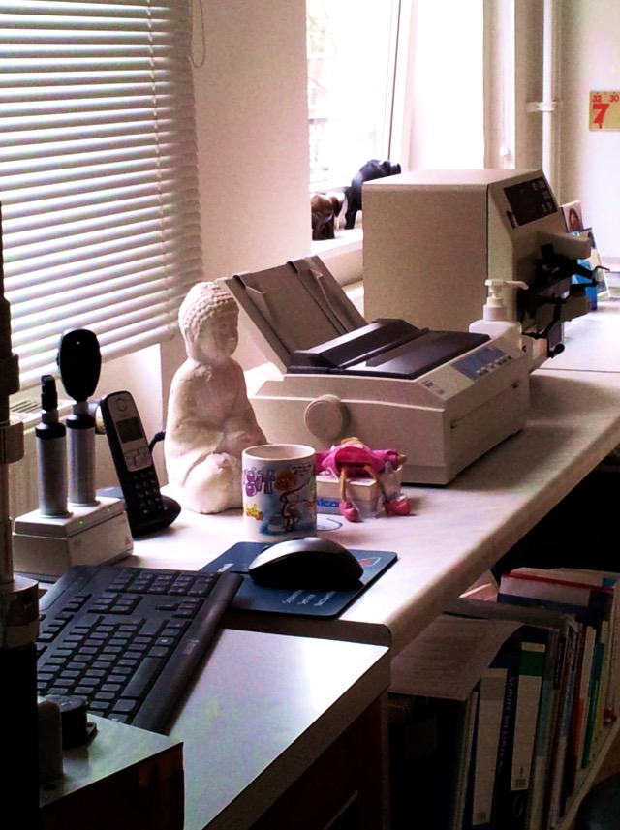
SUMMARY AND REFLECTION
Reflection
CC BY-SA 4.0 „Hamburg“ Source: Adelheid Iken (2016)
Notes:
Considering an open definition of culture helps us to see the multitudes of collectives within a society, e.g. communities aiming at following the teaching of Buddha. It also shows us that through exchange, exposure and interactions new thoughts are being conveyed and integrated into the lives of people, e.g. the notion of mindfulness illustrating the changing nature of culture.
It is probably save to say that people across the world share the wish to feel protected for example against illnesses and misery. Many share the wish to wear and have symbols which they hope will do so and although the particular symbols themselves may vary, there are commonalties with regard to their meaning and purpose. It thus indicates that cultural elements are shared across national boundaries. People who migrate bring along their symbols and integrate them into the new environment. Applying an open definition of culture supports the search for commonalities in this case the notion of protection.
The U.S. American signpost shows that culture is linked to the establishment of conventions and common knowledge, in this case how to indicate time. The convention of dividing time into two periods, a.m. (Latin ante meridiem) meaning before midday and p.m. (Latin post meridiem) meaning after midday is common in the USA. People not familiar with them need to learn about such conventions when entering the USA in order to be able to follow the rules and expectations linked to these.
Culture is in a flux and is changing and is reacting to influences from the outside. These may be new products which are being introduced, people on the move who for example bring along new ideas and different ways of communicating. This is one reason for considering an open definition of culture. Another reason is that people within a country are members of different reference groups and an open definition of culture enables us to view their membership in different collectives, see commonalities as well as differences among the different actors.

Slide 36
SUMMARY AND REFLECTION
Reflection
CC BY-SA 4.0 „Paris“ Source: Adelheid Iken (2015)
Notes:
Considering an open definition of culture helps us to see the multitudes of collectives within a society, e.g. communities aiming at following the teaching of Buddha. It also shows us that through exchange, exposure and interactions new thoughts are being conveyed and integrated into the lives of people, e.g. the notion of mindfulness illustrating the changing nature of culture.
It is probably save to say that people across the world share the wish to feel protected for example against illnesses and misery. Many share the wish to wear and have symbols which they hope will do so and although the particular symbols themselves may vary, there are commonalties with regard to their meaning and purpose. It thus indicates that cultural elements are shared across national boundaries. People who migrate bring along their symbols and integrate them into the new environment. Applying an open definition of culture supports the search for commonalities in this case the notion of protection.
The U.S. American signpost shows that culture is linked to the establishment of conventions and common knowledge, in this case how to indicate time. The convention of dividing time into two periods, a.m. (Latin ante meridiem) meaning before midday and p.m. (Latin post meridiem) meaning after midday is common in the USA. People not familiar with them need to learn about such conventions when entering the USA in order to be able to follow the rules and expectations linked to these.
Culture is in a flux and is changing and is reacting to influences from the outside. These may be new products which are being introduced, people on the move who for example bring along new ideas and different ways of communicating. This is one reason for considering an open definition of culture. Another reason is that people within a country are members of different reference groups and an open definition of culture enables us to view their membership in different collectives, see commonalities as well as differences among the different actors.

Slide 37
SUMMARY AND REFLECTION
Reflection
What do you consider to be central elements of culture and why? How would you include them when performing a cultural analysis?
What do we mean by an open definition of culture based on multi-collectivity and what are the benefits of applying such a definition when working in a multi-national environment?
How can such a definition help you when meeting people from different cultural backgrounds?
Do you think that people who meet can ‘create’ culture? If so, what evidence can you cite?

Slide 38
SUMMARY AND REFLECTION
Reflection
Look at the worksheet ‘Breakfast in Berlin’ (WS)
Was the breakfast you personally enjoy mentioned? Is your preference related to your nationality and thus a closed definition of culture?
Considering an open definition of culture, does it make sense to talk about a ‘German breakfast’ or a ‘French breakfast’?

Slide 39
SUMMARY AND REFLECTION
Reflection
Rewrite the following short note about French managers considering an open definition of culture
There are US American managers who argue that in Europe, the French are particularly difficult to get along with. One thing they complain about is that the French don’t delegate, are particularly sensitive towards hierarchy and status, that they fail to keep their subordinates informed and in fact are highly authoritarian. Another complaint is that French managers don’t show responsibility towards their subordinates and generally speaking are not good team players. (cf. Steers, R. 2013:41)

Slide 40
HOME ASSIGNMENT
Read the essay by Dr. Peter Witchalls ‘Is national culture still relevant?’ In: interculturejournal 11 (19): 11-18 http://www.interculture-journal.com/index.php/icj/article/viewFile/178/280
Summarise his arguments and discuss the relevance of these for intercultural encounters

Slide 41
SOURCES
Bolten, Jürgen 2011. Unscharfe und Mehrwertigkeit: “Interkulturelle Kompetenz” vor dem Hintegrund eines offenen Kulturbegriffs. In: Hoessler, U. & W. Dreyer (Eds.) Perspektiven interkultureller Kompetenz. Göttingen: Vandenhoeck&Ruprecht, pp. 55-71
Bolten, Jürgen 2013. Fuzzy Cultures: Konsequenzen eines offenen und mehrwertigen Kulturbegriffs für Konzeptualisierung interkultureller Personalentwicklungsmaßnahmen. In: Mondial: Sietar Journal für interkulturelle Perspektiven, pp. 4-10. http://www2.uni-jena.de/philosophie/IWK-neu/typo3/fileadmin/publicationen/Bolten_2013_Fuzzy_Cultures.pdf (14.3.2017)
Bolten, Jürgen 2014. ‘Kultur’ kommt von colere: Ein Plädoyer für einen holistischen, nicht-linearen Kulturbegriff. In: Jammal, Elias (Ed.) Kultur und Interkulturalität: interdisziplinäre Zugänge. Wiesbaden: Springer, pp. 85-108
Bolten, Jürgen 2015. Einführung in die Interkulturelle Wirtschaftskommunikation. Göttingen: Vandenhoeck&Ruprecht (2nd ed.)
Bolten, Jürgen 2016. Interkulturelle Trainings neu denken. In: interculture journal Special issue “(Inter)Kulturalität neu denken! 15 (26), pp.75-92 http://www.interculture-journal.com/index.php/icj/issue/viewIssue/37/9
Bolten, Jürgen 2016a. “Interkulturelle Kompetenz neu denken?! Forthcoming in Polylog, Sonderheft ‘Interkulturelle Kompetenz in der Kritik. Wien. http://www2.uni-jena.de/philosophie/IWK-neu/typo3/fileadmin/team/juergen.bolten/1608Ik_Kompetenz_neu_denken_-_Polylog.pdf
Brewer, Paul & Sunil Venaik 2013. On the misuse of national cultural dimensions. In: International marketing Review, 29( 6), pp. 673-683
Hansen, Klaus P. 2009. Kultur, Kollektivität, Nation. Passau: Stutz
Meyerson, D. 1991 Acknowledging and uncovering ambiguities in cultures, In: P. Frost et al. (Eds.) Reframing Organizational Culture. Newbury Park, CA: Sage, pp.254-70.
Steers, R. M. et al. 2013. Managing across cultures – Developing global competencies. Cambridge: Cambridge University Press
Sweeney, Brendan 2002. Hofstede’s Model of national cultural differences and their consequences: A triumph of faith-a failure of analysis. 55(1), pp. 89-118

Slide 42
SOURCES
Tietmeyer, Elisabeth 2011. Cultural Contacts and Localization in Europe-from the Collections of the Museum of European Cultures. Berlin: National Museums in Berlin
Tsui, A. et al. 2007. ‘Cross-national, cross-cultural organizational behaviour research: advances, gaps, and recommendations’. In: Journal of Management, 33(3); pp. 426-78
Witchalls, Peter James. 2012 Is national culture still relevant? In: interculture journal 11 (19), pp. 11-18 http://www.interculture-journal.com/index.php/icj/article/viewFile/178/280
Zeutschel, Ulrich 2016. “Zoomen” zum Entdecken interkultureller Verständigungspotenziale und -ressourcen In: interculture journal 15(26), pp. 92-96 http://www.interculture-journal.com/index.php/icj/issue/viewIssue/37/9
Except where otherwise noted, content in this presentation / on this site is licensed under a Creative Commons Attribution Share Alike 4.0 International license.

