Slide 1


EduBox 01:
Culture, a new perspective
Author: Prof. Dr. Adelheid Iken
Project: EduBoxes for Hamburg Open Online University (www.hoou.de)
CC BY-SA 4.0 „EduBoxes Logo“ Source: Hans Limo Lechner (2016)

Slide 2
INTRODUCTION TO EDUBOX 01
The socio-cultural and economic features of globalisation have a strong influence on the practices of modern organisation and thus business communication and management.
More than ever before, managers and co-workers are networking and communicating at the intersection of diverse cultures. And yet, at the same time, cultures are undergoing rapid change, catalysed by new forms and means of communication.
These rapid changes have required us to review our understanding of culture as well as the tools we use to develop a common basis of understanding. Through these new tools and ways of viewing culture, we open up the possibility of not only solving issues that may arise from cross-cultural encounters but of actively developing synergies that can emerge from such interactions.
And that is precisely the objective of this EduBox.

Slide 3
EduBox 01:
Culture, a new perspective
Session 03:
A culture reflexive approach to
the analysis of cross-cultural
interactions
Author: Prof. Dr. A. Iken with contributions by Prof. Dr. K. Nazarkiewicz
Project: EduBoxes for Hamburg Open Online University (www.hoou.de)

Slide 4
A CULTURE REFLEXIVE APPROACH
Introduction to Session 03
The concept of multi-collectivity is essential when trying to understand the complexity and multifaceted nature of intercultural encounters. As will be argued in this session, this approach needs to be complemented by an intercultural perspective as well as a contextual approach, which pays particular attention to power relationships.
The aim of this session is to introduce these three approaches, using the concept of cultural reflexivity as a tool to analyse intercultural encounters and apply them to different settings.

Slide 5






ICONS
Discussion / Reflection
Task / Home assignment
Learning Outcome / Objectives
Summary
License
Video

Slide 6
LEARNING OUTCOME
Students analyse cross-cultural situations while applying a culture reflexive approach

Slide 7
OBJECTIVES
At the end of the session, students will be able to:
explain what we mean by cultural reflexivity
apply a culture-reflexive approach to the analysis of cross-cultural encounters, and
based on the findings make meaningful suggestions as to how to deal with the issue at stake

Slide 8
A CULTURE REFLEXIVE APPROACH
Topics
Learning outcome
Objectives
Lead-in
A culture reflexive analysis
  Cultural reflexivity
  Three perspectives of cultural reflexivity
  Putting it into practice
  Case studies
Summary and reflection
Home assignment
Sources

Slide 9
LEAD-IN
What do you think?
‘…if a Chinese acquaintance is invited to a dinner party, how much of this invitee’s behaviour at that party can be attributed to the fact that he or she is Chinese, and how much to other factors, such as affiliations to a whole host of sub-cultures that could be professional, regional, gender-specific, generational, interest-group related or even a culture that simply relates to family, friends or the individual themselves?’ (Witchalls 2012, p.12; used by permission)
Notes:
Students may mention aspects such as that the Chinese probably grew up in China and thus adapted some behavioural patterns associated with the Chinese national culture. They may also mention that a professional sub-culture influences behavioural patterns as well and that these may or may not correspond with behaviour associated with the Chinese national culture. Gender as well as other factors such as the fact that the encounter takes place at a dinner party and that this dinner party (set-up, food, etc.) may or may not meet the expectation of the Chinese acquaintance will equally influence the behaviour of the guest.

Slide 10
A CULTURE REFLEXIVE ANALYSIS
Cultural reflexivity
What do you associate with the term ‘reflexivity’ and more specifically ‘cultural reflexivity’?

Slide 11
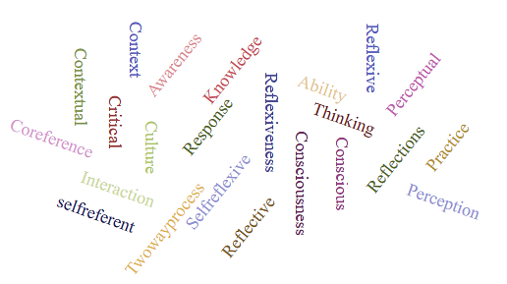
A CULTURE REFLEXIVE ANALYSIS
Cultural reflexivity
Notes:
These are some of the answers

Slide 12
A CULTURE REFLEXIVE ANALYSIS
Cultural reflexivity
Activity 1:
Use a search engine to look for expressions and explanations linked to ‘reflexivity’ and note them down on a piece of paper.

Slide 13
A CULTURE REFLEXIVE ANALYSIS
Cultural reflexivity
Following the entry in Wikipedia, the term reflexivity within sociology … means an act of self-reference where examination or action "bends back on", refers to, and affects the entity instigating the action or examination. It commonly refers to the capacity of an agent to recognize forces of socialization and alter their place in the social structure (Wikipedia https://en.wikipedia.org/wiki/Reflexivity_(social_theory) (Accessed 18th September 2018)
Notes:
On this and the following slide are some of the findings related of the internet search.

Slide 14
A CULTURE REFLEXIVE ANALYSIS
Cultural reflexivity
According to the online Cambridge Dictionary reflexivity refers to‘ the fact of someone being able to examine his or her own feelings, reactions, and motives (= reasons for acting) and how these influence what he or she does or thinks in a situation…’ (Cambridge University Press https://dictionary.cambridge.org/de/worterbuch/englisch/reflexivity (Accessed 22nd October 2018, used by permission)
Notes:
Mo 22.10

Slide 15
A CULTURE REFLEXIVE ANALYSIS
Cultural reflexivity
Pollner (1991:370) describes reflexivity as
“…an ‘unsettling,’ i.e., an insecurity regarding the basic assumptions, discourse and practises used in describing reality.”
Notes:
What this relates to is that we need to question the assumptions which are guiding our behaviour, but also the impact our behaviour has and reviewing our actions critically and from a distance. Such an approach can be an uncomforting and is definitely a situation which is unsettling in other words making us feel insecure. Nonetheless such a view is required if we fully want to understand our interactions with others and if we aim at developing a more collaborative, responsive and fruitful way of dealing with cross-cultural encounters. Cunliffe (2016) argues that if we become reflexive practitioners, we are to develop a greater awareness of our self, different perspectives and thus also different possibilities in dealing with others. We are better able to understand and learn and thus skilled in exploring new possibilities.
A reflexive approach is based on the understanding that our social reality and self is something which is created between us through our day to day interactions with others. This process of constructing reality is ongoing, unconscious and because it is influenced by many factors never completely under our control. It is linked to the way we respond to others and interact with them.

Slide 16
A CULTURE REFLEXIVE ANALYSIS
Cultural reflexivity
Fold your arms as you normally do
Now fold your arms the opposite way
Notes:
Folding one’s arms in a way we do this without thinking is a reflex interaction and it is comfortable, normal and habitual. If we fold our arms the other way around, we do this consciously and we reflect on how we position and interweave our arms. This means we do this consciously and reflective.

Slide 17
A CULTURE REFLEXIVE ANALYSIS
Cultural reflexivity
Cultural reflexivity can be understood as the ability to recognize the existence of cultural diversity in general and one’s own and other’s membership in different collectives. It includes a subjective-process of self-conscious inquiry and introspection and the study of social behaviour and interaction with reference to different parameters.
Notes:
A reflexive approach is based on the understanding that our social reality and self is something which is created between us through our day to day interactions with others. This process of constructing reality is ongoing, unconscious and because it is influenced by many factors never completely under our control. It is linked to the way we respond to others and interact with them. A culture reflexive approach thus requires that social actors become conscious of and reflect upon social life which starts with an inward look and consciousness of one’s action and what moves these actions. And it involves the capacity to consider oneself in relation to context and power relations.
The culture reflexive approach also refers to the understanding that in order to grasp the complexity and subtlety of culture, a variety of references need to be considered. It is based on the understanding that there is a growing need to cultivate innovative ways of thinking and acting in order to be able to understand people’s behaviour more fully. A culture reflexive approach centres on the question of how one could explain the behaviour of a person taking on different perspectives and considering details.

Slide 18


A CULTURE REFLEXIVE ANALYSIS
Cultural reflexivity
In practical terms cultural reflexivity means
questioning the assumptions and beliefs underlying social actions and the impact of these actions, and
analysing cross-cultural encounters from a variety of perspectives with the premise that
such a process has the potential to maintain and transform social relations and the development of constructive cross-cultural dialogues.
CC0 Source: pixabay
CC0 Source: pixabay

Slide 19

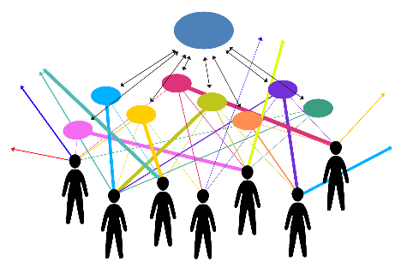

A CULTURE REFLEXIVE ANALYSIS
Three perspectives of cultural reflexivity
The intercultural perspective
The multi-collective perspective
The contextual and power reflexive
perspective
CC BY-SA 4.0 Source: Julia Flitta (2017)
Boss
…
Illustrations based on Nazarkiewicz, K. 2016a and Yildirim-Krannig, Y. 2014
…
Employee
Notes:
The concept of a culture-reflexive approach challenges the concept which views culture primarily as a category based on language, the borders of a country or nationality and asks for the application of a variety of perspectives in order to grasp the complexity of intercultural encounters.
In this context Kirsten Nazarkiewicz (2016) distinguishes three perspectives which are intertwined and at times are difficult to delineate, the intercultural perspective, the multi-collective perspective and the contextual and power reflexive perspective. Let us look at each of them in more detail.

Slide 20

A CULTURE REFLEXIVE ANALYSIS
Three perspectives of cultural reflexivity
The intercultural perspective
CC BY-SA 4.0 Source: Julia Flitta (2017)
Based on Nazarkiewicz, Kirsten 2016a
Notes:
The ‘intercultural perspective’ is based on what Kirsten Nazarkiewicz (2016) calls a ‘natural world view’ which may also be termed conventional wisdom. It illustrates a situation in which two people with different cultural backgrounds meet, but are able to identify overlapping cultural areas. In order to identify differences and overlaps, cultural standards or dimensions, symbols, artefacts and institutions are commonly used as signifiers. From such a perspective, culture can be a dividing or a connecting element as it is considered a kind of grammar which has to be learned.
A major critique of this perspective is that it is based on the assumption that a person basically belongs to one culture and that this culture can be clearly delineated and analysed. It also assumes that cultures are fairly homogenous and thus people from the same culture display more or less the same behavioural patterns. Despite the fact that there may be an overlap, an intercultural perspective has the tendency to see meeting people from another culture as producing a collision of two worlds and thus entailing a great potential for conflicts which have to be dealt with.
The focus of such a perspective is to develop an understanding of behavioural differences and learning from the ‘other’ in order to achieve one’s goal. It requires self-reflection and awareness of one’s own cultural orientation and is based on making assumptions about the culture of the ‘other’. Because it reduces individuals to a group membership, it has to be clear that this is a ‘Zooming’ out perspective. This means that one can only see generalising and very often stereotypical patterns.
For example a company wants to establish business links with clients in another country and is about to send a business person to the respective country. And the business person requires a brief introduction to the country and its people. In such a situation, the intercultural perspective can be used to provide a first and fast generalised impression of what to look out for or to consider when setting off to the country.

Slide 21
A CULTURE REFLEXIVE ANALYSIS
Three perspectives of cultural reflexivity
The intercultural perspective
  Considers people as primarily belonging to one culture
  Anticipates a likelihood of ‘culture clashes’ when people from different cultures meet
  Has a tendency to generalise and perpetuate perceptions of differences
  Focuses on learning about the other culture and avoiding confrontation
  Is not usually aimed at finding commonalities and searching for synergy

Slide 22
A CULTURE REFLEXIVE ANALYSIS
Three perspectives of cultural reflexivity
Watch the following short YouTube video and note down how you would describe Emil as a cultural person

Slide 23
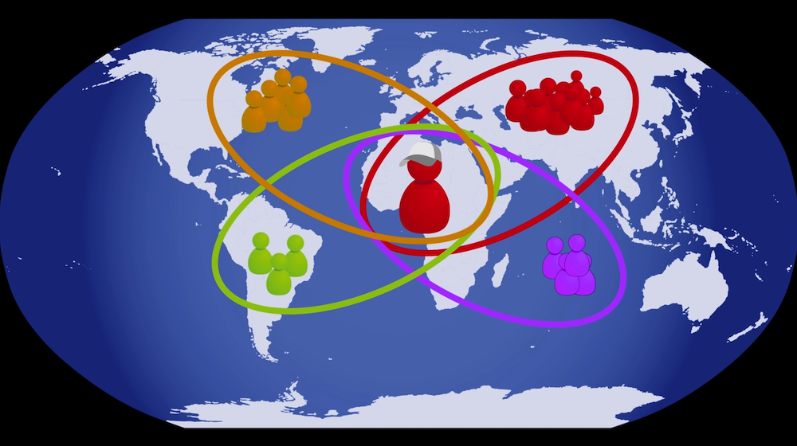
A CULTURE REFLEXIVE ANALYSIS
Three perspectives of cultural reflexivity
CC BY 4.0 „Social relations towards a network approach “ by Prof. Dr. Adelheid Iken, Peter Witchalls, Jakob Kopczynski
Watch the video online: https://www.podcampus.de/nodes/RrLPn
Or watch/download it here: https://blogs.hoou.de/eduboxes/eduboxes/edubox-01-session-01/session-03/

Slide 24

A CULTURE REFLEXIVE ANALYSIS
Three perspectives of cultural reflexivity
The ‘multi-collective’ perspective
Membership
based on…
Gender
Study group
Organisation
Profession
Football club
Languages
CC BY-SA 4.0 Source: Julia Flitta (2017) Based on Yildirim-Krannig, Yeliz 2014
Notes:
The multi-collective perspective includes the understanding that we all belong to different sub-collectives and view ourselves as members of these collectives. This is shown in this figure illustrating multi-collectives, e.g. various milieus, organisational culture, choir members, civil servant, sister, guitar player and different other co-cultures people communicating may be a member of. To a certain extent, one can move in and out of such sub-collectives. For example somebody may decide to quit being a member of the football club. But the collectives as such are marked by a reasonable stability and boundaries.
Considering multi-collectivity and understanding and perceiving ourselves as individuals with membership in different collectives enables us to consider an individual’s cultural orientation which is influenced by factors such as a person’s life paths, education, upbringing, experiences and membership in roof-collectives. It requires self-reflection and understanding of one’s own background as well as the exploration and enquiry of the other person’s background and membership in collectives.
The different colours of the pie chart not only indicate membership in different collectives but also the relevance of membership in a specific encounter. This is indicated by the thickness of the pie-pieces. Depending on the context, membership in one collective may be more relevant than another. For example when starting to work in a team, membership in a sub-collective based on educational background or language may be more relevant than membership in a football club.

Slide 25
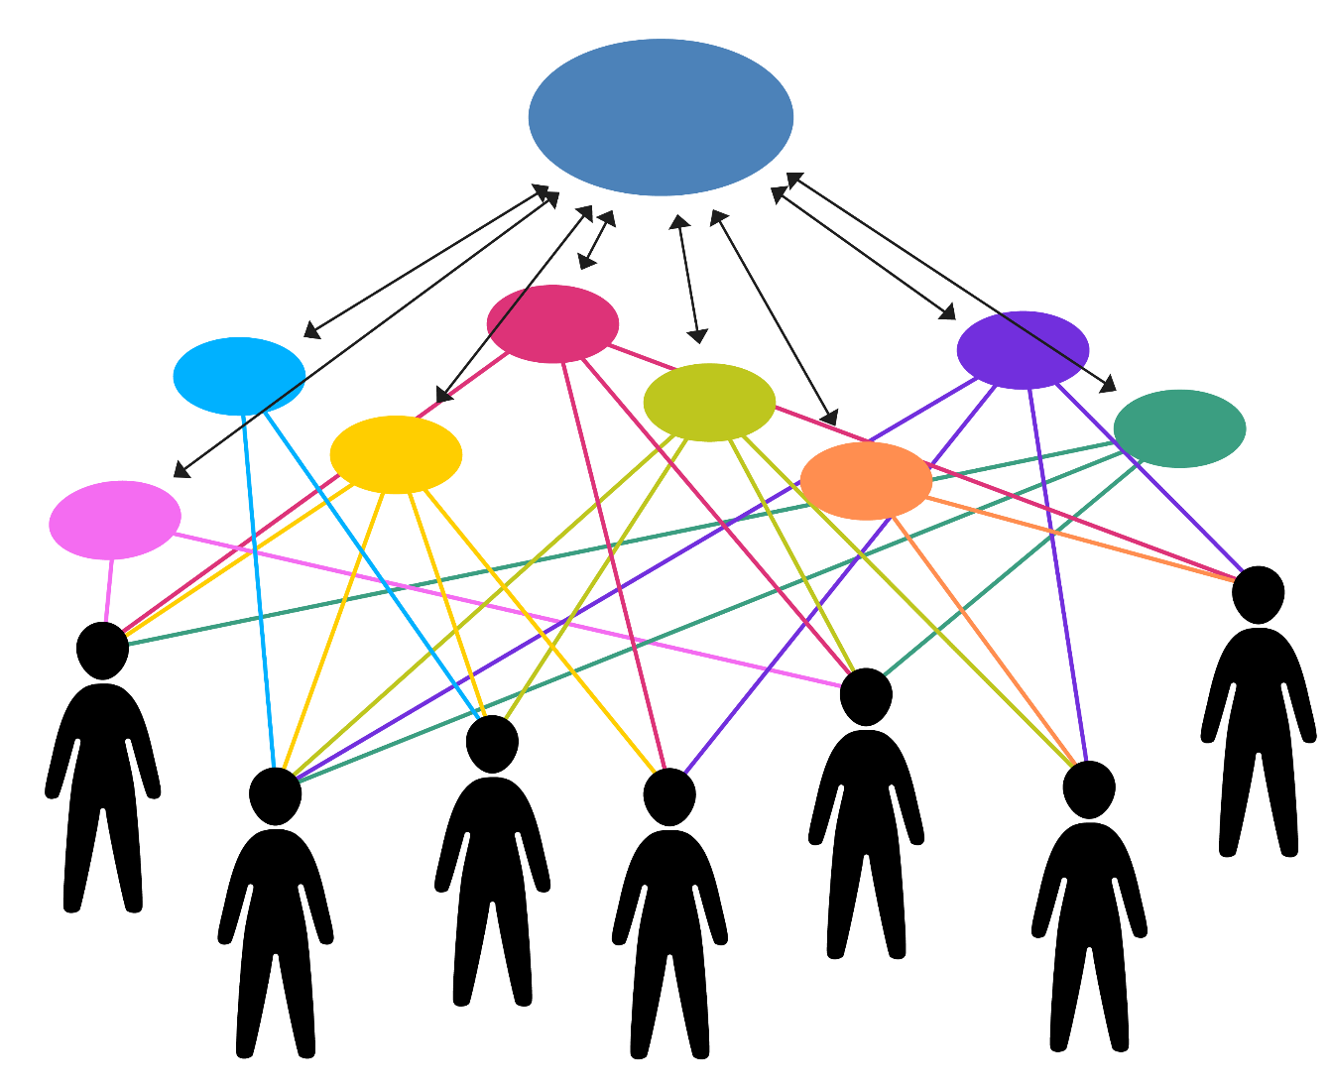
A CULTURE REFLEXIVE ANALYSIS
Three perspectives of cultural reflexivity
The ‘multi-collective’ perspective
Roof-
collective
Sub-collectives
CC BY-SA 4.0 Source: Julia Flitta (2017) Based on Yildirim-Krannig, Yeliz 2014
Notes:
When applying a multi-collective perspective no assumptions are being made based on nationality which requires an exploration into the membership in different sub-collectives.

Slide 26
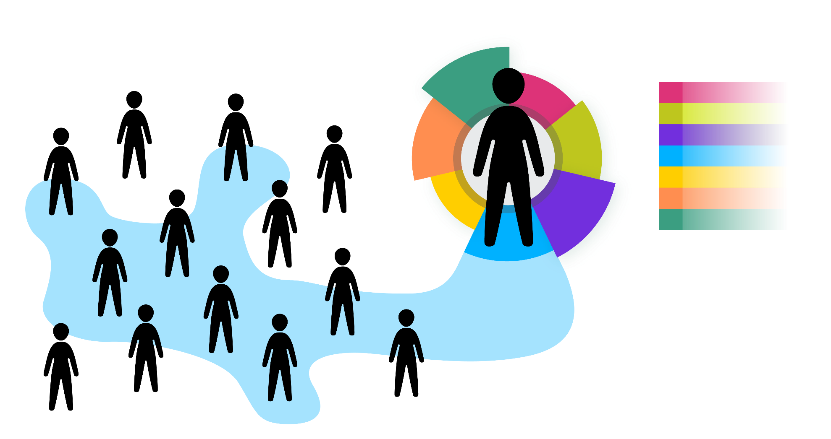
A CULTURE REFLEXIVE ANALYSIS
Three perspectives of cultural reflexivity
The ‘multi-collective’ perspective
CC BY-SA 4.0 Source: Julia Flitta (2017) Based on Rathje, Stefanie 2015
Football club
Notes:
The advantage of a multi-collective perspective is that it greatly supports the understanding that whenever individuals interact, a multitude of cultures is involved which supports and eases the search for commonalities.
Imagine you just started studying at the university and are about to get to know your fellow-students. On a private level you strongly identify with one of the local football clubs. So far you have not mentioned it to any of your fellow students but there is an important game coming up and during the break you talk about this to one of your fellow students. And all of a sudden you realise that there are many more in your class who are strong supporters and are going to watch the game. So very quickly your organise to go and watch it together. This example shows several things. One is that we are members in many different sub-collectives but not all play a role in a specific context. In our case the membership in a foot-ball club did not appear as relevant in the context of university studies.
Another aspect is that we navigate between different collectives depending on context. In our case the important game and communicating about it highlighted a membership which became relevant.
And a third aspect is that by communicating and revealing membership in different collectives enables us to find commonalities and therefore a common ground of understanding which in turn strengthens our ability to develop social relations.

Slide 27

A CULTURE REFLEXIVE ANALYSIS
Three perspectives of cultural reflexivity
The ‘multi-collective’ perspective
CC BY-SA 4.0 Source: Julia Flitta (2017) Based on Rathje, Stefanie 2015
Football club
Foreign language
Notes:
If we take membership in different collectives into account, our chart may look like this. We may find that some fellow students are members of the local football club and speak a foreign language.
By searching for commonalities the ‘them’ and ‘us’ can quickly submerges into a ‘we’ supporting a notion of belongingness and inclusion. This is a good base for establishing familiarity, trust and developing relationships.
For example imagine you are about to coordinate a newly established international team and are wondering how best to bring the members together thinking about an adequate leadership style and ways of communicating. Enquiring into membership in sub-collectives serves as a good starting point to get to know the team members.

Slide 28
A CULTURE REFLEXIVE ANALYSIS
Three perspectives of cultural reflexivity
The multi-collective perspective
  Considers multiple cultural orientations and self-identification
  Has the potential to identify commonalities and common interests
  Provides a basis for establishing trust
  Requires self-reflection and openness from communication partners
  Requires time
  Facilitates relationship building

Slide 29
A CULTURE REFLEXIVE ANALYSIS
Three perspectives of cultural reflexivity
The contextual and power related reflexive perspective
Man
Little
experience
abroad
…..
Employee
CC BY-SA 4.0 Source: Julia Flitta (2017) Based on Nazarkiewicz, Kirsten 2016a
Boss
Worked
abroad for
many years
Valuing personal independence
Woman
Notes:
However, apart from integrating the ‘multi-collective’ perspective, power as well as contextual variables need to be taken into consideration when trying to analyse a situation or when aiming at solving a conflict. Kirsten Nazarkiewicz (2016), refers to this as the need to deconstruct the power-discourse and thus calls the third perspective ‘power-reflexive perspective’. The factors which require attention here could be linked to the resources and influence people involved are having, the relationship between the stakeholders, could be linked to gender or personality to name but a few. With regard to contextual variables, the question to be raised is in how far the context in which the interaction takes place influences the interaction.

Slide 30
A CULTURE REFLEXIVE ANALYSIS
Three perspectives of cultural reflexivity
The contextual and power-reflexive perspective
  Acknowledges and supports the consideration of personal as well as situational aspects
  Considers in particular ‘power’ and asymmetrical power relations as an interfering factor
  Limits the problem of ‘over-culturalisation’
  Shows potential limits of influence and interactions

Slide 31



A CULTURE REFLEXIVE ANALYSIS
Three perspectives of cultural reflexivity
Which questions could be asked regarding the situation and those involved?
The search for meaning:
Which cultural factors could play a role?
The search for reciprocal effects and solutions: The membership of which sub-collectives and systems could be important and thus need consideration? What is it we don’t know and how can we find a common solution?
How are the privileges and opportunities to participate distributed in advance? Who has which privileges, what kind of power-relations are relevant? What are other important context factors worth considering?
CC BY-SA 4.0 Source: Julia Flitta (2017)
Illustrations based on Nazarkiewicz, K. 2016a and Yildirim-Krannig,Y. 2014
Notes:
Analysing an encounter based on culture-reflexivity has the potential to establish a process of mediated understanding and to create common meaning. As such it is rooted in social interactions and requires some form of participation from both partners. It is also based on the understanding that knowledge creation and learning is a social activity which is relational in its intent and mediated, as well as contextual and dynamic. Through such a process the culture reflexive approach is able to acknowledge potentials in intercultural encounters, as well as paving ways to meet misunderstandings.
A culture reflexive approach as a critique also implies the questioning of one’s own practices, assumptions, interpretative schemata and seeks to make the interacting parties become aware of their practices and assumptions. It therefore enables established practices coupled with the awareness of membership in different collectives to be questioned. It provides the power to think about the details of one’s practices and actions and to steer one’s emotions. This facilitates the exploration of alternative ways of acting.
In practical terms reflexivity can be achieved through the questioning and the awareness raising for assumptions, a disciplined way of thinking and self-appraisal, as well as the establishment of a meaningful dialogue and the shared acquirement of knowledge and common meaning.

Slide 32

A CULTURE REFLEXIVE ANALYSIS
Putting things into practice
The complaint – a critical event
A job applicant with a North African migrant background complained to his case worker’s superior at the State Employment Agency that her clothing was too revealing.
The tops with spaghetti straps that she wore on
hot summer days were inappropriate from his
Muslim point of view.
What is your spontaneous reaction and position?
You have two minutes to think about it.
(Source: Cf. Nazarkiewicz, Kirsten 2016, p.25 translated)
CC BY-SA 4.0 „Woman“ Source Adelheid Iken (2017)

Slide 33
A CULTURE REFLEXIVE ANALYSIS
Putting things into practice
The complaint from the intercultural perspective or with a ‘natural worldview’.
Confusion because two people from different countries meet
Anticipated differences in value systems and value based interpretation. The concept of honour and sexual ethics linked to this meets individualistic, self-determined and pragmatic clothing style
Readiness to observe and practice non-judgmental recognition of cultural factors that influence behaviour
Notes:
This perspective supports the view of a kind of clash which is due because two people from different countries meet having different values, were socialised with different cultural standards and orientations and standards. These circumstances and the accompanying assumed differences are initially perceived as major dividing factors which are producing misunderstandings and conflicts. From the point of view of the job-seeker and his concept of honour the case worker’s clothing style shows no dignity. The case worker, considering the weather and her individual taste perceives her clothing style as appropriate and indicating her self-determined life style.
Many approaches of intercultural learning are based on such comparisons and linked to the assumption that both parties are willing to come to terms with the ‘culture clash’ and want to learn from each other. There is an openness to develop a mutual understanding which requires the practice of non-judgemental recognition of cultural factors influencing an interaction and its protagonists. Such an approach bears the danger of overestimating cultural factors in human interactions.

Slide 34
A CULTURE REFLEXIVE ANALYSIS
Putting things into practice
The complaint from a multi-collective perspective considers a multitude of viewpoints:
The concrete situation shows two people meeting in a public service institution
A multitude of systems and collectives are involved:
  Organisational culture with etiquette rules and conventions in business life
  Various role constellations such as service provider via customer; an expert and a lay person
  Various memberships in sub-collectives such as based on gender, profession, language
Central to clarifying self- and other expectations and using knowledge for the development of multiple hypothesis
Notes:
The complaint from a multi-collective perspective is based on the understanding that many systems, sub-systems and thus sub-collectives might be playing a role and have an influence on the interaction. By searching for possible explanations for the perceived differences we have to reflect our own expectation of the encounter. By considering membership in different sub-collectives, we may or may not find an applicable answer to behavioural differences and at the same time commonalities. But we are searching for a multitude of differences which may or may not be applicable with the aim of generating knowledge and finding a multiperspective solution.
In the concrete case study, it may be that the formal or informal etiquette of the institution or the department does not consider tops with spaghetti straps to be an appropriate dress when meeting people from the public or when meeting people in general. But it is likewise possible that in the public service institution the appearance is considered as acceptable.
Searching for sources of influence and disturbance, clarifying expectations of the parties involved and developing multiple hypotheses is paramount for finding and negotiating a solution.

Slide 35
A CULTURE REFLEXIVE ANALYSIS
Putting things into practice
The contextual and power-reflexive perspective
Consideration of macro-influences, pre-distributed social inequalities and powerful asymmetries
Social positioning and differences in ability to participate in the example:
  Member of a dominant culture <-> person with a migrant background
  Holder of a permanent job <-> job searcher in a meritocracy
  Diversity category gender: man <-> woman
  Skin colour
Further opportunities to participate: education, language skills…?
From a contextual perspective the question would be linked to the state of intercultural competence of the organisation or its intercultural openness and policy of inclusion
Notes:
A contextual and power-reflexive perspective tries to include the notion of pre-distributed social inequalities and power asymmetries into the analysis. From such a perspective, culture can be viewed as a conflict and a battle field in which protagonists are fighting over identities, belongingness, participation, acceptance and privileges. In such a context, different diversity factors may be coming into play which may include age, sexual orientation, skin colour and religion to name but a few. As such, this perspective is difference and diversity oriented and with a notion of searching of participation of persons involved. For example in the case study it may be important to consider that the case worker has a steady job whereas the situation that the customer is seeking for a job or that she is a member of the mainstream culture, whereas he has a migrant background which influences their self-concept.
Nazarkiewicz 2016 points to the importance of critically (self) reflecting these aspects because nobody is neutral, unbiased or impartial.

Slide 36
A CULTURE REFLEXIVE ANALYSIS
Putting things into practice
Now the different parts of the three perspectives can be fanned out
How could this look like?
Man-woman
….

Slide 37
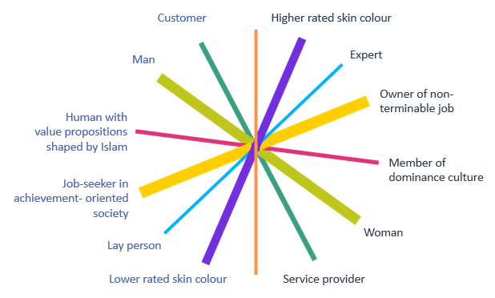
A CULTURE REFLEXIVE ANALYSIS
Putting things into practice
CC BY-SA 4.0 Source: Julia Flitta (2017) Based on Nazarkiewicz, K. 2016a
Male actor
Female actor

Slide 38



A CULTURE REFLEXIVE ANALYSIS
Putting things into practice
Consideration of intercultural and culture-specific knowledge
Multi-perspective solution oriented view
Consideration of macro influence on identity factors and interactions
CC BY-SA 4.0 Source: Julia Flitta (2017)
Illustrations based on Nazarkiewicz, K. 2016a and Yildirim-Krannig,Y. 2014

Slide 39
A CULTURE REFLEXIVE ANALYSIS
Case studies
Read the quote again. Does your answer differ now compared to the beginning of the session and if yes, how?
‘…if a Chinese acquaintance is invited to a dinner party, how much of this invitee’s behaviour at that party can be attributed to the fact that he or she is Chinese, and how much to other factors, such as affiliations to a whole host of sub-cultures that could be professional, regional, gender-specific, generational, interest-group related or even a culture that simply relates to family, friends or the individual themselves?’ (Witchalls 2012, p.12; used by permission)
In pairs, share what you noted down as your immediate reaction and compare these with the results of the analysis based on the culture reflective approach
Discuss the benefits of a culture reflexive approach using the case
Notes:
The answer should include that behavioural patterns are influenced by many aspects such as the belongingness to a national culture, different sub-cultures as well as the context and power relations. The question ‘how much’ cannot be answered but what we should do is use a multi-perspective approach as this will help us not to reduce a person’s behavioural pattern to an anticipated behaviour linked to a country or region. A ‘Chinese acquaintance’ may or may not display a behaviour commonly associated with his passport identity or place of birth. In order to understand why he is behaving in a certain way would require a lot more knowledge and a more thorough analysis.

Slide 40
A CULTURE REFLEXIVE ANALYSIS
Case studies
You are an intern in an international company and are asked to put together a portfolio for your boss who is going to Buenos Aires as he wants to meet potential new clients. You have an afternoon to accomplish this.
What would you do and which of the three approaches would you focus on and why?
What would be possible shortcomings and potentials of the approach chosen?

Slide 41
A CULTURE REFLEXIVE ANALYSIS
Case studies
You have only been with the company for two years, but because of your own international experience you are asked to lead a new team which is truly international. Some of the team members are located in New York, others in London, Mumbai and Bangalore.
What would be key aspects to consider and questions to ask when leading this team and working together? Answer this question with reference to the three perspectives of the culture-reflexive approach.

Slide 42
A CULTURE REFLEXIVE ANALYSIS
Case studies
You are working in an office with staff from different cultural backgrounds and realise that many conflicts between them and your boss emerge due to misunderstandings.
Applying a culture-reflexive approach what requires attention and why? What would you want to know from the staff in order to develop a common understanding?

Slide 43
A CULTURE REFLEXIVE ANALYSIS
Case studies
You are a sales manager and need to summon one of your employees of Russian decent. You have heard that he is attracting many Russian customers to the shop who, although they have brought orders, have also caused a sustained disturbance to both employees and other customers through their appearance.
It is your job to find a solution. How would you go about this using a culture-reflexive approach?

Slide 44
SUMMARY AND REFLECTION
Summary
A culture-reflexive approach has the ability to capture the complexity of culture, its multi-faceted nature and dynamics and the inclusion of important contextual aspects in the overall analysis.
It is thus acknowledges that in intercultural encounters people meet whose behaviour is influenced by many different factors.
Using a culture-reflexive approach is an important starting point for ‘creating culture together’ or in other words, developing a common basis for communication.

Slide 45
SUMMARY AND REFLECTION
Reflection
What are different elements of a culture reflective approach and what could be the stumbling blocks when applying the approach in day to day interactions?
Think about a situation you have experienced in which a culturally-reflexive approach could have helped you to develop a basis for common meaning and knowledge.
What are the vital skills required in order to apply a culturally reflexive approach?

Slide 46
ASSIGNMENT
Assignment 1:
Read the case study by Peter Witchalls ‘Made in Germany (or India?)’ In: interculturejournal 14 (24): 67-76
http://www.interculture-journal.com/index.php/icj/article/view/243/347
Analyse the issues using a culture reflexive approach.
Notes:
CC BY-SA 4.0 Licence

Slide 47
ASSIGNMENT
Assignment 2:
Read the case study by Prof. Jasmin Mahadevan and based on a culture reflexive analysis discuss possible solutions to solve the conflict.

Slide 48
ASSIGNMENT
Assignment 3:
Read the case study by Prof. Javier Montiel ‘Identity in an international research centre’ and carry out the tasks as outlined on the worksheet.

Slide 49
SOURCES
Cambridge University Press 2018. Reflexivity. Cambridge online dictionary. https://dictionary.cambridge.org/dictionary/english/reflexivity (accessed 22.10.2018)
Conifer, Ann L. 2016. Republication of “On Becoming a Critically Reflexive Practioner”. In: Journal of Management Education 40 (6), pp. 747-768
D’Cruz, Heather; Gillingham, Philip & Melendez, Sebastien 2007. Reflexivity: A Concept and its Meanings for Practitioners Working with Children and Families. In: Critical Social Work 8 (1), pp. 1-18 http://www1.uwindsor.ca/criticalsocialwork/reflexivity-a-concept-and-its-meanings-for-practitioners-working-with-children-and-families (retrieved 24.3.2018)
Hansen, Klaus P. 2011. Kulturtheorie heute. University Poznan, Poland (23.11.2010). http://www.klaus-p-hansen.de/fileadmin/downloads/kulturtheorie%20heute.pdf (retrieved 2.2.2017).
Nazarkiewicz, Kirsten 2016. Kulturreflexivität statt Interkulturalität? In IntercultureJournal 15 (26), pp. 23-32 http://www.interculture-journal.com/index.php/icj/article/view/278/362 (retrieved 2.2.2017)
Nazarkiewicz, Kerstin 2016a. Kulturreflexive Perspektiven für Systemiker*innen. Vortrag auf der 16. Jahrestagung der GGSF in Frankfurt. http://www.consilia-cct.com/dokumente/Nazarkiewicz-Kulturreflexive-Perspektiven-fuer-Systemikerinnen.pdf (retrieved 8.2.2018)
Pollner, M. 1991. Left of ethnomethodology: The rise and decline of radical reflexivity. In: American Sociological Review 56 (3), pp. 370-380.
Rathje, Stefanie 2015. Multicollectivity – It changes everything. Key Note Speech at the SIETAR Europe Congress http://stefanie-rathje.de/wp-content/uploads/2015/05/SIETAR_slides_Rathje.pdf (retrieved 18.9.2018)

Slide 50


SOURCES
Yildirim-Krannig, Yeliz 2014. Kultur zwischen Nationalstaatlichkeit und Migration. Plädoyer für einen Paradigmenwechsel. Bielefeld: Transcript
Wikipedia 2018. Reflexivity (social theory). https://en.wikipedia.org/wiki/Reflexivity_(social_theory) (retrieved 22.8.2018)
Witchalls, Peter James 2012. Is national culture still relevant? In: interculturejournal 11 (19): pp. 11-18 http://www.interculture-journal.com/index.php/icj/article/viewFile/178/280 (retrieved 13.3.2017)
Witchalls, Peter James 2015. Teaching and learning intercultural business communication through an authentic case study: an experience report. In: interculturejournal 14 (24): pp. 67-76 https://www.ssoar.info/ssoar/bitstream/handle/document/45013/ssoar-interculturej-2015-24-witchalls-Teaching_and_learning_intercultural_business.pdf?sequence=1 (retrieved 12.2.2018)
Except where otherwise noted, content in this presentation / on this site is licensed under a
Creative Commons Attribution Share Alike 4.0 International license.

