Slide 1


EduBox 01:
Culture, a new perspective
Author: Prof. Dr. Adelheid Iken
Project: EduBoxes for Hamburg Open Online University (www.hoou.de)
CC BY-SA 4.0 „EduBoxes Logo“ Source: Hans Limo Lechner (2016)

Slide 2
INTRODUCTION TO EDUBOX 01
The socio-cultural and economic features of globalisation have a strong influence on the practices of modern organisation and thus business communication and management.
More than ever before, managers and co-workers are networking and communicating at the intersection of diverse cultures. And yet, at the same time, cultures are undergoing rapid change, catalysed by new forms and means of communication.
These rapid changes have required us to review our understanding of culture as well as the tools we use to develop a common basis of understanding. Through these new tools and ways of viewing culture, we open up the possibility of not only solving issues that may arise from cross-cultural encounters but of actively developing synergies that can emerge from such interactions.
And that is precisely the objective of this EduBox.

Slide 3


EduBox 01:
Culture, a new perspective
Session 02:
Multi-collectivity as a concept
Author: Prof. Dr. Adelheid Iken
Project: EduBoxes for Hamburg Open Online University (http://www.hoou.de/)

Slide 4
MULTI-COLLECTIVITY AS A CONCEPT
Introduction to Session 02
One way of trying to understand the complexity and multifaceted nature of culture is by considering multi-collectivity. Introducing multi-collectivity as a concept and raising awareness of one’s own membership of different collectives is the goal of this session.

Slide 5






ICONS
Discussion / Reflection
Task / Home Assignment
Learning Outcome / Objectives
Summary
License
Video

Slide 6
LEARNING OUTCOME
Based on an open definition of culture, students identify multi-collectives and their characteristics

Slide 7
OBJECTIVES
At the end of the sessions, students will be able
to explain the meaning and nature of multi-collectives
to give reasons why considering multi-collectivity is important in today’s world, and
to characterise some of the collectives of which they are members

Slide 8
MULTI-COLLECTIVITY AS A CONCEPT
Topics
Learning outcome
Objectives
Lead-in
Multi-collectivity as a concept
  The concept itself
  Reasons to consider multi-collectivity
  Membership of different collectives
The common triangle
Summary and reflection
Assignment
Sources

Slide 9
LEAD-IN
  Take a piece of paper and draw your life journey starting from your early childhood until now. When doing so, think for example about people who influenced your upbringing, visits to countries which may have had a strong impact on you, books you read or institutions that had a strong impact on your life.
  Think about the specific knowledge, skills and cultural orientation emanating from this which may be valuable for this course and for working together.
Notes:
Our lives and life paths are influenced by many different people and experiences and these shape our outlook and behaviour. Reflecting on our life paths thus helps us to evaluate the knowledge, orientation and skills we carry with us. Thus, by comparing life paths we may experience commonalities where we wouldn’t expect them, e.g. among members of different nationalities.
Debriefing: Let students speak and share ideas with their neighbour and search for commonalities as well as differences. Also ask them to evaluate the specific skills, knowledge and other capacities they possess due to their individual experiences and life paths.
Ask them to share one experience with the whole group that they consider to be of particular interest. Close with a general question about what we can take away from looking at life paths.
The following slides show a few examples of how life journeys can be illustrated and then filled with information.

Slide 10
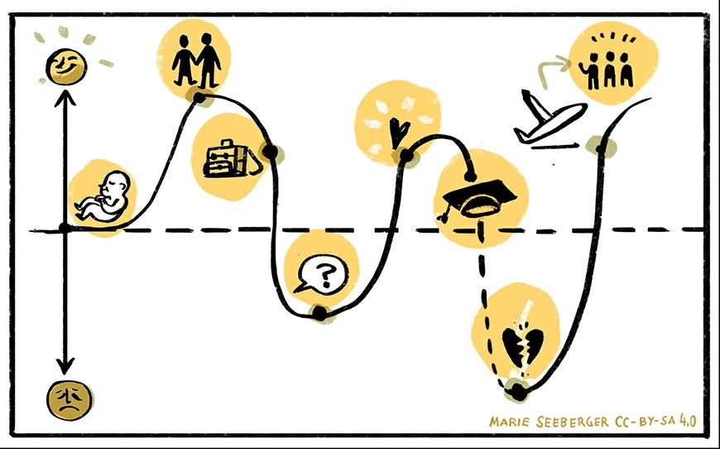
LEAD-IN
CC BY-SA 4.0 „New York“ Source: Adelheid Iken (2010)
CC BY-SA 4.0 Source: Marie Seeberger (2016)
Notes:
This is one example for drawing a life-path showing the ups and downs in your life which you could use to illustrate what you took away from these experiences.

Slide 11
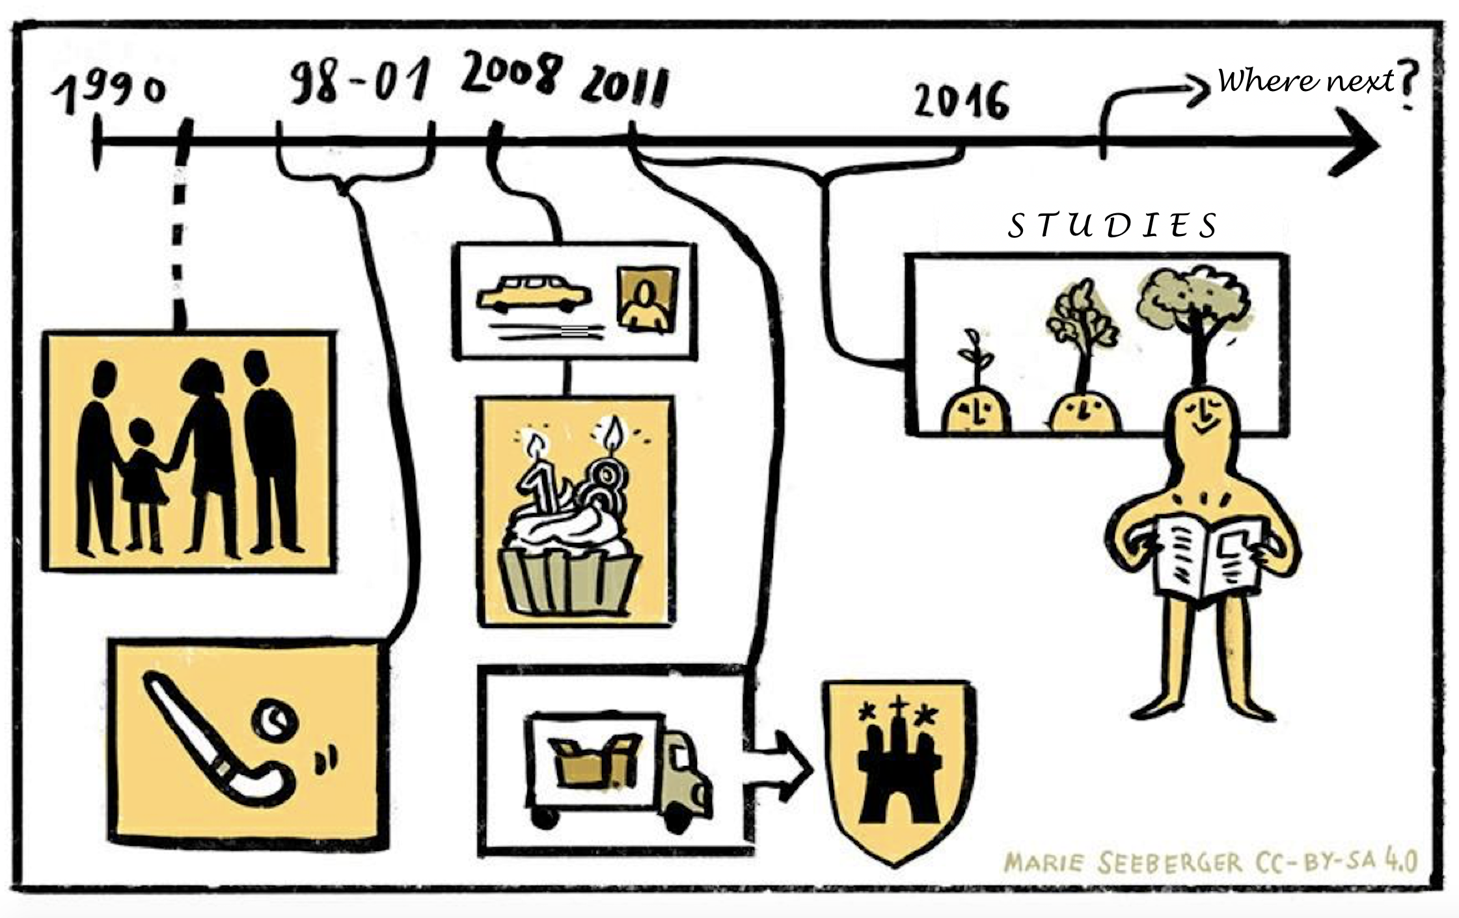
LEAD-IN
CC BY-SA 4.0 „New York“ Source: Adelheid Iken (2010)
CC BY-SA 4.0 Source: Marie Seeberger (2016)
Notes:
This is another option to illustrate your life path using a life-line.

Slide 12

LEAD-IN
CC BY-SA 4.0 Source: Marie Seeberger (2016)
Notes:
The third example shows different life events such as getting a dog, which may have helped you to assume responsibility, for example. These are just three examples. You can of course develop other additional formats that you feel are appropriate.

Slide 13
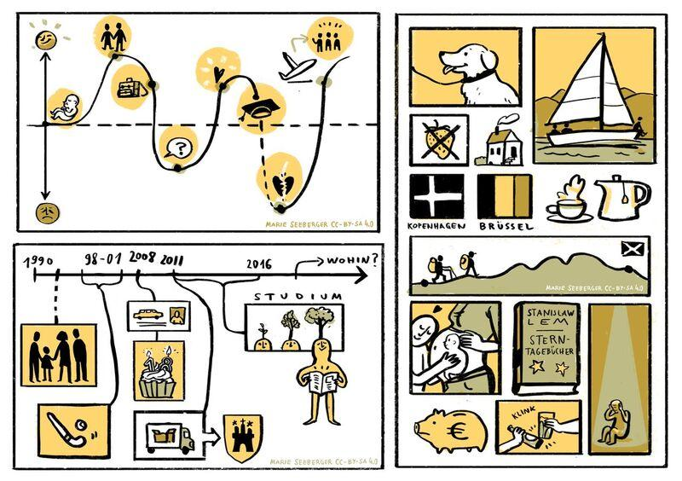
LEAD-IN
CC BY-SA 4.0 Source: Marie Seeberger (2016)

Slide 14
MULTI-COLLECTIVITY AS A CONCEPT
The concept itself
Collectives refer to groups of people who share social habits
Collectives can be linked to families, professions, sports, gender, experience, migration history and age, for example
Collectives can have different sizes, a distinction can be made between roof and sub-collectives
The smaller a collective is, the easier is it to carry out a ‘thick description’
We are all members of many different collectives
Notes:
In his book Hansen (2009) calls for an open definition and understanding of culture. This requires moving away from considering culture for example solely in relation to a ‘passport identity’ or as ‘ethnic groups’ such as the offspring of Turkish migrants in Germany or British pensioners moving to France and living in a kind of ‘cultural enclave’. He postulates that there is a vast number of collectives that influence our lives. These could be religion, regions, villages, clubs, gender, even hair colour (blonde) as well as many others.
We can categorise these memberships into those which are natural, such as gender or age, and into collectives that are based on common interests such as sports, or into abstract collectives such as being blonde.
He also proposes a distinction between roof-collectives and collectives of a first order or sub-collectives. Collectives of a first order are made up of individuals and are small collectives. Collectives of a second order are, for example, the Catholic Church, universities, regions. These roof-collectives are also characterised by a greater heterogeneity than sub-collectives. He considers modern pluralistic nations such as Germany to be a third-grade collective or a poly-collective.

Slide 15
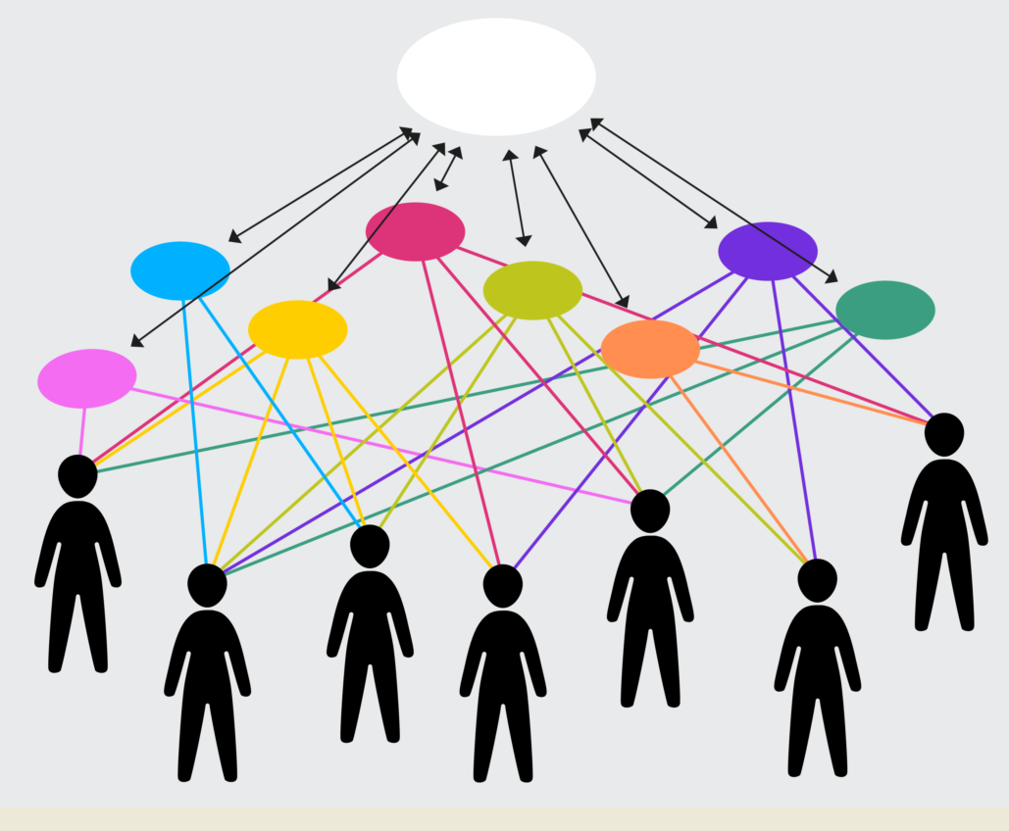
MULTI-COLLECTIVITY AS A CONCEPT
The concept itself
Roof- collective
Sub -
collectives
CC BY-SA 4.0 Source: Julia Flitta (2017) based on Yildirim-Krannig, Y. 2014, p.212
Notes:
This picture illustrates a number of issues:
Members of the same roof-collective are members of many different or the same sub-collectives. Germany for example can be considered a roof-collective and people who have two pass-ports may identify with two different national roof-collectives. People belonging to the German roof-collective may follow the way of Buddha and thus consider themselves to be members of the sub-collectives of Buddhists. They share this membership with many other people attempting to follow the teachings and practices of Buddha. Other sub-collectives are for example your family, your sports-club, and the university where you study.
Members of a collective share a relationship with certain conventions and values. Considering sub-collectives and multi-collectivity thus enables us to study small entities and depicting commonalities among its members. At the same time it means acknowledging the diversity within a society.
This picture also illustrates the fact that roof-collectives are influenced by sub-collectives and vice versa. If we consider the example of the sub-collective of Buddhists, we can see that their mental and moral path may, in the long run, have an influence on the roof-collective and other sub-collectives. Indicators of this are that mindfulness and mindfulness practices, which appear to have their roots in Buddhism and Hinduism are increasingly finding their way into ordinary life, business and management.

Slide 16
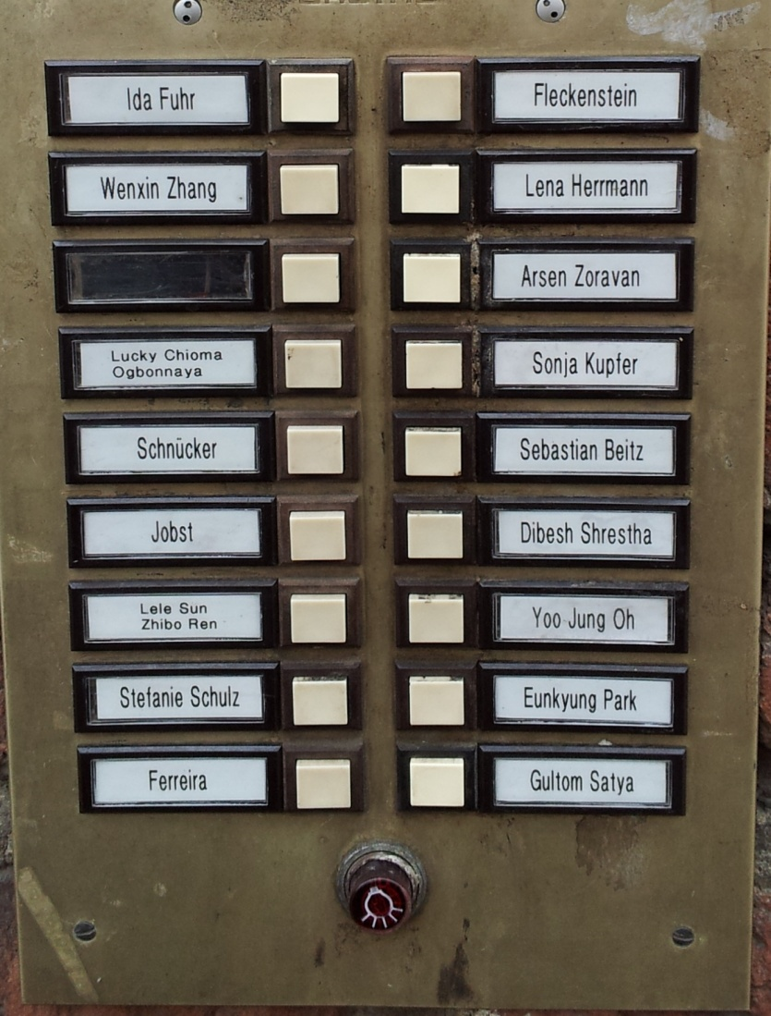
MULTI-COLLECTIVITY AS A CONCEPT
Reasons to consider multi-collectivity
Growing cultural plurality
within countries
CC BY-SA 4.0 „Germany“ Source: Adelheid Iken (2013)
Notes:
If we consider these name-plates, we can say that there is a likelihood that some of the inhabitants have roots or connections to countries outside of Germany. Whether the inhabitants are born here is not known, and if this is indeed the case, for how long the inhabitants have lived here in Germany is also uncertain. Do we know what they share other than living in the same house? Would such knowledge help us when interacting with them? Although this could be debated, the name plates suggest a diversity of cultural orientations and thus we might call this cultural plurality. Cultural plurality here is understood in a descriptive sense to acknowledge the range of cultural orientations within a society and thus membership of different sub-collectives.

Slide 17
MULTI-COLLECTIVITY AS A CONCEPT
Reasons to consider multi-collectivity
Estimated number of speakers of top 20 languages in London, 2000
83,9% 2,3% 2,2% 2,0% 2,0%
83,9% 2,3% 2,2% 2,0% 2,0%
Source: Cf. Vertovec, Steven. 2007, p.1035
83,9% 2,3% 2,2% 2,0% 2,0%
Notes:
The chart indicates that there are many people in London who do not speak English as their main language. Vertovec, referring to a survey carried out by Storkey, estimated that among 897,743 schoolchildren in London in 2000, there are 300 languages spoken. The children reported actually speaking these languages at home. This means that a country, and a city for that matter, has to meet the challenges of multilingualism, e.g. in terms of offering and providing translation and interpretation services, but also in terms of taking note and appreciating that children and adults are multi-lingual.

Slide 18
MULTI-COLLECTIVITY AS A CONCEPT
Reasons to consider multi-collectivity
Countries of Immigration
to Germany 2015
15,3%
10%
Other countries
of origin
41,8%
9,2%
Bundesamt für Migration und Flüchtlinge (BAMF) 2015. Migrationsbericht 2015, p.33; Data source: Statistisches Bundesamt
4,4%
Notes:
Source: Bundesamt für Migraton und Flüchtlinge (BAMF) 2015. Migrationsbericht 2015, p.33; Data source: Statistisches Bundesamt
The chart indicates the countries from which migrants came in 2015. Not surprisingly, the largest number of migrants in 2015 came from Syria, followed by people from Romania and Poland.
In the 1970s, this picture looked very different and people migrating to Germany predominantly came from Italy, Greece, Spain, Turkey and the former Yugoslavia. Indeed, they came under the so called ‘guest worker scheme’.
Comparing this to current migration patterns, it becomes evident that the Germany of today is experiencing an influx of people from many different countries and continents. These migration patterns clearly show that Germany, like many other European countries, is experiencing super-diversity, which in turn supports the notion of multi-collectivity.

Slide 19
MULTI-COLLECTIVITY AS A CONCEPT
Reasons to consider multi-collectivity
Poland
Target countries of people who left Germany in 2015
15,3%
13,9%
13,9%
13,3%
13,3%
12,9%
12,7%
Romania
38,3%
Other
countries
Bundesamt für Migration und Flüchtlinge (BAMF) 2015. Migrationsbericht 2015, p. 33; Data source: Statistisches Bundesamt
47,2%
4,6%
Bulgaria
12,8%
3,8%
Italy
13,3%
3,8%
Hungary
4,7%
Serbia
3,8%
US
3,8%
Notes:
Source: Bundesamt für Migraton und Flüchtlinge (BAMF) 2015. Migrationsbericht 2015, p.33; Data source: Statistisches Bundesamt
The chart indicates target countries of people who left Germany in 2015 which supports the notion of mobility with both inward and outward migration.

Slide 20


MULTI-COLLECTIVITY AS A CONCEPT
Reasons to consider multi-collectivity
Increasing mobility of people
German students abroad in 2013, by host region
Western Europe
77,7%
Eastern Europe
5,2%
North America
9,0%
Asia
5,4%
Deutscher Akademischer Austauschdienst (DAAD) 2016. Wissenschaft weltoffen: Daten und Fakten zur Internationalität von Studium und Forschung in Deutschland, p.38 (13.8.2018), Picture: Pixabay
Africa
0,7%
South and Central
America
0,3%
Australia and
Oceania
1,8%
Notes:
A growing number of students are go abroad for one term or even complete their Bachelor or Master degree abroad. This has an influence on their personal cultural orientation as they learn other ways of doing things and these experiences are likely to influence their behavioural patterns.

Slide 21
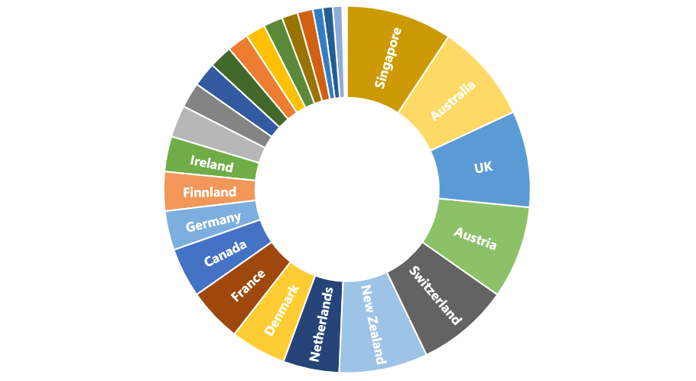
MULTI-COLLECTIVITY AS A CONCEPT
Reasons to consider multi-collectivity
Increasing mobility of people
International students in
selected host countries in 2013
Top 5 countries:
Singapore 19.2%
Australia 18.0%
UK 17.5%
Austria 16.8%
Switzerland 16.8%
15,3%
13,3%
12,7%
47,2%
Deutscher Akademischer Austauschdienst (DAAD) 2016. Wissenschaft weltoffen kompakt: Facts and Figures on the International Nature of Studies and Research in Germany, p. 20 (13.8.2018)
4,6%
3,8%
4,4%
Notes:
In per cent of all students in the relevant country In addition we can observe a growing number of students who come from abroad to study in Germany and other countries for a term or two, thus bringing their own cultural orientation and experience into the seminar room. The chart shows that Singapore and Australia, as well as the UK, are preferred destinations for students studying abroad.

Slide 22
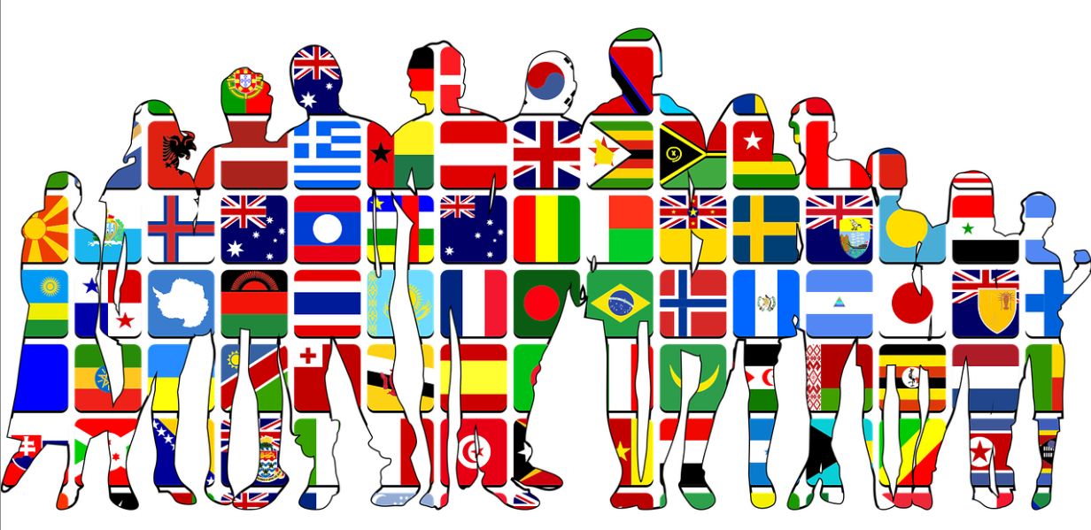
MULTI-COLLECTIVITY AS A CONCEPT
Reasons to consider multi-collectivity
Increasing international and cross-cultural connections, family biographies and multi-rootedness
15,3%
13,3%
12,7%
CC0 Source: pixabay
47,2%
4,6%
3,8%
4,4%
Notes:
In September 2015, the main title of the GEO-magazine was ‘Germany remixed’, showing that a growing number of people living in Germany have what could be called an ‘international family tree’. The magazine for example relates to Julia Dalia, who has family links to Germany, Ghana, Togo as well as the Czech Republic. Apparently there are one million people in Germany who share such multi-rootedness. Considering multi-collectivity enables women such as Julia Dalia to define which collective she perceives herself to be a member of. Depending on circumstances, personal preferences and situation, she may for example consider herself to be Ghanaese and/or German and/or Togolese. (cf. http://www.geo.de/magazine/geo-magazin/13177-geo-nr-09-15-deutschland-remixed-die-neuen-gesichter-unserer-gesellschaft)

Slide 23
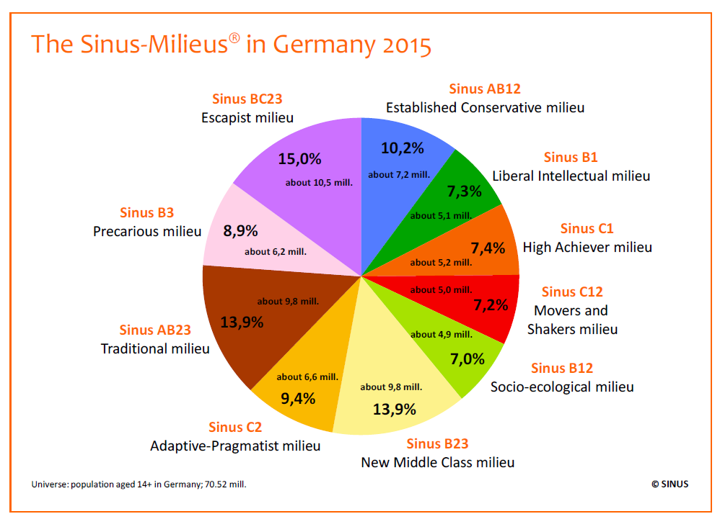
MULTI-COLLECTIVITY AS A CONCEPT
Reasons to consider multi-collectivity
Diversity of lifestyles and milieus within countries
15,3%
13,3%
12,7%
47,2%
4,6%
Source: SINUS-Institut 2015. Information on Sinus-Milieus, p. 13; used by permission
3,8%
4,4%
Notes:
Source: SINUS-Institut 2015. Information on Sinus-Milieus. https://www.sinus-institut.de/fileadmin/user_data/sinus-institut/Downloadcenter/20150805/2015-01-15_Information_on_Sinus-Milieus_English_version.pdf p. 13
The Sinus Institute has been researching people’s values and everyday life worlds for decades. The results for Germany in 2015 can be seen in this diagram, which is able to depict a variety of lifestyles and values, as well as highlight the diversity of life-world orientation within Germany. By providing descriptions of people’s orientation, their values, life goals, attitudes and social backgrounds, it is possible to take a holistic view of the people researched without ignoring the differences in life-worlds. The boundaries between the milieus are fluid, which would indicate that it is seemingly impossible to clearly delimit life-worlds, while it also shows that there are points of contact and transition between the different milieus. And the life worlds are in a flux despite the fact, that basic values tend to be fairly stable.
The chart shows the result of a recent study (2015) and differentiates between ten life-worlds and considers educational background and social strata as well as basic value orientations such as being rooted in and clinging on to traditions, being modern and individualistic, valuing self-realisation, being post-modern, enjoying multiple options, being explorative as well as trying to overcome limitations.
For example people positioning themselves in the conservative milieu tend to be family and homeland oriented, firmly committed to traditional values and appropriate responsibility in this regard. In contrast members of the socio-ecological milieu are idealistic, discerning consumers with normative notions of a sustainable social and ecologically conscious lifestyle. They have a basically sceptical approach to life and are open to alternative ways of living.
Another example is the adaptive-pragmatic milieu which relates to the ambitious core of society with a markedly pragmatic outlook on life and a sense of expedience. They are success-oriented and prepared to compromise as well as being hedonistic and conventional, flexible and security-oriented. The experimental hedonists are non-conformists who are oriented towards having fun and exploring new trends with a focus on living in the here and now. Another example are members of the precarious milieu who are in search of orientation and social inclusion, with strong anxieties about the future and a sense of resentment and bitterness.

Slide 24
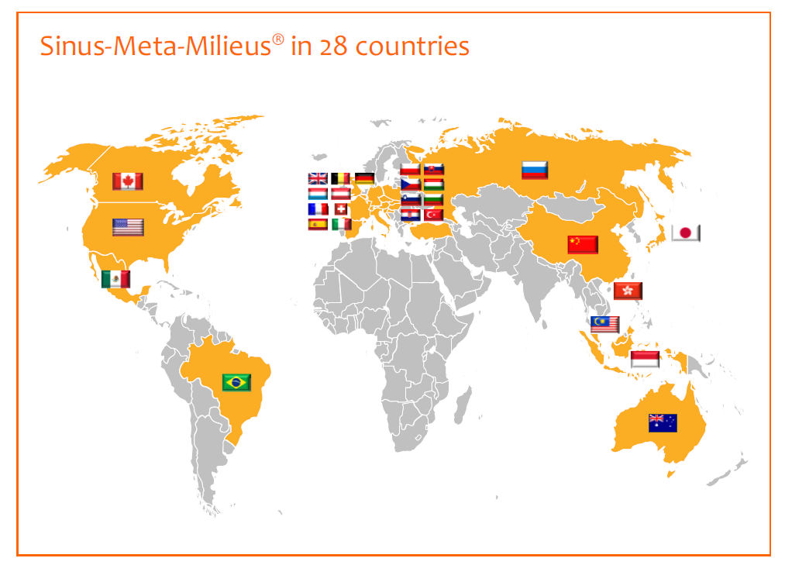
MULTI-COLLECTIVITY AS A CONCEPT
Reasons to consider multi-collectivity
Source: SINUS-Institut 2015. Information on Sinus-Milieus, p.22, used by permission
Notes:
Source: SINUS-Institut 2015. Information on Sinus-Milieus. https://www.sinus-institut.de/fileadmin/user_data/sinus-institut/Downloadcenter/20150805/2015-01-15_Information_on_Sinus-Milieus_English_version.pdf p.22
On the one hand values, life styles as well as life strategies are heterogonous within a country and on the other hand, transnational similarities can be found. The above chart shows the 28 countries for which information considering groups of ‘like-minded people’ is being provided for on the following chart.

Slide 25
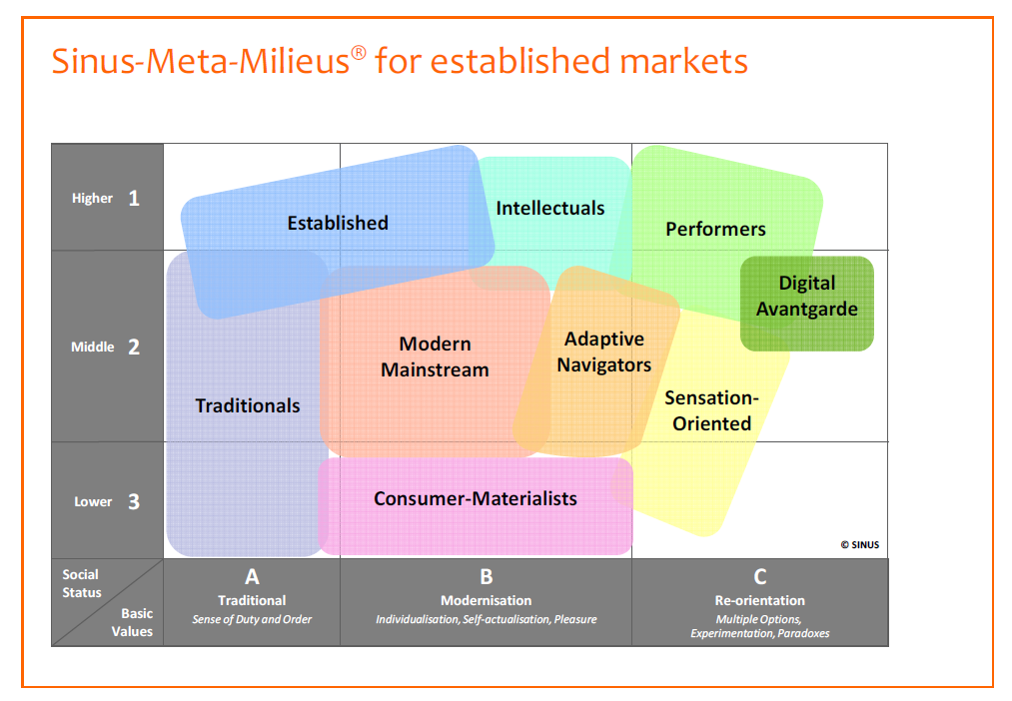
MULTI-COLLECTIVITY AS A CONCEPT
Reasons to consider multi-collectivity
Source: SINUS-Institut 2015. Information on Sinus-Milieus, p.23; used by permission
Notes:
Source: SINUS-Institut 2015. Information on Sinus-Milieus. https://www.sinus-institut.de/fileadmin/user_data/sinus-institut/Downloadcenter/20150805/2015-01-15_Information_on_Sinus-Milieus_English_version.pdf p.23
The above chart indicates what Sinus has termed ‘transnational Meta-Milieus. They describe the life worlds of consumers in holistic terms and allow to carry compare countries. What the results show is that there are people from different countries who are members of comparable milieus. This means that they have more to share and in common with each other than with other people from other milieus in their own country.

Slide 26
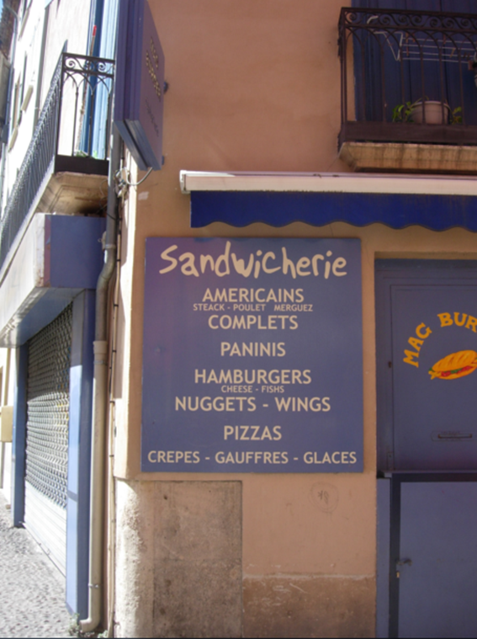
MULTI-COLLECTIVITY AS A CONCEPT
Reasons to consider multi-collectivity
Culture relates to groups
of people
15,3%
12,7%
47,2%
3,8%
4,4%
CC BY-SA 4.0 „ Barcelona“ Source: Adelheid Iken (2008)
Notes:
A sandwich is commonly understood to be two pieces of bread with food such as vegetables, sliced cheese or meat in between, which is eaten as finger food. It is considered to have its origin in the 18th century in Great Britain with John Montagu, the 4th Earl of Sandwich being its namesake. In the 19th century its popularity as a lunch option increased in Spain and England when the rise of industrial society and the working class made it necessary to eat while away from home. In Spain, where the word Sandwich is borrowed from the English language, it commonly refers to food made from English soft sandwich bread. But it appears as if a sandwicherie as seen on this picture is used in a much wider sense, encompassing different forms of snacks and luncheons such as Americains, Hamburgers and crepes. Sandwicherie may be translated by sandwich bar or sandwich shop. What this example shows is how elements of a culture can become mixed, changed and amended, thereby at times changing meaning and content.
The verb sandwich means anything between two other things of different character. For example, Andorra is sandwiched between Spain and France.

Slide 27
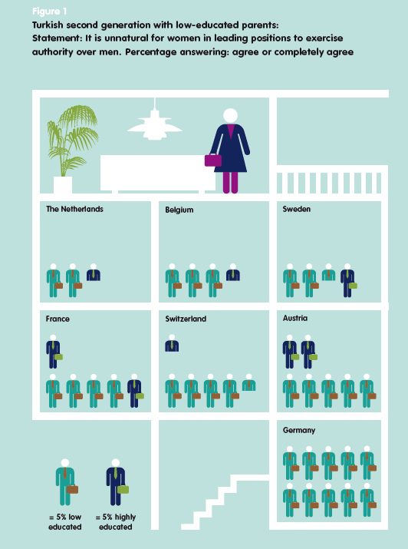
MULTI-COLLECTIVITY AS A CONCEPT
Reasons to consider multi-collectivity
Developing an open mind for commonalities
15,3%
13,3%
12,7%
47,2%
CC BY Source: Schneider, Jens; Crul, Maurice & Frans Lelie. 2015. Generation Mix. Die superdiverse Zukunft unserer Städte und was wir daraus machen. Münster: Waxmann www.waxmann.com/buch3182 Infographic by A. Vlasblom von Zeppa (Amsterdam); used by permission
4,6%
3,8%
4,4%
Notes:
Schneider et al. 2015 researched into second generation migrants with a focus on immigrants of Turkish decent, who make an ideal group for large scale research and comparison in Western Europe comprising more than 4 million people. One of the author’s major messages and findings is that the offspring of Turkish migrants are a very heterogeneous group. For example, the figure above shows refers to whether it is unnatural for women in leading positions to exercise authority over men, and finds that there is a quite different response depending on the country. Therefore, simply labelling and clustering second generation migrants would not do them justice and would completely ignore the wide variety of orientations and lifestyles as well as many other variables.
The authors further maintain that the different countries have obviously shaped the integration of migrants in very different ways and that it is actually the way education is structured and how the transition to the labour market is organised which profoundly contributed to this.
The authors also argue and show evidence that the cultural and social differences within the group of second generation migrants are often even larger than their differences to the old majority group. In other words, it can be helpful not to focus on the perception of differences due to a family history of migration but to concentrate on the similarities which may exist with people who do not have a family history involving migration.

Slide 28
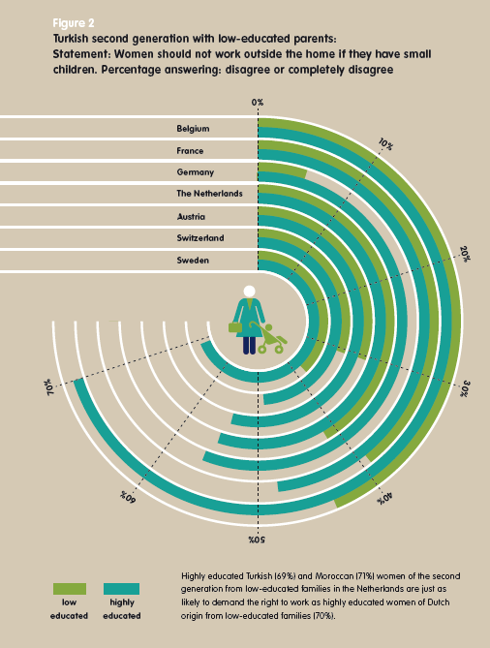
MULTI-COLLECTIVITY AS A CONCEPT
Reasons to consider multi-collectivity
Developing an open mind for commonalities
15,3%
13,3%
12,7%
47,2%
CC BY Source: Schneider, Jens; Crul, Maurice & Frans Leslie 2015. Generation Mix. Die superdiverse Zukunft unserer Städte und was wir daraus machen. Münster: Waxmann. www.waxmann.com/buch3182. Infographic by A. Vlasblom von Zeppa (Amsterdam), used by permission
4,6%
3,8%
4,4%
Notes:
This figure is interesting because it deals with the fairly commonly held stereotype that many, if not most, migrants of Turkish or Moroccan decent would agree with the statement that women should not work outside the home while the children are still small. Again, this shows that the responses differ across countries and that education obviously has a strong impact on the findings.

Slide 29
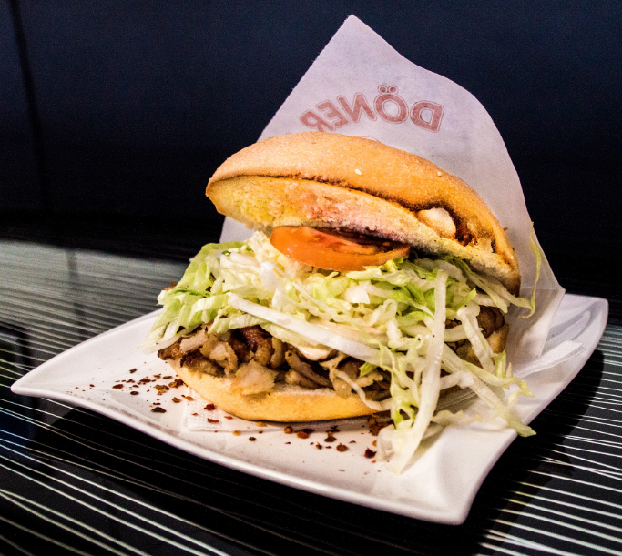
MULTI-COLLECTIVITY AS A CONCEPT
Reasons to consider multi-collectivity
‘Creolisation’ where the mixing of cultural elements leads to something new
15,3%
13,3%
CC0 Source: pixabay
12,7%
47,2%
4,6%
3,8%
4,4%
Notes:
The so called Döner originates in Turkey, but there it was not eaten as fast food. The Döner as we know it today was developed in Germany, and most likely in Berlin, as the most popular telling of its history goes. Today it is one of the most popular fast foods in Germany and is now also starting to catch on in many other parts of the world. Because there are so many Döner shops in Berlin, it is also called Berlin Döner in Istanbul. Unlike in Turkey, in Germany salad and sauces are served in the bread along with the meat. It is an example showing that cultures and cultural elements can be mixed and this can can develop into something new.

Slide 30
MULTI-COLLECTIVITY AS A CONCEPT
Reasons to consider multi-collectivity
Super-diversity
Linked to:
  An unprecedented level of diversity
  The need to acknowledge more variables
  The greater speed, scale and spread of diversity
  The re-ordering of society in economic, social and cultural perspective, and
  The normalisation of diversity in everyday life
Notes:
The term super-diversity was coined by Steven Vertovec in 2005. It is similar to the term hyper-diversity, or generation mix as Jens Schneider calls the current generation, the terms refers to a level of diversity among societies not experienced before and it acknowledges the diversity factors and variables that influence our social interaction. Although Vertovec specifically refers to the situation in Great Britain, where the social landscape has been transformed drastically through migration processes over the last decades, the arrival of new migrants has led to the emergence of an unprecedented variety of cultures in most countries of Western Europe, including multiple identities, faiths and languages, which in turn has led to the establishment of minority populations in many other European and non-European countries and thus to a new and unprecedented level of diversity.
A further concept is “diversity within diversity’, referring to the fact that rather than simply acknowledging ‘the migrant’, we can observe a large degree of variation in migration histories, educational backgrounds, faiths, length of residence and economic backgrounds. Super-diversity should be seen as a lens through which intercultural communication can be analysed.
Apart from the diversification induced by migration or immigration, there is also a need to acknowledge further variables that influence social relations and behavioural patterns. People today are strongly influenced by social media, and other variables which are of relevance, but which have received less attention in the past such as gender, social status and power structures to name just a few.
The speed, scale and spread of diversity has reached previously unknown levels. People increasingly have more and better opportunities to relocate, whether it be for leisure, work, political or economic reasons and therefore increase their horizons and cultural orientations. The speed with which diversification is taking place and the spread of diversity is challenging our political, economic and social systems. Indeed, we are only beginning to understand the changes and challenges that are linked to these developments.
And finally, the concept of super-diversity also takes cognisance of the fact that for many diversity has become a normal occurrence.

Slide 31
MULTI-COLLECTIVITY AS A CONCEPT
Reasons to consider multi-collectivity
The concept of multi-collectivity acknowledges
an unprecedented level of diversity;
the many dynamics and challenges linked to the growing cultural pluralism within societies and multifaceted identities;
the complexity and multiple, cross-cutting categories of ‘difference’
the collectively shared in contrast to individual identities
Notes:
Cultural pluralism is distinct from the general understanding of multiculturalism where minority groups are expected to assimilate into the mainstream group.

Slide 32
MULTI-COLLECTIVITY AS A CONCEPT
Reasons to consider multi-collectivity
The concept of multi-collectivity
is an antidote to categorising people according to nationality
considers individual differences and self-identification
requires re-tooling regarding cross-cultural communication
requires a rethinking of concepts and approaches commonly used in cross-cultural interaction

Slide 33

MULTI-COLLECTIVITY AS A CONCEPT
Membership of different collectives
Different collectives you may be a member of:
Cultural heritage
Languages you speak
The countries you know a lot about
Age
Professional status
Membership of a sports club
Love for classical music
The study course you chose
The cultural elements you have adopted
Personal background
…..
…..
CC0 Source: pixabay
Notes:
Ask students to think about different collectives they are a member of and what the characteristic features of these collectives are, e.g. being a member of a volleyball team enhances values such as team spirit and fighting for a common goal.

Slide 34
MULTI-COLLECTIVITY AS A CONCEPT
Membership of different collectives
Look back at the ‘journey of life’ activity you did at the beginning of the session. Use this as a basis to identify the different sub-collectives you are a member of.
For each of the sub-collectives that you belong to, please note down in a few sentences what is typical about them or what characterises them.
Notes:
When carrying out this task, the focus should be on the micro-perspective.

Slide 35
MULTI-COLLECTIVITY AS A CONCEPT
The common triangle
The common triangle refers to:
a summary of things we share and where we differ
differences and commonalities which influence inter-
actions at work, during leisure time and in other social encounters

Slide 36
MULTI-COLLECTIVITY AS A CONCEPT
The common triangle
Imagine that you are expected to work together in a team of three
What elements do you consider to be vital when you want to work together (e.g. personal characteristics, cultural and situational variables)?
List about ten of these using the information from your life journey and the analysis of your membership of different collectives.
Get together in groups of three and in turn explain the items you have chosen.
Discuss and try to establish a common meaning for these.
Search for commonalities and differences among the three of you. These may be found between person A and B, B and C or A and C only. Also take note of things you all share and those which are unique to one person.
Use the results to develop a common triangle.

Slide 37
MULTI-COLLECTIVITY AS A CONCEPT
The common triangle
Sit together in a team of three and develop a common ground triangle.
Person A (what is unique about him/her)
What A and B have in common
What you all have in common
What A and C have in common
Person B (what is unique about him/her)
Person C (what is unique about him/her)
What B and C have in common
Notes:
The main purpose is to show what two people share, what all share and what is unique to an individual.
For example, you may all share a good knowledge of English and the same motivation for studying the program you are joining. But A and B may have in common that they both spent a semester in Australia and therefore may have an understanding of everyday working customs.

Slide 38
MULTI-COLLECTIVITY AS A CONCEPT
The common triangle
Choose one of the following tasks
Develop a plan for the end of term celebration
Develop ideas for the introduction of a new deodorant for men
Prepare for the introduction of a new intern into the company
You have 20 minutes for the task and are expected to use your knowledge from common triangle to do so
Be ready to present your ideas on a flipchart (5 min)

Slide 39
MULTI-COLLECTIVITY AS A CONCEPT
The common triangle
How can the result of this exercise help you to work well together and benefit from each other’s experiences and knowledge?
Where do you have to negotiate common rules of interaction?

Slide 40
SUMMARY AND REFLECTION
Summary
In a context of growing diversity due to factors such as people’s increasing mobility, exposure to different lifestyles, and the integration of cultural elements into one’s daily life, we need to do justice to the complexity of our social and cultural world. The concept of multi-collectivity has that potential.
By acknowledging membership of different roof and sub-collectives, it is possible to see cultures as entities whose members belong to a variety of collectives. Such collectives may be made up of people sharing a certain interest, locality, social status, profession, and gender to name but a few.
Recognizing that people are members of many and at times very different collectives means that searching for commonalities where one may anticipate differences and thus develop a common ground for understanding can be very fruitful.

Slide 41
SUMMARY AND REFLECTION
Reflection
https://www.youtube.com/watch?v=jD8tjhVO1Tc
Watch the YouTube ‘All that we share’ and use the content to argue why a multi-collective approach is able to deal with the complexity of identities and to find a common ground for interaction that we can use for social and work encounters.
What are the parameters that are used to differentiate groups?
Which ones would you consider to be of particular relevance in a work-context?
How can the understanding of multi-collectivity be used when dealing with cross cultural challenges?

Slide 42
SUMMARY AND REFLECTION
Reflection
The illustration on the following slide shows the life path and cultural profile of a student.
Use this profile to identify several collectives the student is a member of and compare it with your own cultural profile
Where do you find commonalities and differences?
How could knowing about these help you when working together?
What are the benefits of such an approach if you wish to work together?

Slide 43
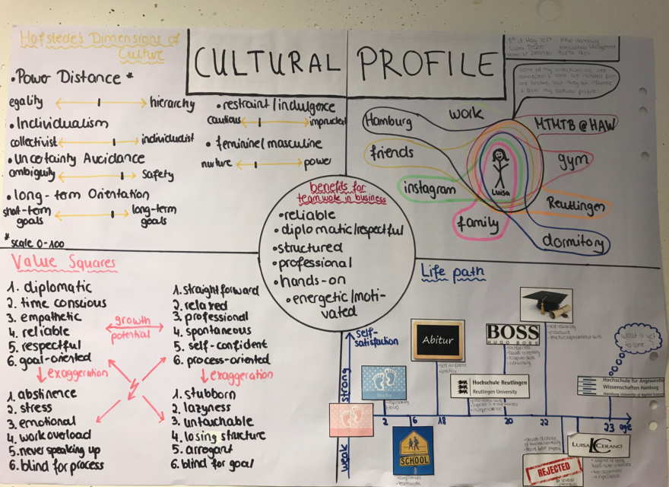
SUMMARY AND REFLECTION
Reflection
CC BY-SA 4.0 „Cultural Profile“ Source: Adelheid Iken

Slide 44
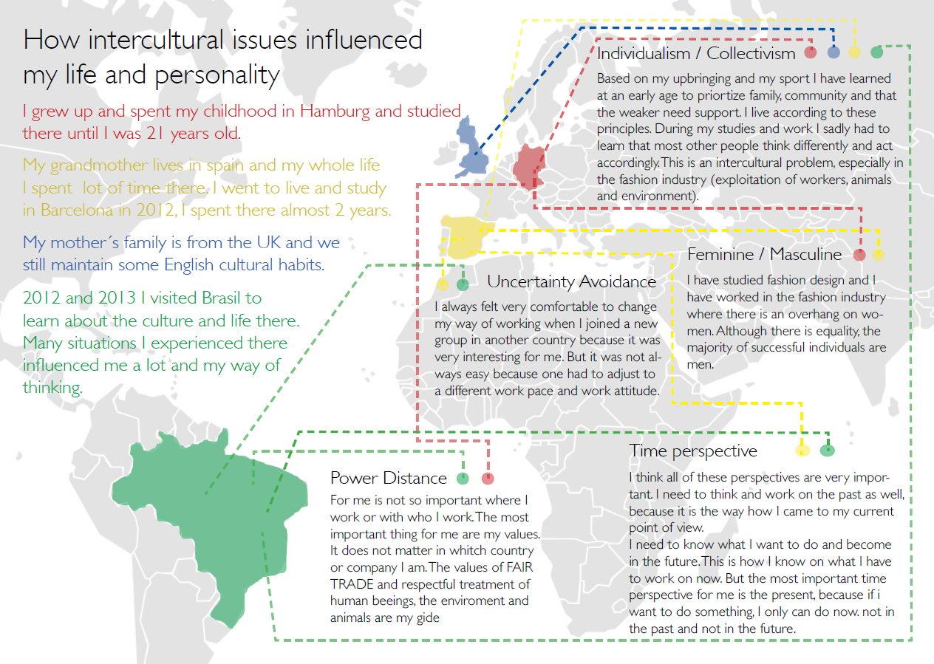
SUMMARY AND REFLECTION
Reflection
CC BY-SA 4.0 „Influences“ Source: Adelheid Iken

Slide 45
ASSIGNMENT
Assignment 1:
Read the biographical notes and analyse the personal journey from a multi-collective perspective
Where, why and how do you think the membership of these collectives may influence the person’s personal cultural orientation?
What type of specific resources such as knowledge, talents, experiences is the writer likely to possess due to his/her membership of different collectives?

Slide 46
SOURCES
Bundesamt für Migration und Flüchtlinge (BAMF) 2015. Migrationsbericht 2015. https://www.bamf.de/SharedDocs/Anlagen/DE/Publikationen/Migrationsberichte/migrationsbericht-2015.pdf?__blob=publicationFile (10.11.2018)
Bolten, Jürgen 2007. Einführung in die Interkulturelle Wirtschaftskommunikation. Göttingen: Vandehoeck & Ruprecht
Bolten, Jürgen 2015. Einführung in die Interkulturelle Wirtschaftskommunikation. Göttingen: Vandenhoeck&Ruprecht (2nd ed.)
Calmbach, Marc et al. 2016. Wie ticken Jugendliche 2016? Wiesbaden: Springer http://www.sinus-institut.de/veroeffentlichungen/buecher-und-artikel/ (14.3.2017)
Crul, Maurice et al. 2013. Super-diversity: A new perspective on integration. Amsterdam:VU University Press https://research.vu.nl/ws/portalfiles/portal/898459/Super-diversity+Crul+et+al+2013.pdf (12.11.2018)
Deutscher Akademischer Austauschdiesnt (DAAD). 2016. Wissenschaft weltoffen kompakt: Daten und Fakten zur Internationalität von Studium und Forschung in Deutschland. http://www.wissenschaftweltoffen.de/publikation/wiwe_2016_verlinkt.pdf (13.8.2018)
Deutscher Akademischer Austauschdienst (DAAD) 2016. Wissenschaft weltoffen kompakt: Facts and figures on the International Nature of Studies and Research in Gerrmany. http://www.wissenschaftweltoffen.de/kompakt/wwo2016_kompakt_en.pdf (13.8.2018)
Hansen, Klaus P. 2009. Kultur, Kollektiv, Nation. Passau: Stutz
Hansen, Klaus P. 2011. Kulturtheorie heute. University Poznan, Polen (23.11.2010). http://www.klaus-p-hansen.de/fileadmin/downloads/kulturtheorie%20heute.pdf (retrieved 2.2.2017).

Slide 47
SOURCES
Köster, Kathrin 2010. International Project Management. London: Sage
Nazarkiewicz, Kirsten 2016. Kulturreflexivität statt Interkulturalität? In IntercultureJournal 15(26); pp.23-32 http://www.interculture-journal.com/index.php/icj/article/view/278/362 (retrieved 2.2.2017)
Schneider, Jens; Crul, Maurice & Frans Lelie. 2015. Generation Mix. Die superdiverse Zukunft unserer Städte und was wir daraus machen. Münster: Waxmann
Vertovec, Steven. 2007. Super-diversity and its implications. In: Ethnic and Racial Studies, 30:6, 1024-1054.
Witchalls, Peter James. 2012 Is national culture still relevant? In: interculturejournal 11 (19); pp.11-18 http://www.interculture-journal.com/index.php/icj/article/viewFile/178/280 (retrieved 13.3.2017)
Yildirim-Krannig, Yeliz 2014. Kultur zwischen Nationalstaatlichkeit und Migration. Plädoyer für einen Paradigmenwechsel. Bielefeld: transcript Verlag

Slide 48

LICENCES
Except where otherwise noted, content in this presentation / on this site is licensed under a
Creative Commons Attribution Share Alike 4.0 International license.

