Slide 1


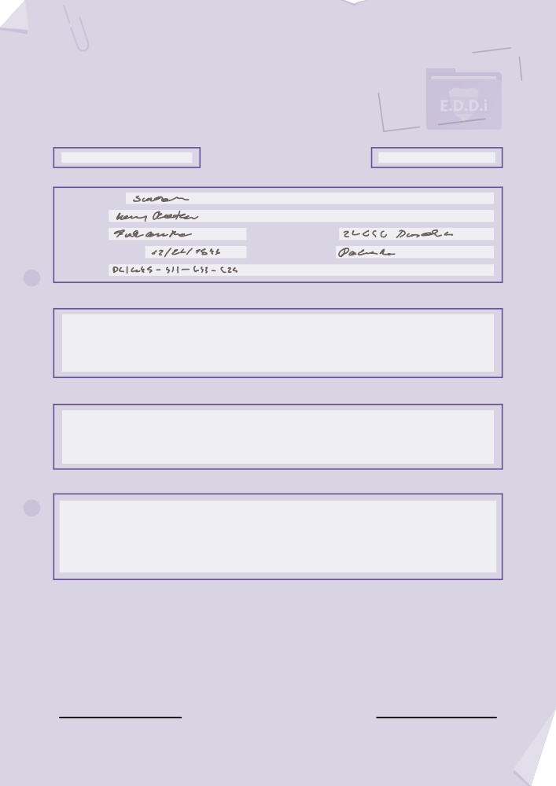


Epidemic Disease
Detectives Hamburg
Epidemic
Disease
Detectives
Hamburg
We want you!
Support our Team E.D.D.i Hamburg and start your journey as a Junior Epidemic Disease Detective!
** Crash Course ** Outbreak Investigation Epidemiological Evaluation Basics of Data Analysis
#protectyourcommunity
Welcome Tutorial
JOIN!
Epidemic Disease Detectives Hamburg

Slide 2
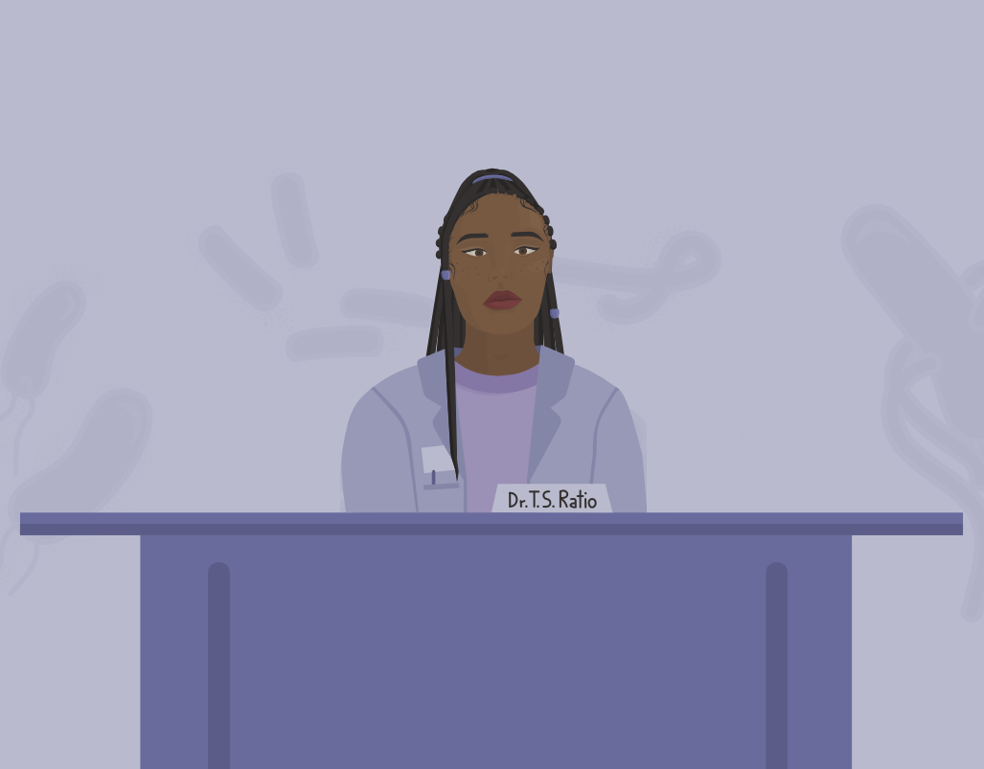

Dear candidates,
Great to welcome you to our Outbreak Investigation Welcome Tutorial!
You are here because you want to become an Epidemic Disease Detective to support our mission to assess, maintain and improve the health and safety of our community.
My name is Todd S. Ratio and I will be guiding you through this crash course.
Infectious Disease Outbreaks: What are they? How do you investigate them? And how do you control them?
This course aims to bring you to the introductory level of outbreak investigation and epidemiological evaluation: the key activities of an Epidemic Disease Detective.
Let's get started!
E.D.D.i Academy
Epidemic Disease Detectives Hamburg

Slide 3
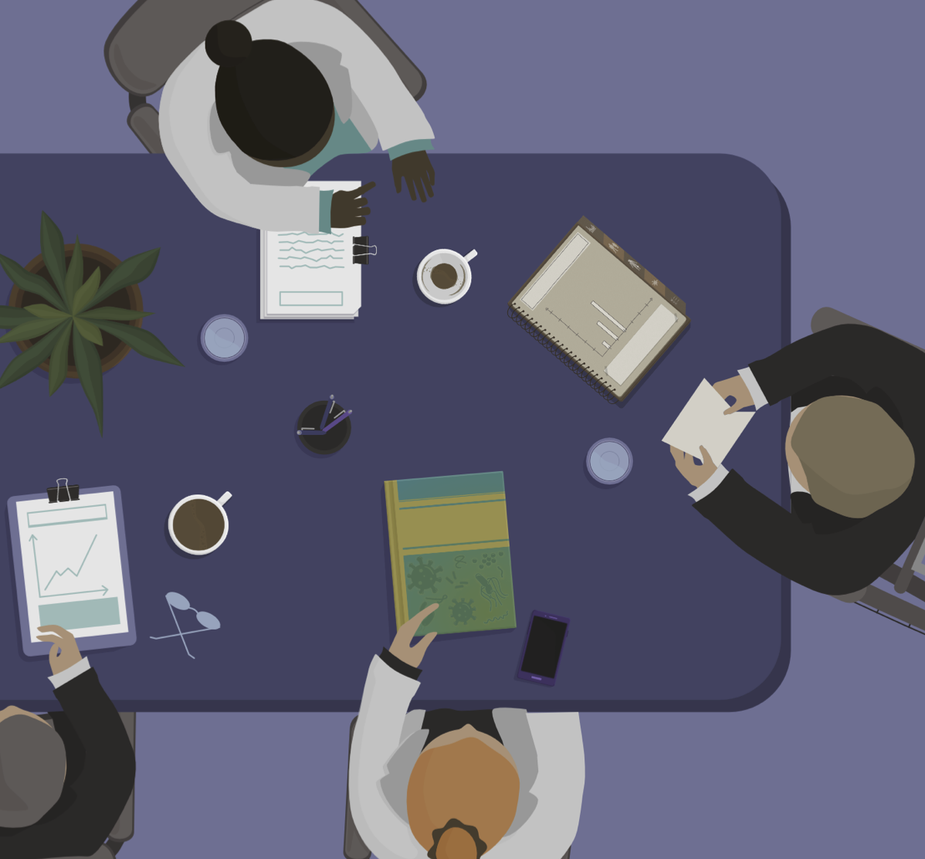




Your very first lesson covers the topic:
Let’s move on, shall we?
OUTBREAKS
Investigation and Control
Just click on the box and watch the video carefully.
Research Methods
Quick Intro
In total, we have prepared six lessons and an epidemiological cheat sheet for you. You can find all materials on the desk by simply clicking on them.
Enjoy the materials!
How to
interpret an epidemiological curve?
Epidemiology
A very short
Introduction
Cohort and Case Control Studies
Epidemic Disease Detectives Hamburg

Slide 4

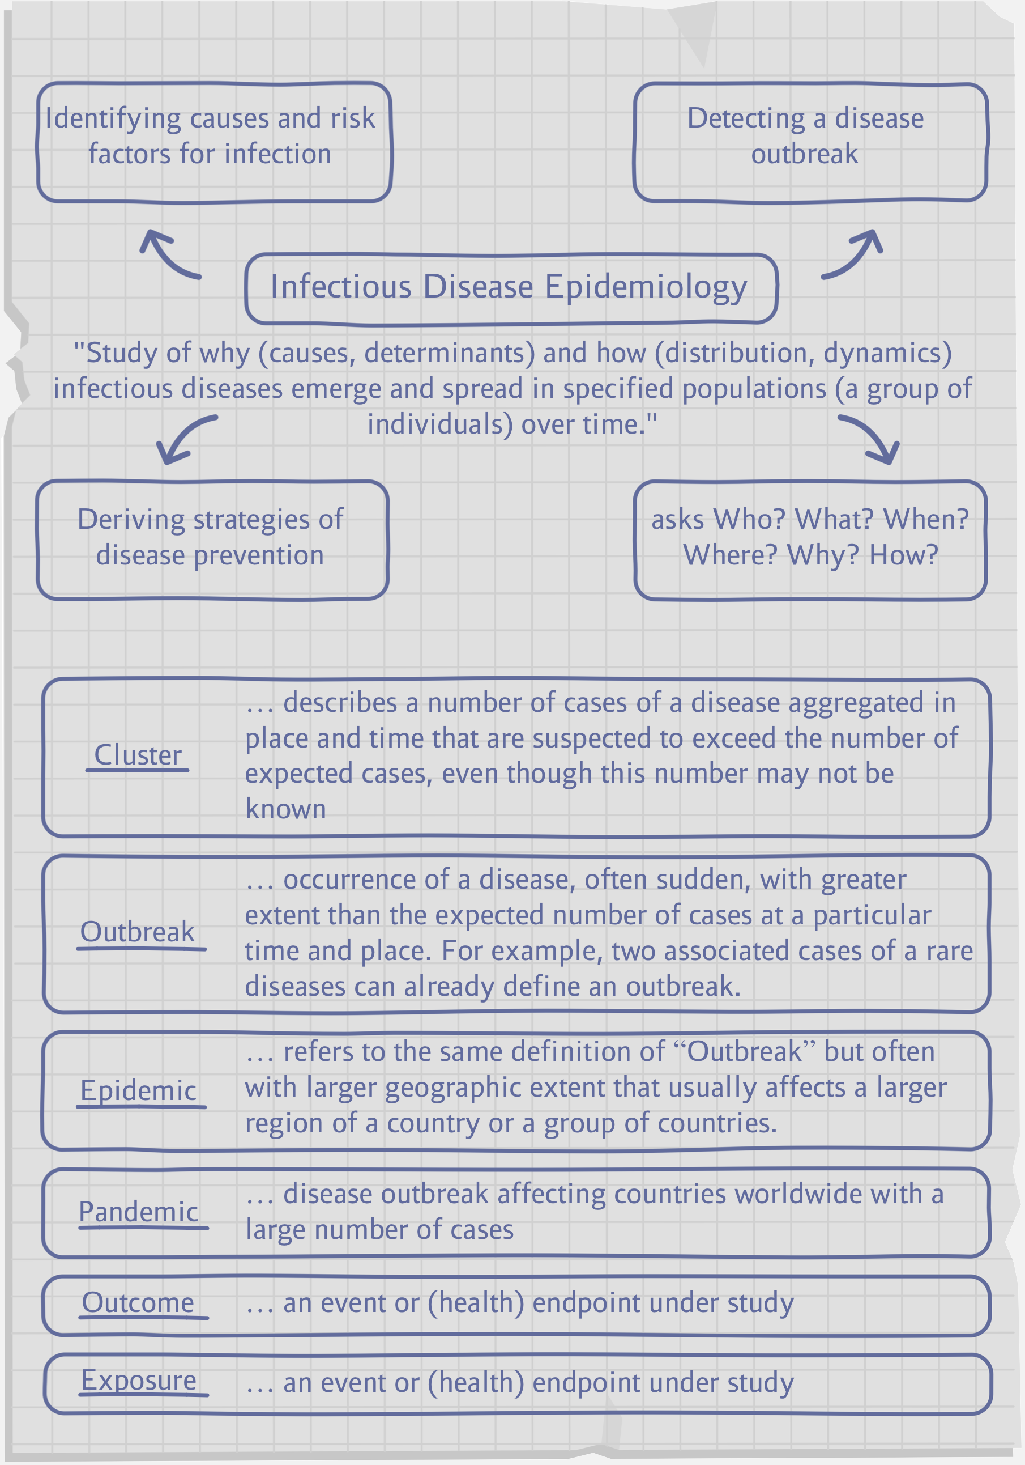
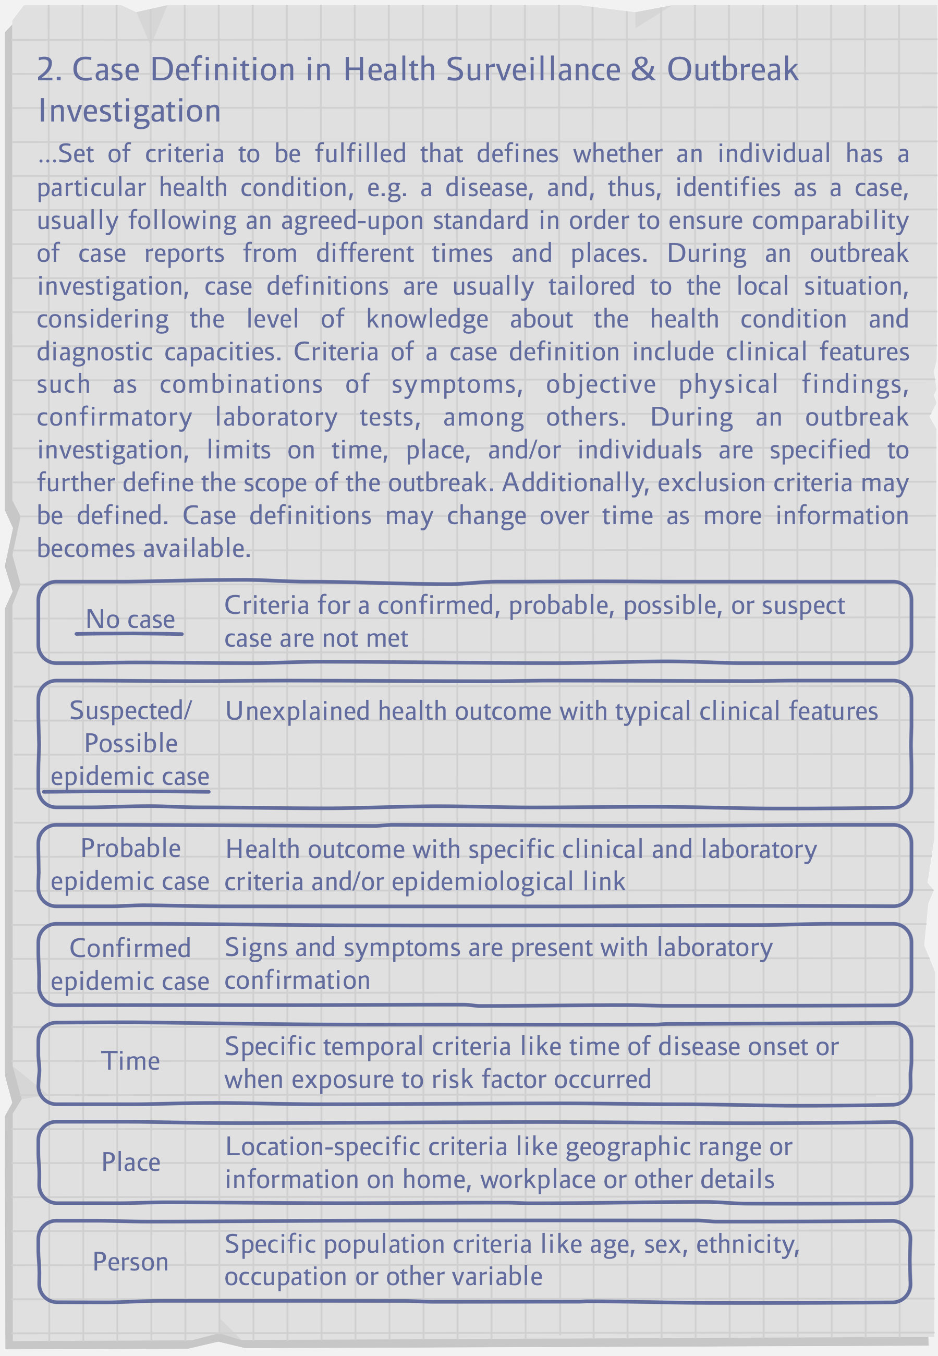
CHEAT SHEET
Epidemic Disease Detectives Hamburg

Slide 5
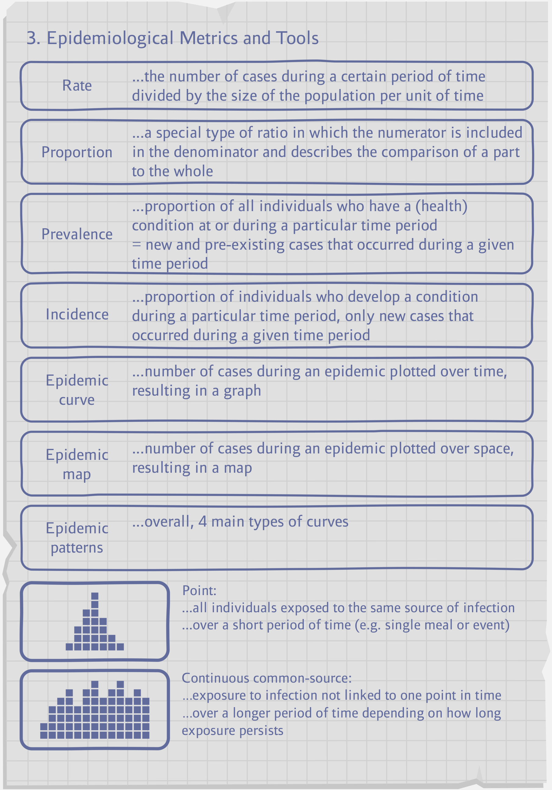
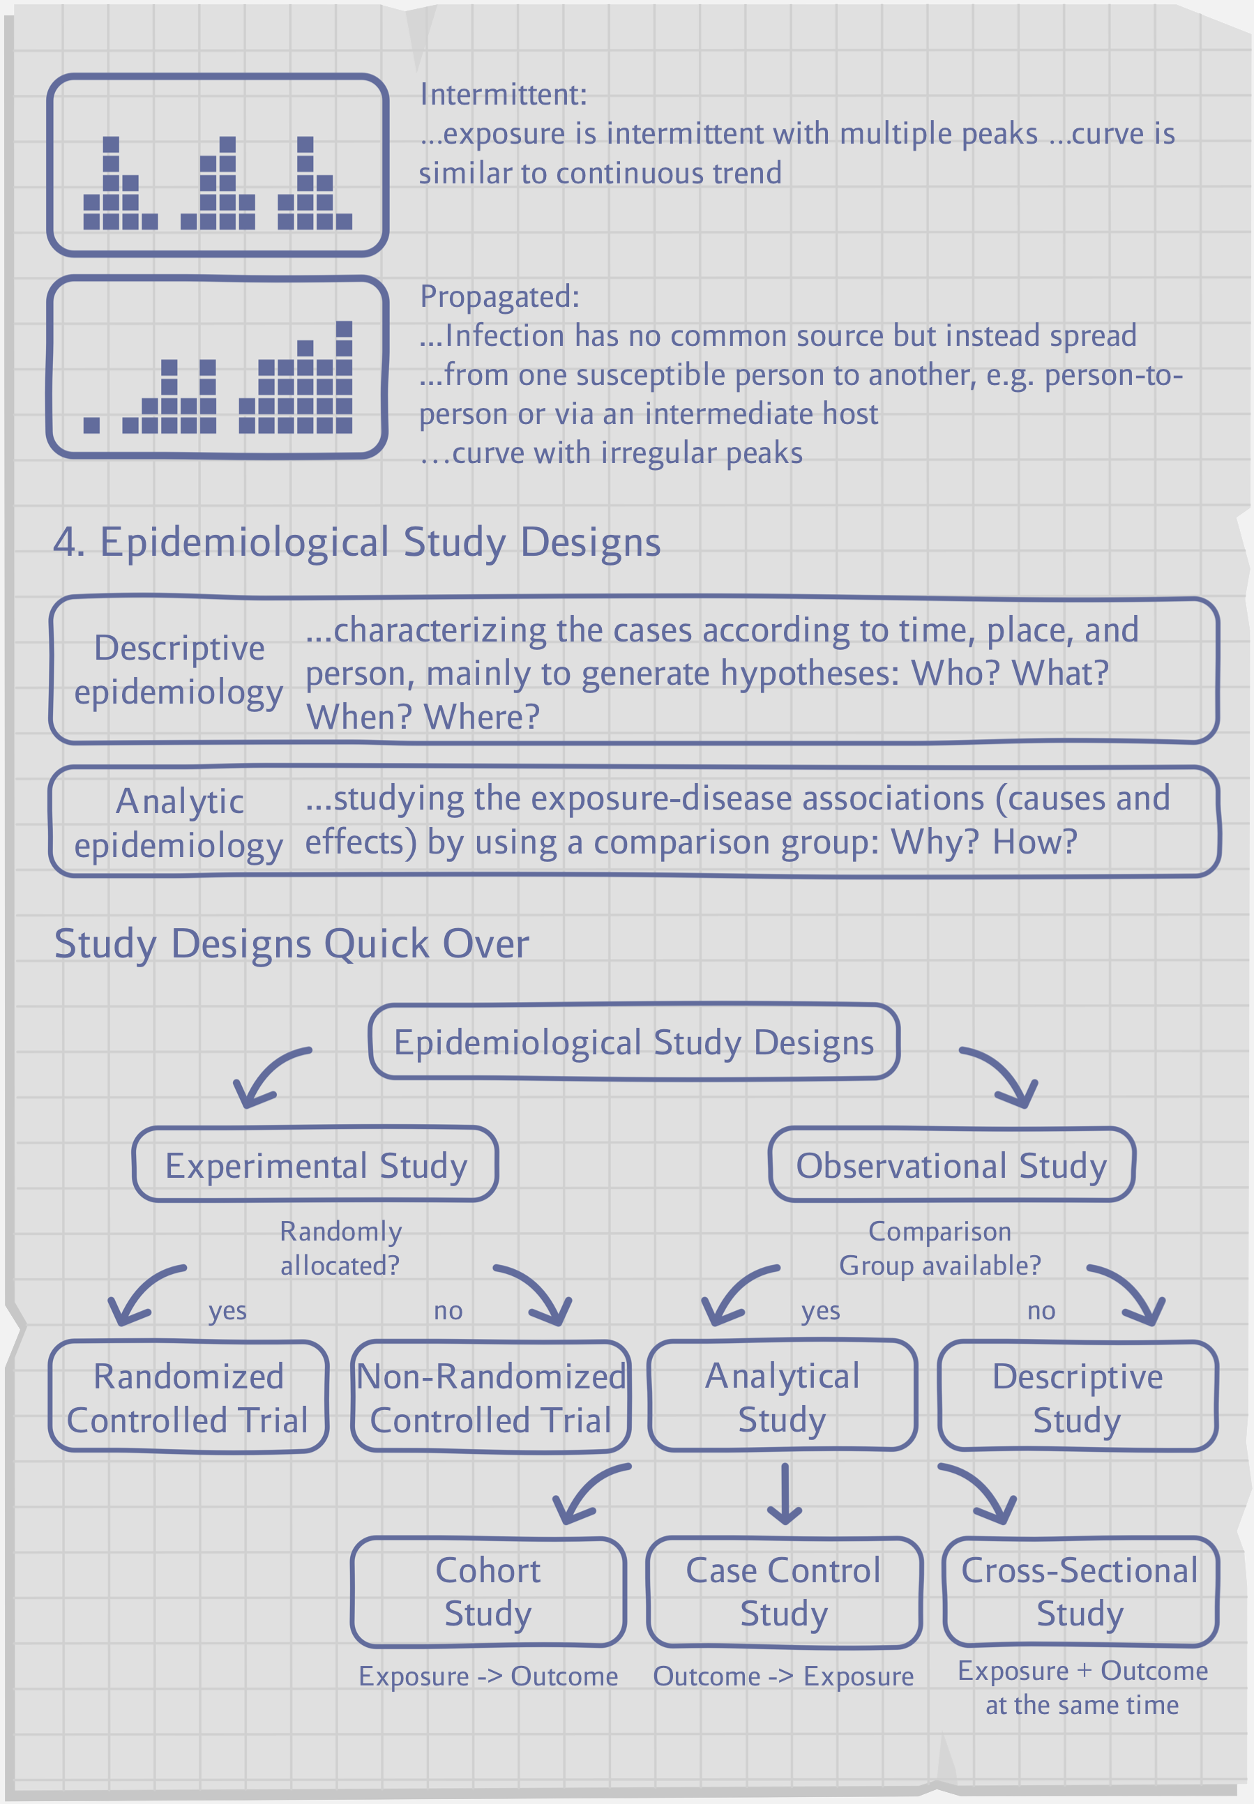
CHEAT SHEET
Epidemic Disease Detectives Hamburg

Slide 6
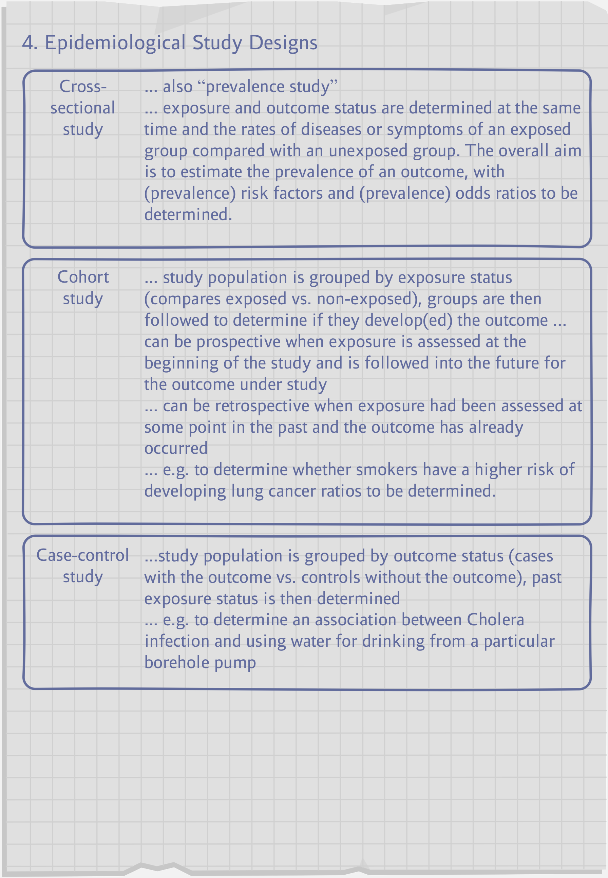
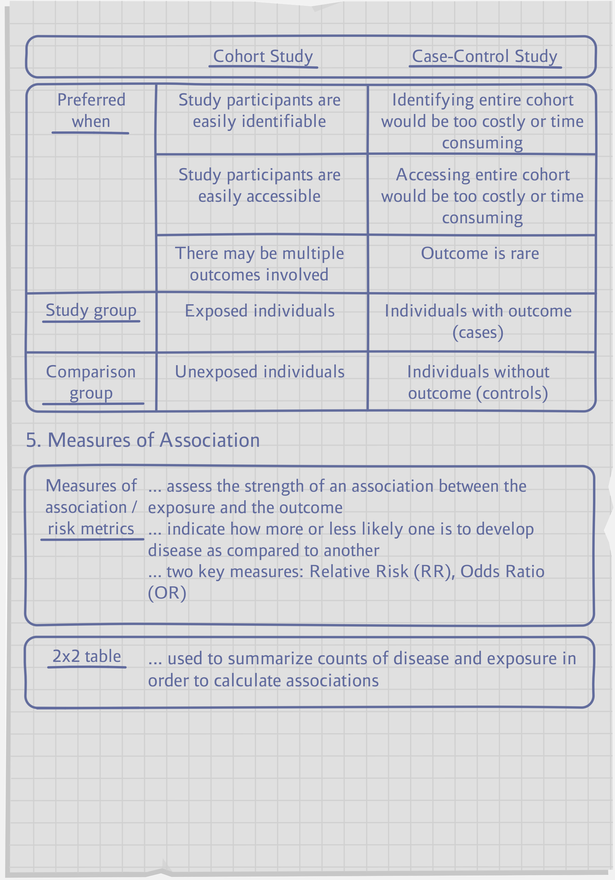
CHEAT SHEET
Epidemic Disease Detectives Hamburg

Slide 7
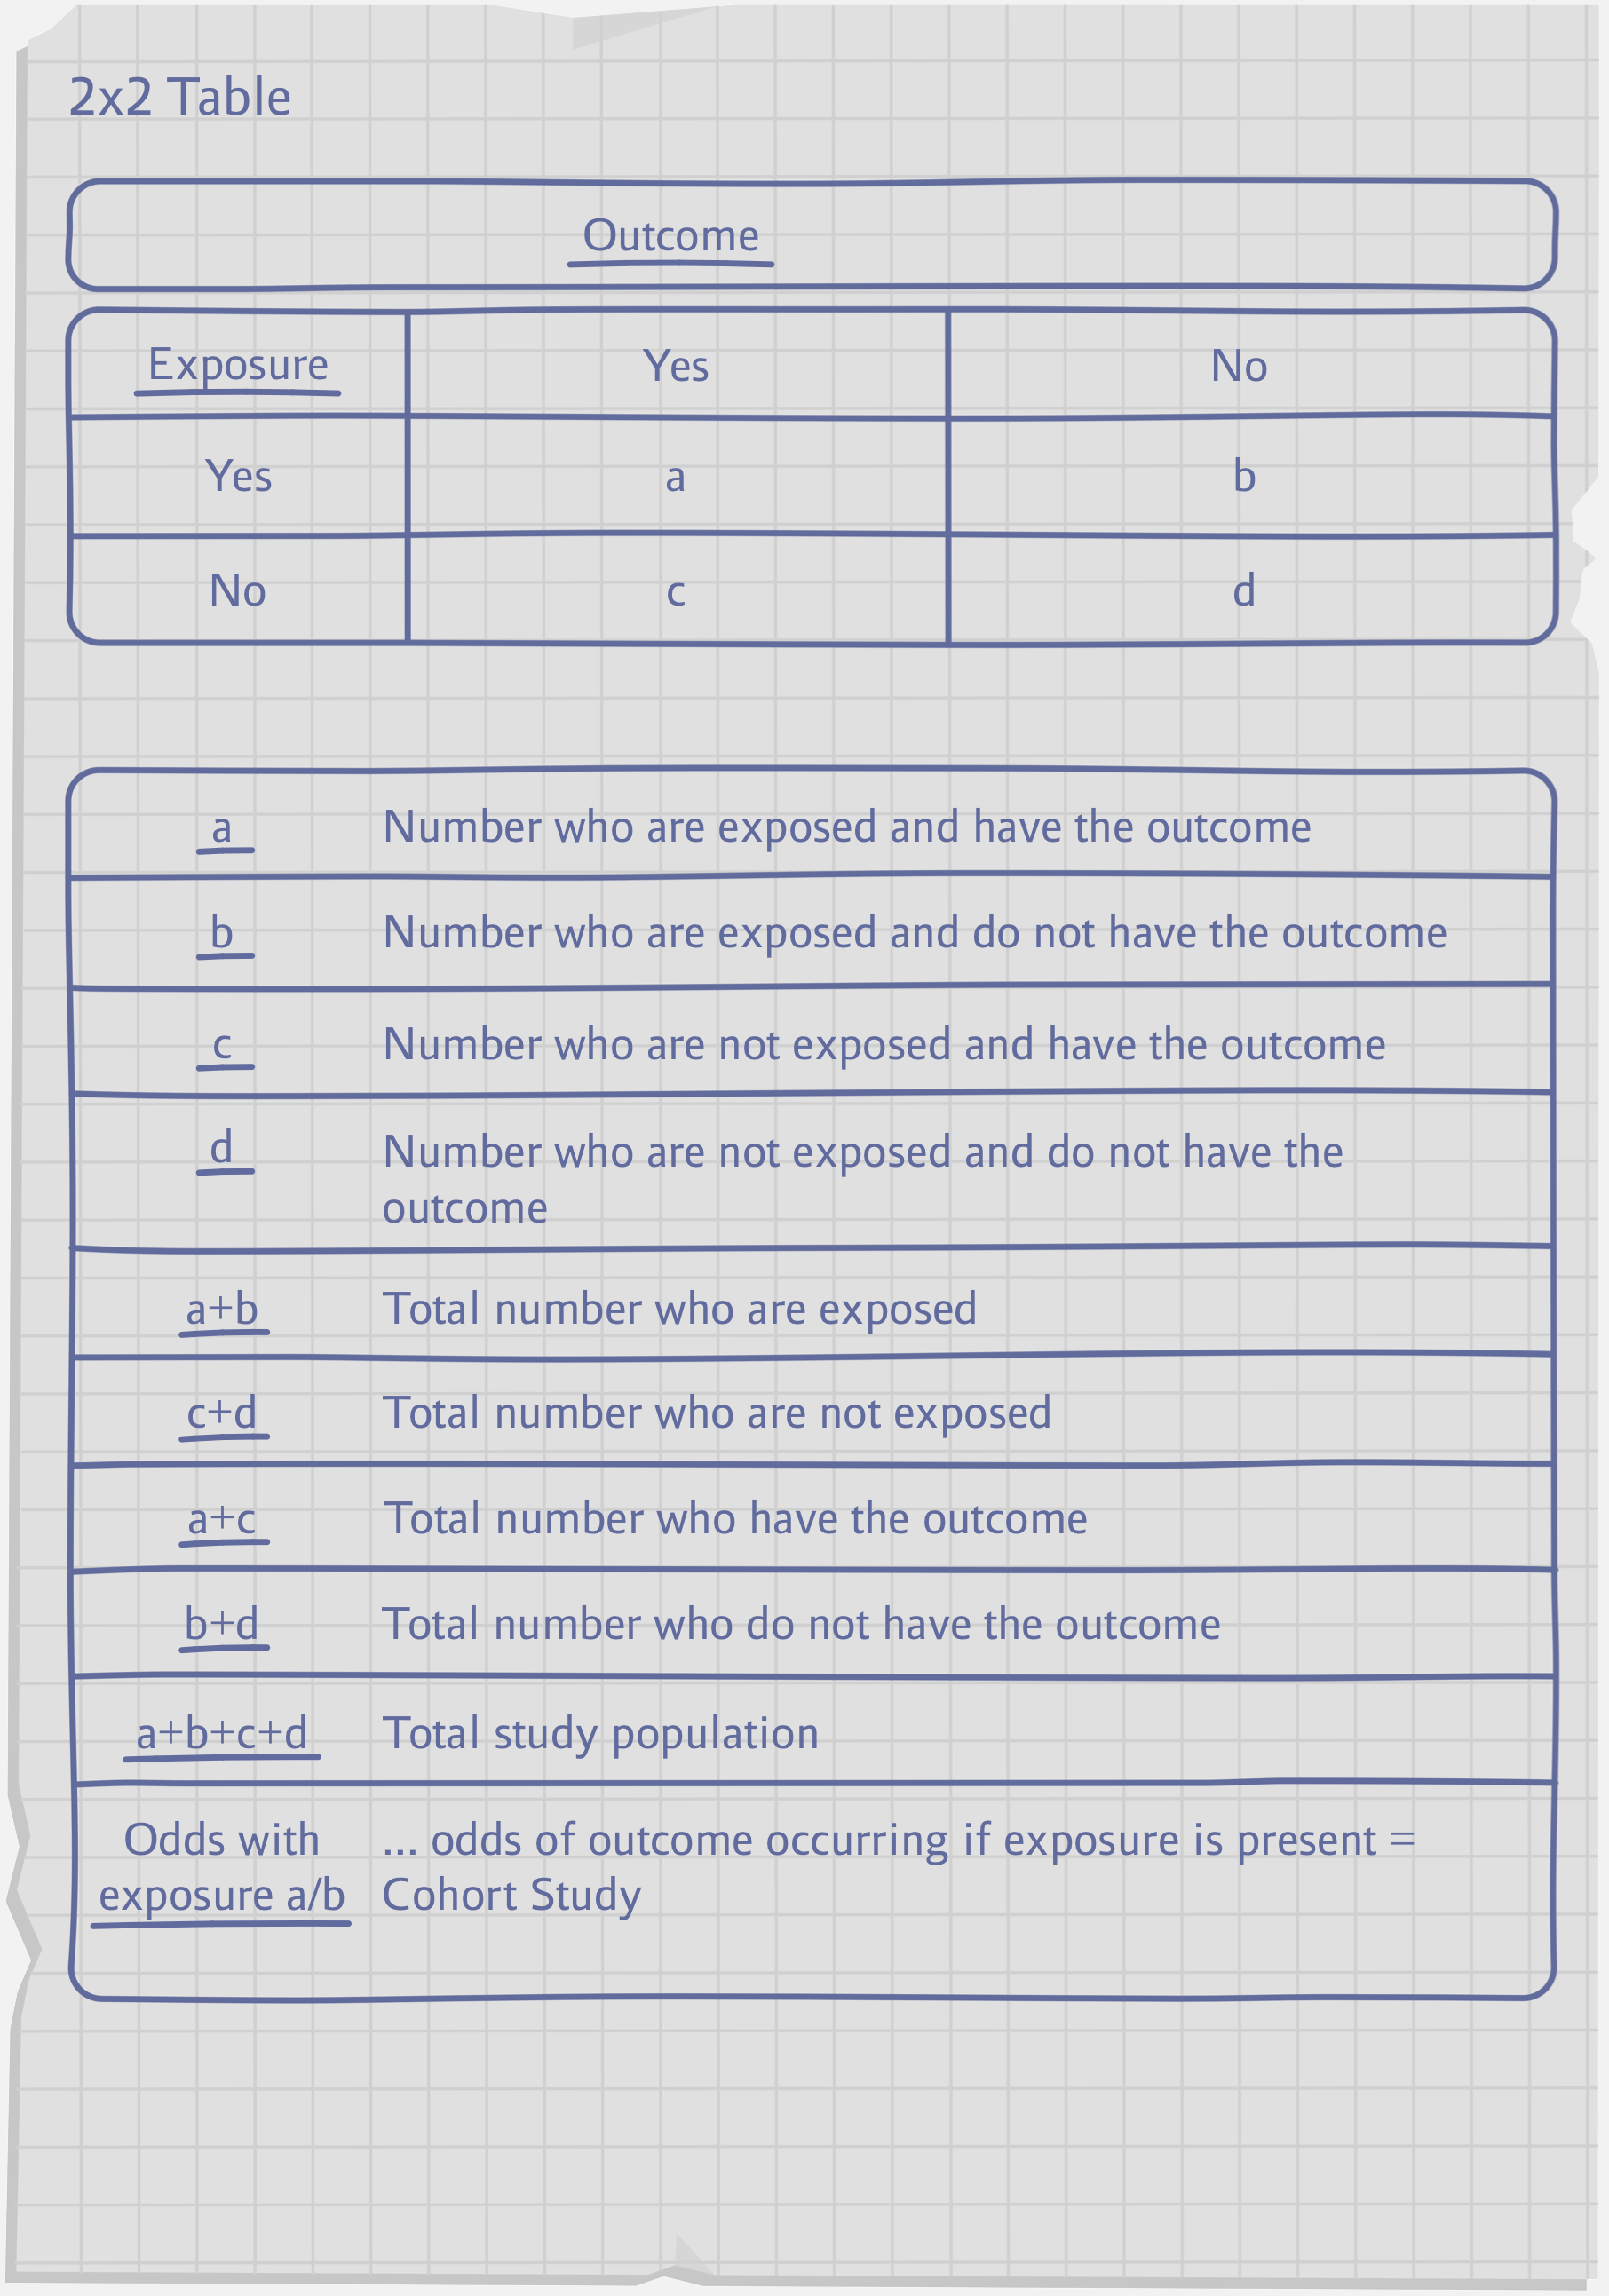
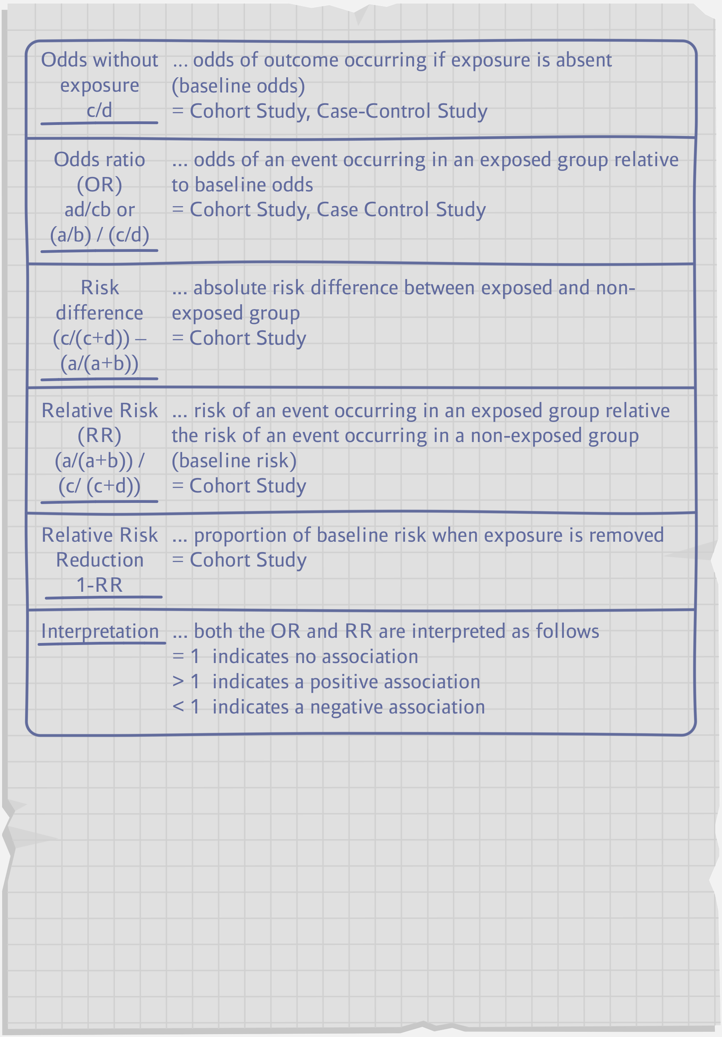
CHEAT SHEET
Epidemic Disease Detectives Hamburg

Slide 8
You don’t have any further questions?
Ready to move on?
If you would like to try out the EDDi Serious Game let me give you a few pointers along the way.
We will provide you with various tools and materials that help you investigate outbreaks.
This also works off-screen!
Return to the HOOU website to browse through the materials for self-learning or group work in class. These are prepared as print-outs along with a short instruction manual.
If you want to continue exploring the crash course materials
If so...
Let’s take a look at your workplace!
go back to desk.
E.D.D.i Academy
Epidemic Disease Detectives Hamburg

Slide 9
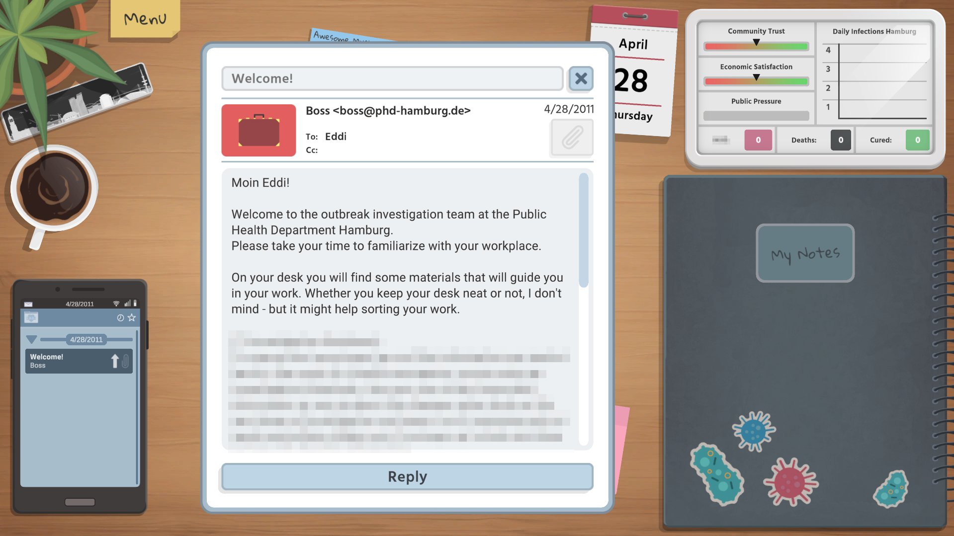
EDDi Serious Game – Your Workplace
Epidemic Disease Detectives Hamburg

Slide 10
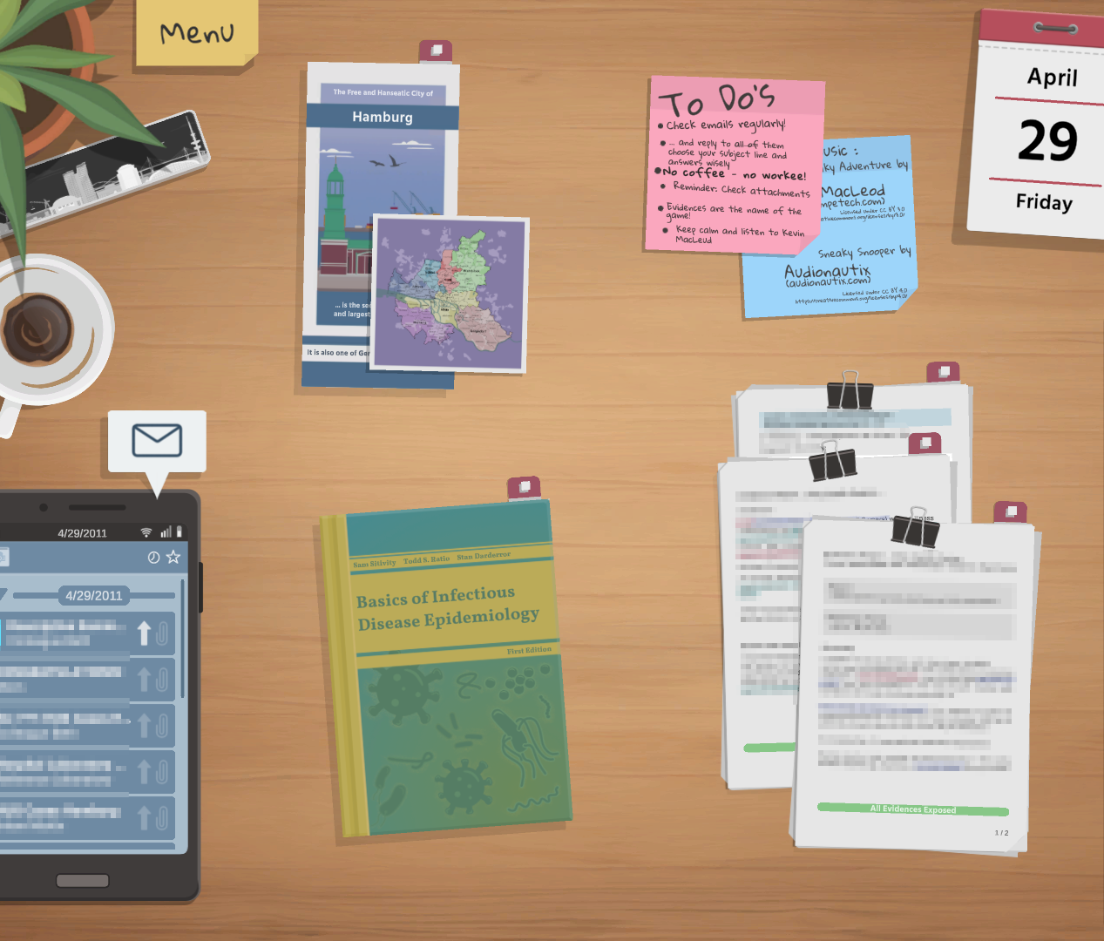
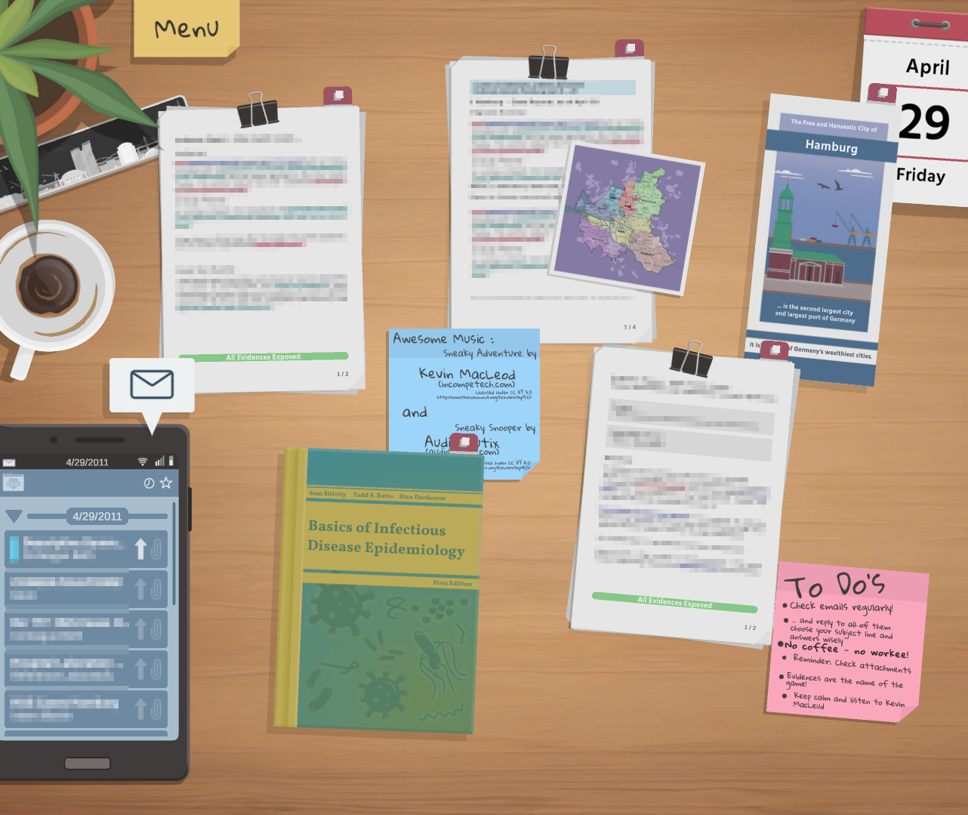
EDDi Serious Game – Your Workplace
The deeper you dive into the case, the more chaotic your workplace might get....
Hint: Organize your work now and again to keep on top of things.
Epidemic Disease Detectives Hamburg

Slide 11
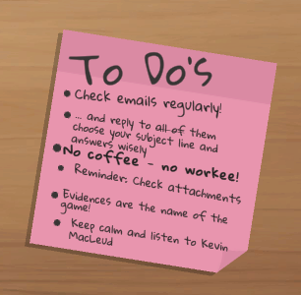
EDDi Serious Game – Your Tasks
To Do-List:
Keep track of your Emails and don't forget to respond to them. Firstly, choose the subject line wisely, secondly, complete your reply.
You won't be able to answer emails without… Coffee! As soon as your coffee is empty, call it a day!
Email Attachments: Any document enclosed? Don't forget to print it!
To solve the outbreak, you need Evidence. Find hints and clues in the textbook and email attachments and gather them in your notebook.
Epidemic Disease Detectives Hamburg

Slide 12
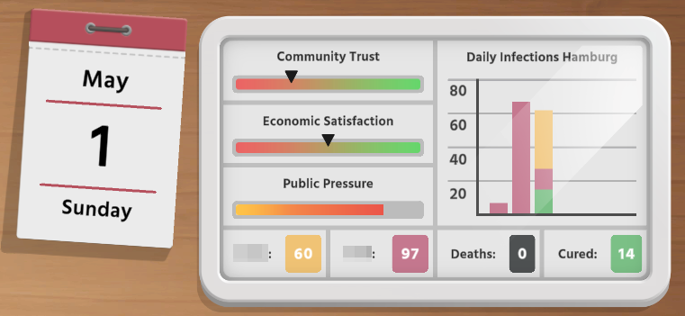

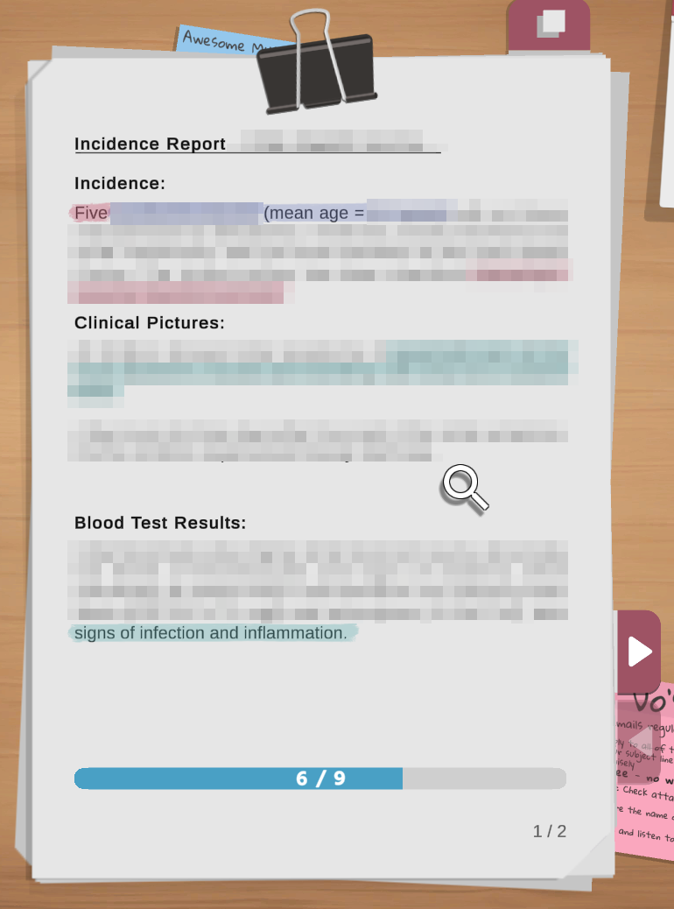
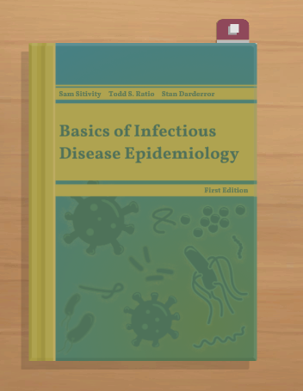
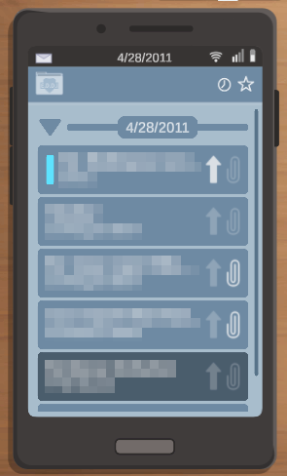
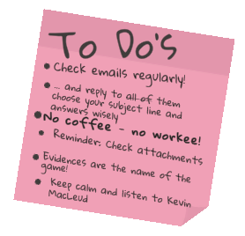

Your Tools and Materials
Outbreak Statistics
Your Coffee
To Do List
Email Attachments
Textbook
Your Evidence!
Your Investigation Notebook!
Your Emails!
Epidemic Disease Detectives Hamburg

Slide 13
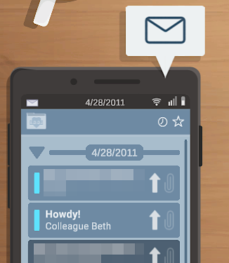






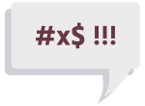

Check your Emails regularly!
Enjoy the break
A new email is waiting for you!
Email(s) waiting to be answered…
Attachment(s) waiting to be printed…
Bad news might be waiting for you…
Epidemic Disease Detectives Hamburg

Slide 14
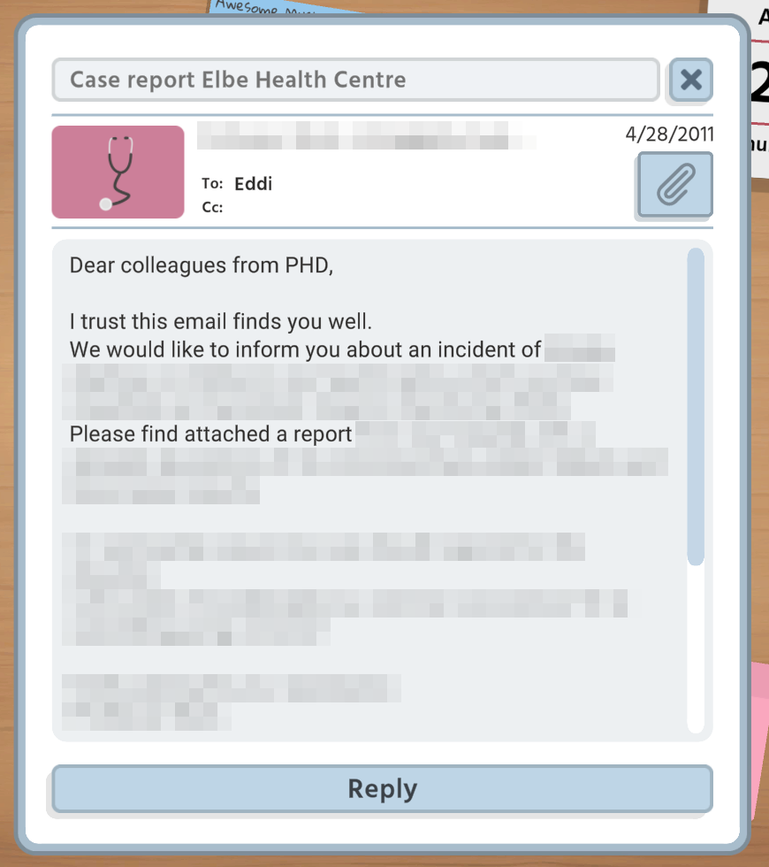
Incoming Email
Subject line
Close
email
Sender of email
Attachment
Some emails contain attachments. Don't forget to print them by clicking the button!
This is You!
Reply to email
Epidemic Disease Detectives Hamburg

Slide 15
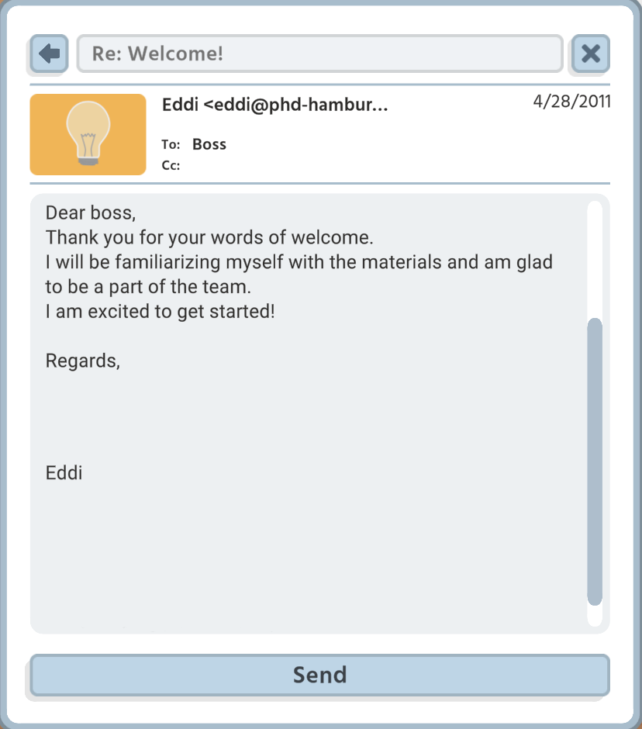
Outgoing Email
Close
email
Go back to email
Subject line
This is
You!
Email recipient
Email with single subject line and no evidence required
Send your answer
Epidemic Disease Detectives Hamburg

Slide 16
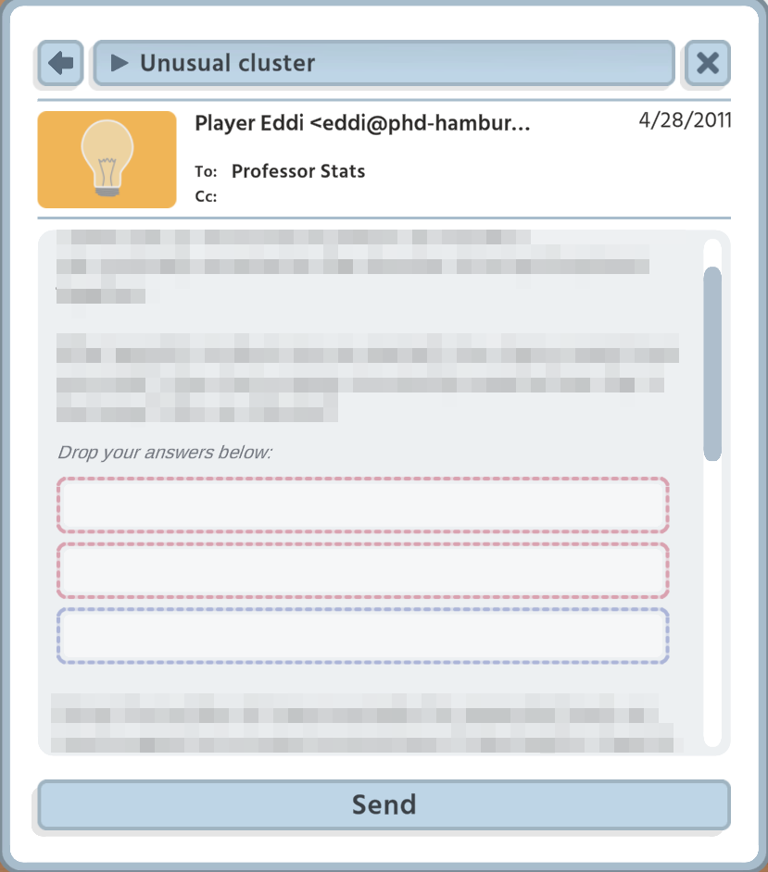
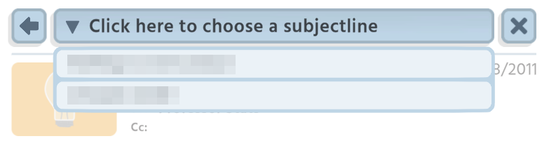
Outgoing Email
Subject lines
For some emails, you will have two subject lines to choose from. Always check thoroughly for the best option before answering an email!
Answer box
Some emails require Evidences to be answered. Drag the matching evidence
from your notebook into
the answer box! The number of boxes indicate the required entries; click on the trash bin to clear the box.
Email with multiple subject lines and evidence required to answer the mail
Send your answer
Epidemic Disease Detectives Hamburg

Slide 17
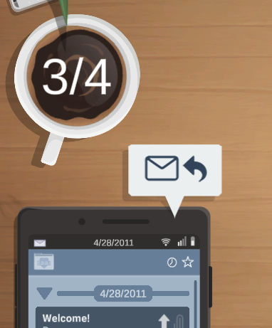
No Coffee – No Workee!
Coffee fuels your Email System!
Every day you start with freshly brewed coffee and a count of four big sips.
Every email you send takes a sip of coffee....
Epidemic Disease Detectives Hamburg

Slide 18
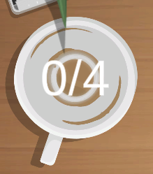
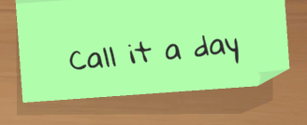
No Coffee – No Workee!
Coffee fuels your Email System!
You won't be able to answer emails without coffee…
As soon as your coffee is empty, call it a day!
Click on the post-it and wait for the day to change
Epidemic Disease Detectives Hamburg

Slide 19

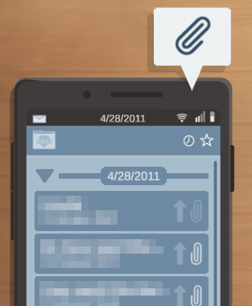
Print Attachments!
Click the Paper Clip!
Some emails contain attachments and many of them provide important information for the outbreak investigation. Evidences!
To find them, carefully study the text (magnifying glass). To uncover evidences, rest the magnifying glass on the text and wait until they fade into colour. But be careful - sometimes they are well hidden or not quite as useful as expected!
Email with attachment
Epidemic Disease Detectives Hamburg

Slide 20
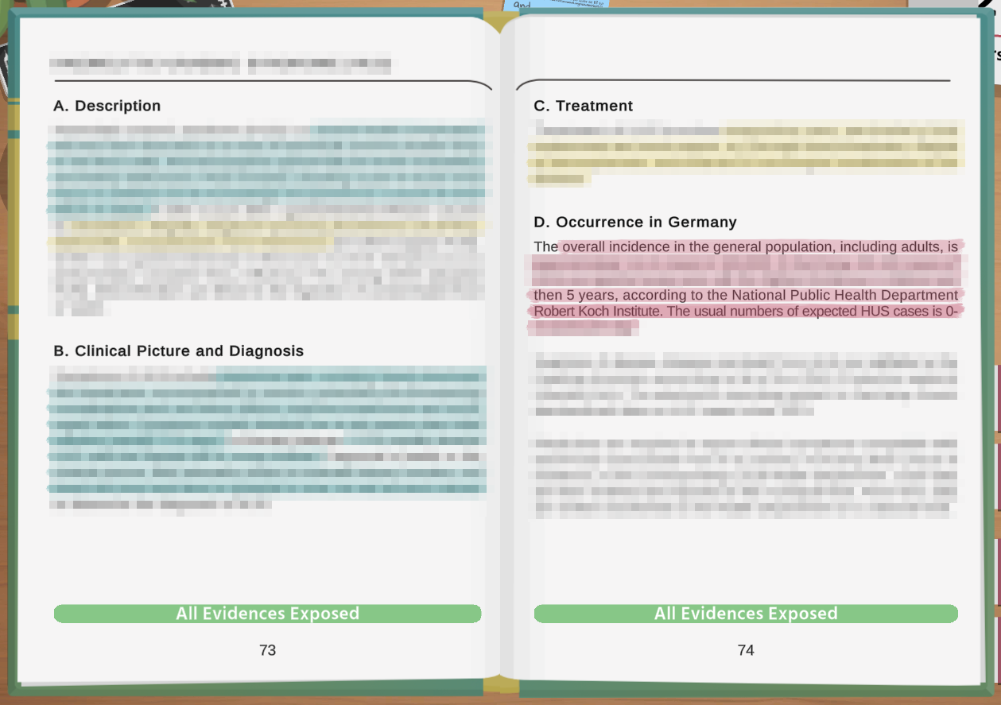
Textbook
Background Knowledge!
The textbook contains important information on diseases and basic epidemiological knowledge. Read through the textbook to make sure you don't miss any evidences to solve the outbreak!
To find them, carefully study the texts (magnifying glass). To uncover evidences, rest the magnifying glass on the text and wait until they fade into colour. But be careful - sometimes they are well hidden or not quite as useful as expected!
Epidemic Disease Detectives Hamburg

Slide 21
The To Do-List does not offer much interaction. But it reminds you of the most important tasks, step by step:
Keep track of your Emails and don't forget to respond to them. First choose the subject line wisely, then complete your reply.
You won't be able to answer emails without… Coffee! As soon as your coffee is empty, call it a day!
Email Attachments: Any document enclosed? Don't forget to print it out!
To solve the outbreak, you need Evidences. Find hints and clues in the textbook and email attachments and gather them in your notebook.
To Do – List
Epidemic Disease Detectives Hamburg

Slide 22
Outbreak Statistics
Every day the statistics change according to your activities. Right decisions can slow down the outbreak and may increase community’s trust. Incorrect answers can have a negative impact and cause numbers to rise. Every action counts!
Daily Case Numbers
Current Date
Total Cases, Fatalities and Recovered
Trust of the community in your actions
Economic response to your actions
Public response to your actions
Epidemic Disease Detectives Hamburg

Slide 23
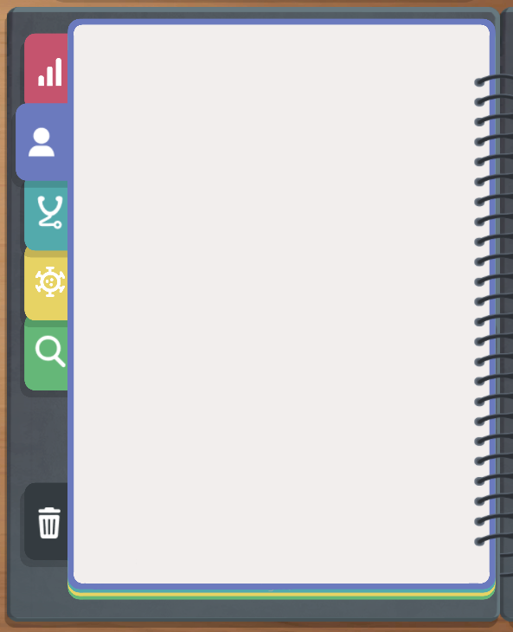
Your Investigation Notebook
Your notebook is designed to keep track of important information and to group them into Evidences. It is also your repository for answering questions (emails) throughout the game.
There are five main categories and useful sub-categories, as well as a trash folder. Transferring evidences to the notebook and categorizing them will happen automatically.
You can also prioritize very important evidence by changing their order, and move information into the trash folder. Sometimes, however, even removed evidence can still prove useful.
Outbreak Facts
Affected Population
Clinical Description
Epidemiology and Management
Investigation Plan
Trash Folder
Epidemic Disease Detectives Hamburg

Slide 24
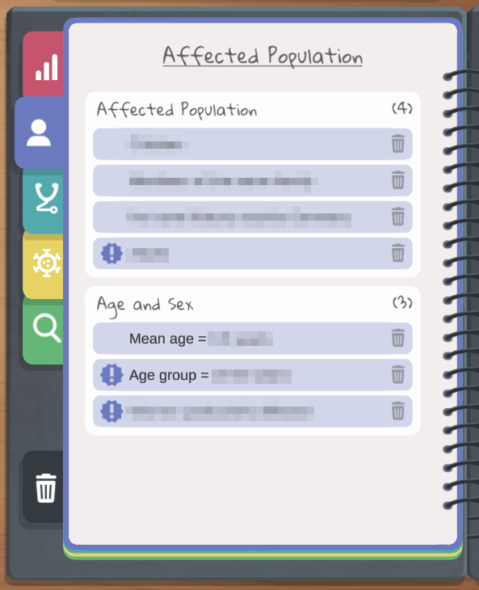
Your Investigation Notebook
Delete Evidence
Main
Categories
(Scrollable Notebook Pages)
Prioritize Evidence by moving to first position
Sub- Categories
Trash Folder (Evidence won’t be lost)
New Evidence
Epidemic Disease Detectives Hamburg

Slide 25

Collecting Evidence from Textbook Pages
Find Evidence!
Transfer and classification
Epidemic Disease Detectives Hamburg

Slide 26
Collecting Evidence from Attachments
Find Evidence!
Transfer and classification
Epidemic Disease Detectives Hamburg

Slide 27
E.D.D.i Art Work
“EDDi – Press Conference” (original size / modified size) (slide 1-3, 8, 26-27)
“EDDi – Emergency Meeting” (slide 3)
“EDDi – Button Attachment (Warning)” (slide 3)
“EDDi – Button Back (Normal)” (all slides)
“EDDi – Epidemiological Cheat Sheet” and “EDDi – Tapes” (slide 4-7)
by Annabell Koenen-Rindfrey licensed under CC BY 4.0
EDDi In-Game Artwork (Screenshots) (slide 9-25) - see Downloadables HOOU website
by Annabell Koenen-Rindfrey and Moritz Heinemeier licensed under CC BY 4.0
This interactive slideshow was created in the context of the E.D.D.i project (Hamburg University of Applied Sciences in collaboration with the Bernhard Nocht Institute for Tropical Medicine), funded by the Hamburg Open Online University / Hamburg University of Applied Sciences. The slideshow contains links to external sources accessible on Youtube (“Global Health with Greg Martin”), which have not been created by the project team and are not provided under a Creative Commons License.
Epidemic Disease Detectives Hamburg

Slide 28
E.D.D.i Overview
Hamburg Open Online University
Hamburg University of Applied Sciences
Bernhard Nocht Institute for Tropical Medicine
Licenced under CC BY 4.0
Epidemic Disease Detectives Hamburg

Slide 29
Epidemic Disease
Detectives Hamburg
Epidemic
Disease
Detectives
Hamburg
Thank you for joining the Welcome Tutorial!
Return to the HOOU website to browse through the materials for self-learning or group work in class.
Thank You!
Epidemic Disease Detectives Hamburg

